Slide 1
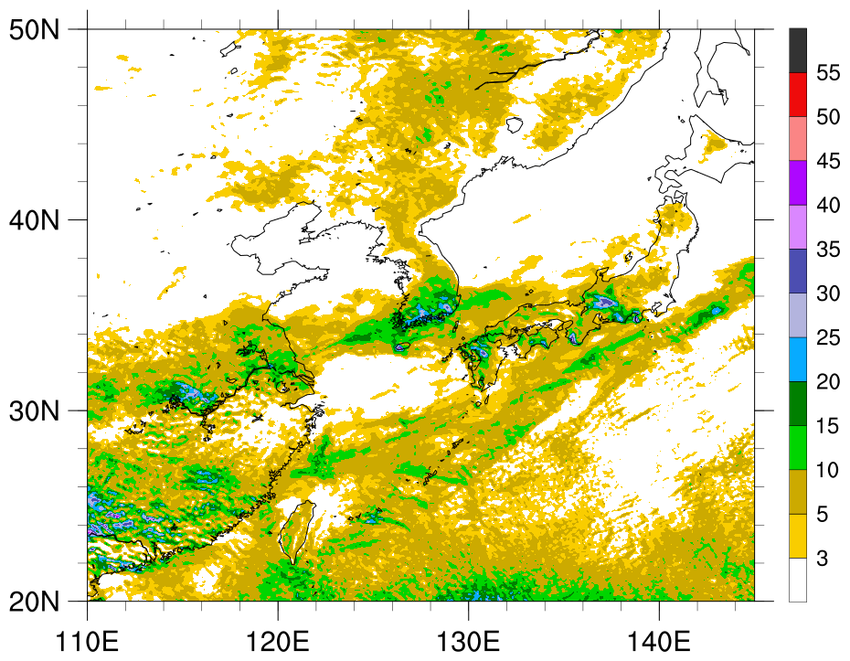
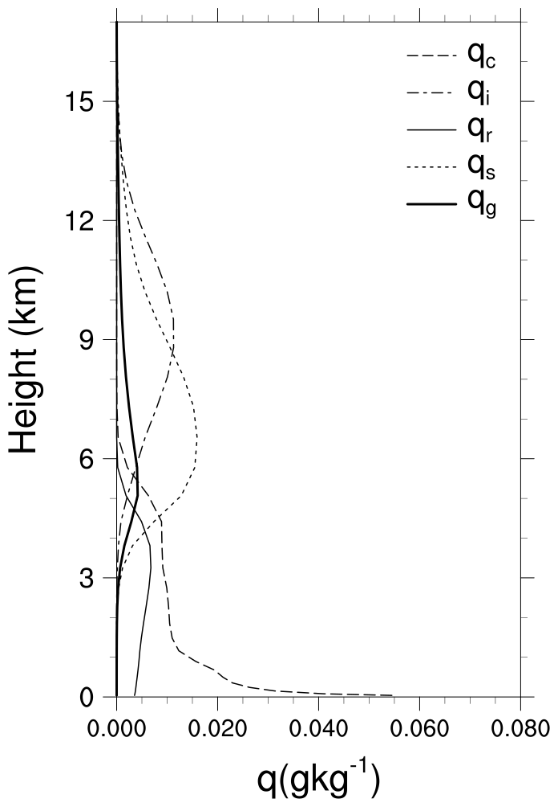
Correcting numeric parameters in microphysics scheme improved WRF performance
Scientific Achievement
In this study, we found an inherent numerical error in the ice microphysics processes of WDM6 and corrected by redriving theoretical formula.
We found that the correction has improved monsoon precipitation distribution over the East Asia in the WRF regional climate simulation.
Research summary
The major characteristics of ice microphysics in Weather Research and Forecasting (WRF) Double-Moment 6-class (WDM6) bulk-type cloud microphysics originate from the diagnosed ice number concentration, which is a function of the cloud-ice mixing ratio. In this study, we correct numerical errors in ice microphysics processes of the WDM6, in which the cloud-ice shape is assumed as single bullets and examine the impact on regional climate simulations. By rederiving the relationships between cloud microphysics characteristics, including the one linking the cloud-ice mixing ratio and number concentration, we remove numerical errors intrinsic to the description of cloud-ice characteristics in the original WDM6 microphysics scheme. The revised WDM6 is tested using a WRF framework for regional climate simulations over the East Asian region. We find that our correction to the WDM6 improves the model’s performance in capturing the observed distribution of the monsoon rain band.
Significance & Impact
The WDM6 is one of widely used microphysics schemes in Weather Research and Forecasting (WRF) Model, which predicts mixing ratio and number concentration for cloud droplets and rain. The WRF is also a most widely used numerical model in weather and climate. The revised WDM6 code will be implemented to WRF, thus the result of this study could be applicable to any research that uses WRF and WDM6 in the future.
Kim, K.-B., K.-S. Lim, and Jiwoo Lee, 2022: Numerical errors in ice microphysics parameterizations and their effects on simulated precipitation convection. Asia-Pacific Journal of Atmospheric Sciences, doi: 10.1007/s13143-022-00288-z

