Slide 1
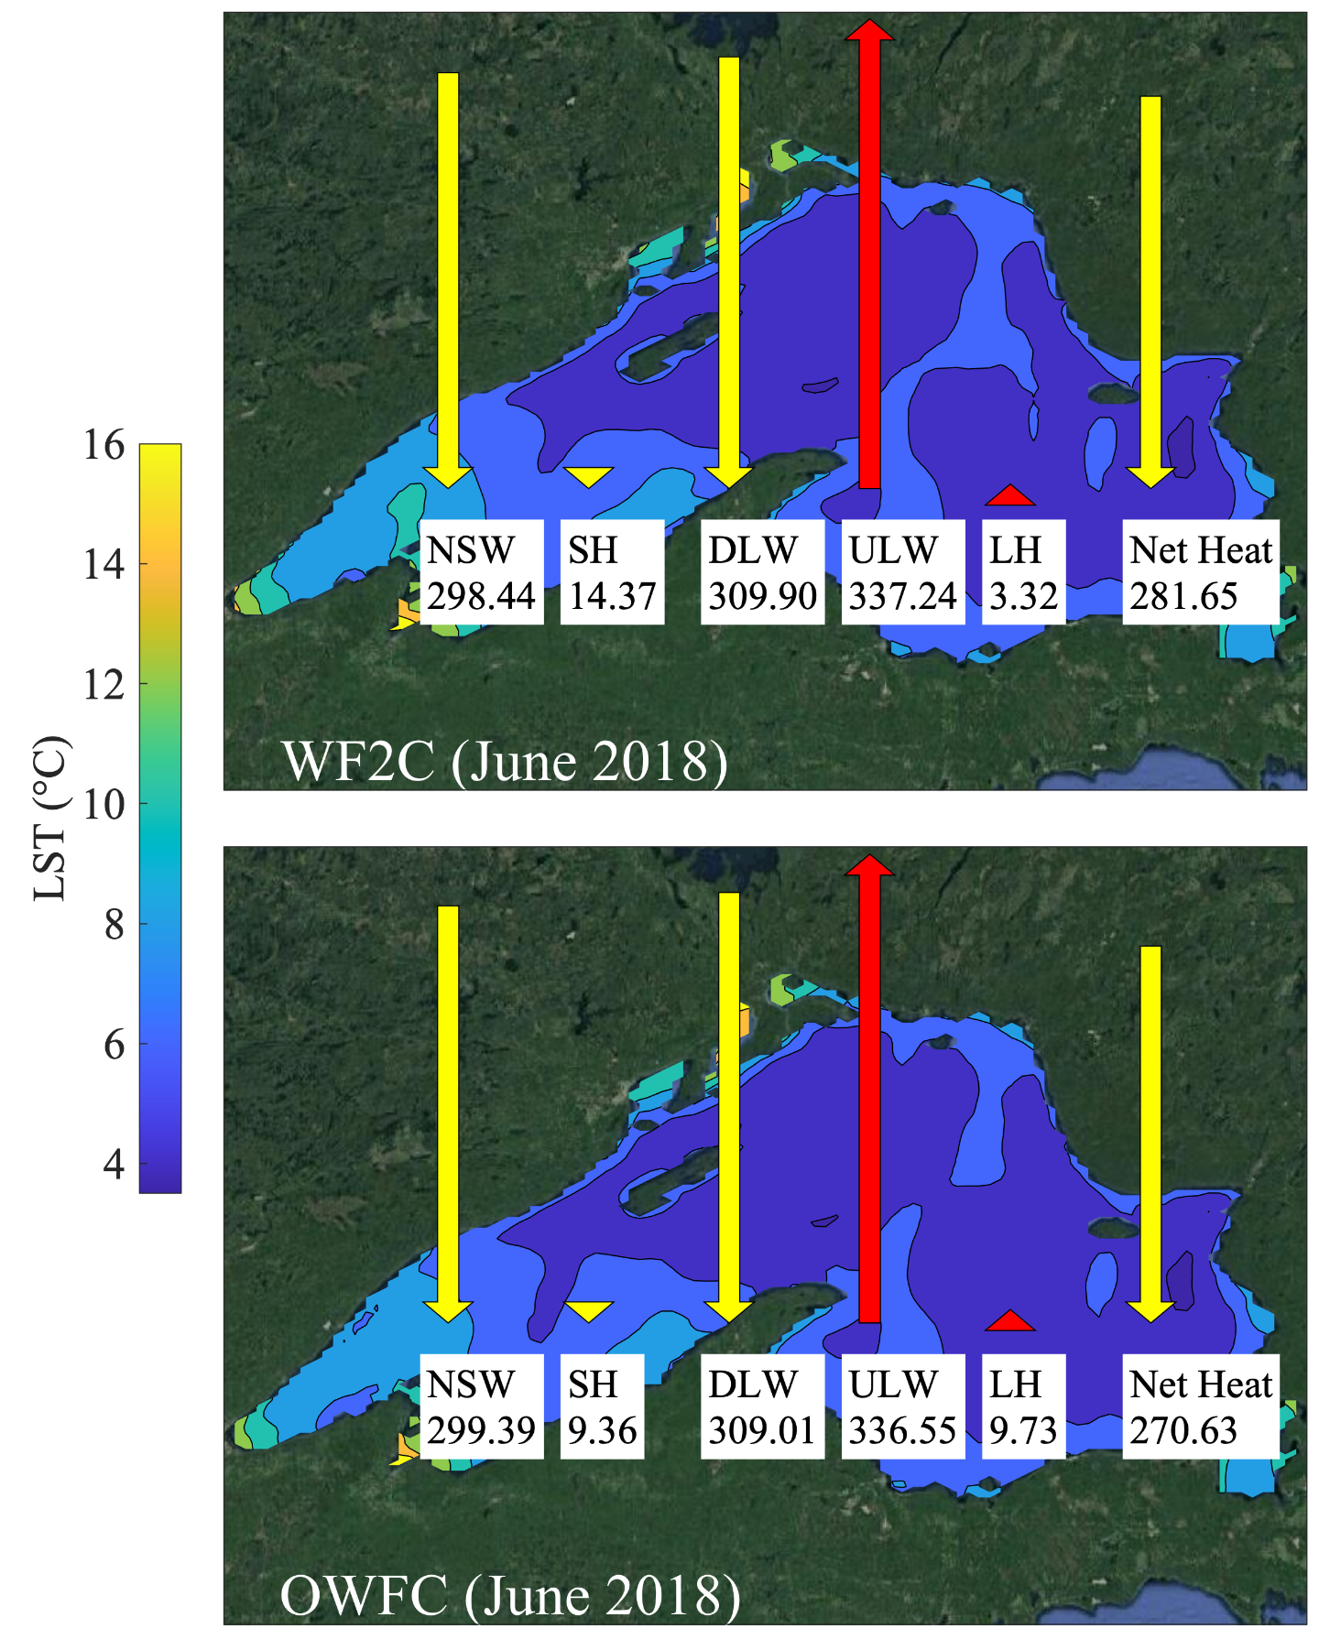
Insights from Simulating Summer Warming of the Great Lakes
Scientific Challenge
Regional climate models typically represent the Great Lakes through coupled one-dimensional lake models, leading to unresolved hydrodynamics and biases in lake surface temperature (LST) that affect the accuracy of climate simulations.
The scarcity of coupled three-dimensional lake models has led to a knowledge gap in understanding the mechanistic impact of the lake-atmosphere interactive processes on Great Lakes simulations.
Approach and Findings
Researchers developed and validated a fully two-way coupled modeling system, called WF2C, using the Weather Research and Forecasting model and a three-dimensional hydrodynamic and ice model based on the Finite Volume Community Ocean Model.
WF2C improved upon past one-dimensional lake model-based studies by significantly reducing the simulated LST bias.
Comparisons of WF2C and an observation-driven modeling system, called OWFC, showed that coupled lake-atmosphere dynamics can elevate summer LST by modifying the surface heat fluxes entering or leaving the lake by influencing meteorological state variables.
Figure
Significance and Impact
This study provides insights into the coupled modeling system behavior which is critical for developing predictive understanding of the Great Lakes climate system.
This work sets a foundation for future studies exploring WF2C's potential to produce reliable climate projections and accurately simulate the lake–atmosphere dynamics of the Great Lakes under future climate conditions.
For the June 2018 simulation period, lake-atmosphere coupling notably increases the incoming sensible heat flux and decreases the outgoing latent heat flux, which in turn increases the net heat flux and ultimately LST.
Kayastha, M. B., Huang, C., Wang, J., Pringle, W. J., Chakraborty, T. C., Yang, Z., et al. “Insights on simulating summer warming of the Great Lakes: Understanding the behavior of a newly developed coupled lake-atmosphere modeling system.” Journal of Advances in Modeling Earth Systems, 15, e2023MS003620 (2023). [DOI: 10.1029/2023MS003620]
Department of Energy • Office of Science • Biological and Environmental Research
Notes:
Word highlight text here.

