Slide 1
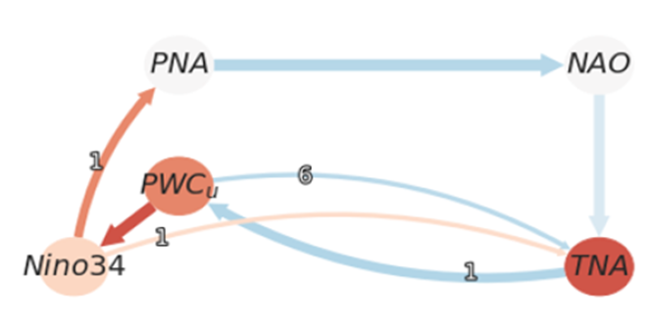
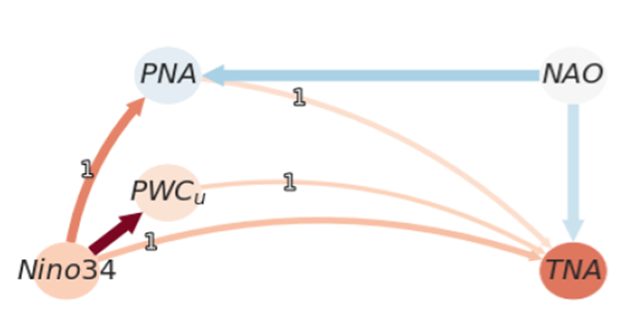
Machine learning causal discovery provides new insights into Pacific-Atlantic interactions
Karmouche, S., E. Galytska, G.A. Meehl, J. Runge, K. Weigel, and V. Eyring, 2024: Changing effects of external forcing on Atlantic-Pacific interactions, Earth System Dynamics, 15, 689–715, https://doi.org/10.5194/esd-15-689-2024.​ (DOE RGMA authors in bold face)
OBJECTIVE
Causal discovery is applied to observational, CMIP6, and pacemaker data to better understand the processes and mechanisms that connect the Pacific and Atlantic Ocean basins on decadal timescales. The role of external forcing on these interactions is not clear from previous studies. Here we apply a novel causal discovery regime-oriented algorithm to provide new insights into these interactions.
APPROACH
Machine learning AI involving PCMCI+ regime-oriented causal discovery shows that CMIP6 models exhibit varying skill in simulating the observed causal fingerprints governing the interactions between the modes of decadal climate variability over the Pacific and Atlantic basins. The models better simulate the connections when SSTs have opposite sign between the tropical Atlantic and tropical Pacific.
IMPACT
External forcing most likely contributed to strengthening of the Walker Circulation with easterly surface wind anomalies over the tropical Pacific, thus favoring La Niña-like negative Interdecadal Pacific Oscillation pattern in the Pacific during the most recent decades. This is the first time these effects of external forcing have been demonstrated, and the results have implications for what is needed for skillful Earth system predictions in the Pacific and Atlantic regions.
Causality diagrams, top: Tropical North Atlantic(TNA) causes opposite-sign response (blue arrow) in the Pacific Walker Circulation and Pacific SSTs (PWC, Nino3.4) when external forcing is included; bottom: Removing external forcing reverses the connection and produces the same sign SST response from Pacific to Atlantic (orange arrows)

