Slide 1
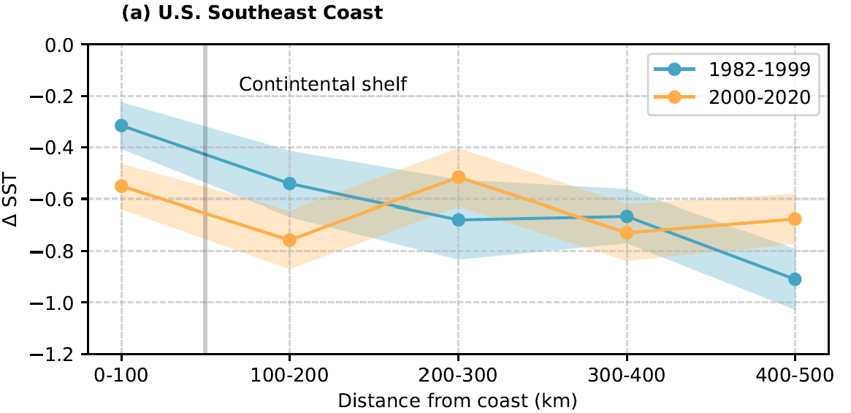
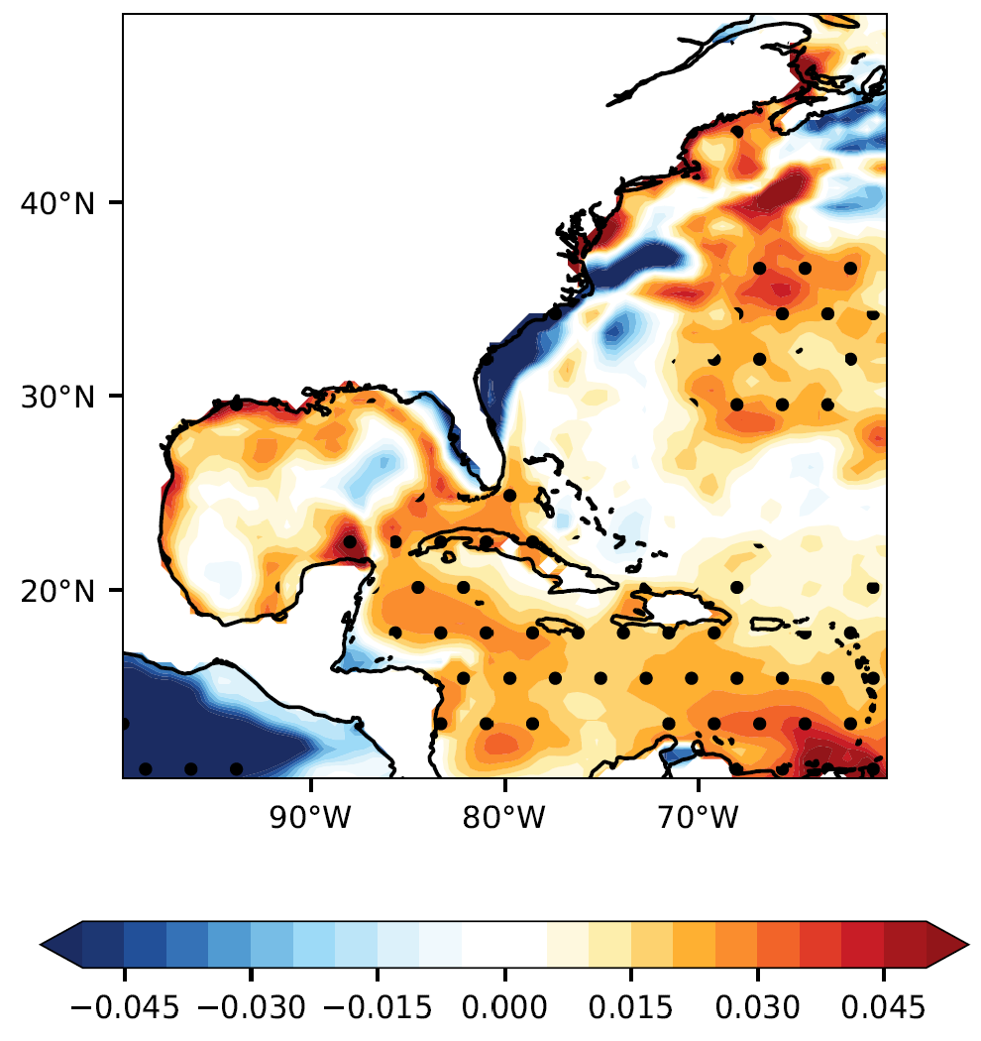
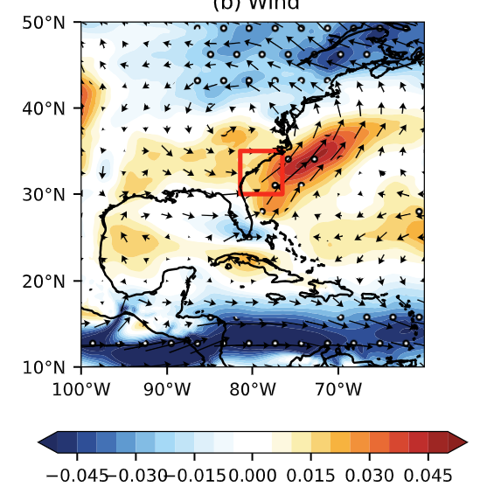
Stronger sea surface cooling produced by hurricanes along the U.S. Southeast Coast
Objective
To investigate and understand the mechanisms for the upper-ocean temperature response to hurricanes along the nearshore regions of the U.S. Southeast and Gulf Coasts.
Approach
Analyze changes in the magnitude of sea surface cooling induced by hurricanes using satellite observations.
Examine the ambient storm environment using atmosphere and ocean reanalysis data to understand its role in the observed changes in cold wakes.
Use CMIP6 climate models to understand the relative contributions of natural and anthropogenic forcings driving these changes.
Impact
Significant increase in the magnitude of cold wakes along the U.S. Southeast Coast is found, but changes near the Gulf Coast are mostly insignificant.
Further analysis suggests that long-term cooling of the sub-surface ocean plays a key role in the observed increase in cold wake magnitude.
Enhanced alongshore winds near the U.S. Southeast Coast in recent decades is likely responsible for changes in the subsurface ocean by increasing the upwelling of cold, deeper waters.
CMIP6 climate models suggest that anthropogenic greenhouse gases (GHGs) are likely driving the changes in atmospheric circulation, and consequently, the upper-ocean thermal structure near the U.S. Southeast Coast.
A
B
C
A) Observed changes in the cold wakes with respect to distance from coast within 500km of the U.S. Southeast coast during 1982—1999 and 2000–2020. The trends in (B) temperature averaged from surface to 100m depth and (C) 850 hPa wind circulation in the northwestern Atlantic Ocean. Trends are computed over the period of 1982-2014. All variables are averaged during June-October.
John, E. B., K. Balaguru, L. R. Leung, S. M. Hagos and R. D. Hetland. Observed increase in Tropical-Cyclone induced Sea surface cooling near the U.S. Southeast Coast. Geophysical Research Letters. 51, e2024GL110087 (2024). https://doi.org/10.1029/2024GL110087.

