Slide 1
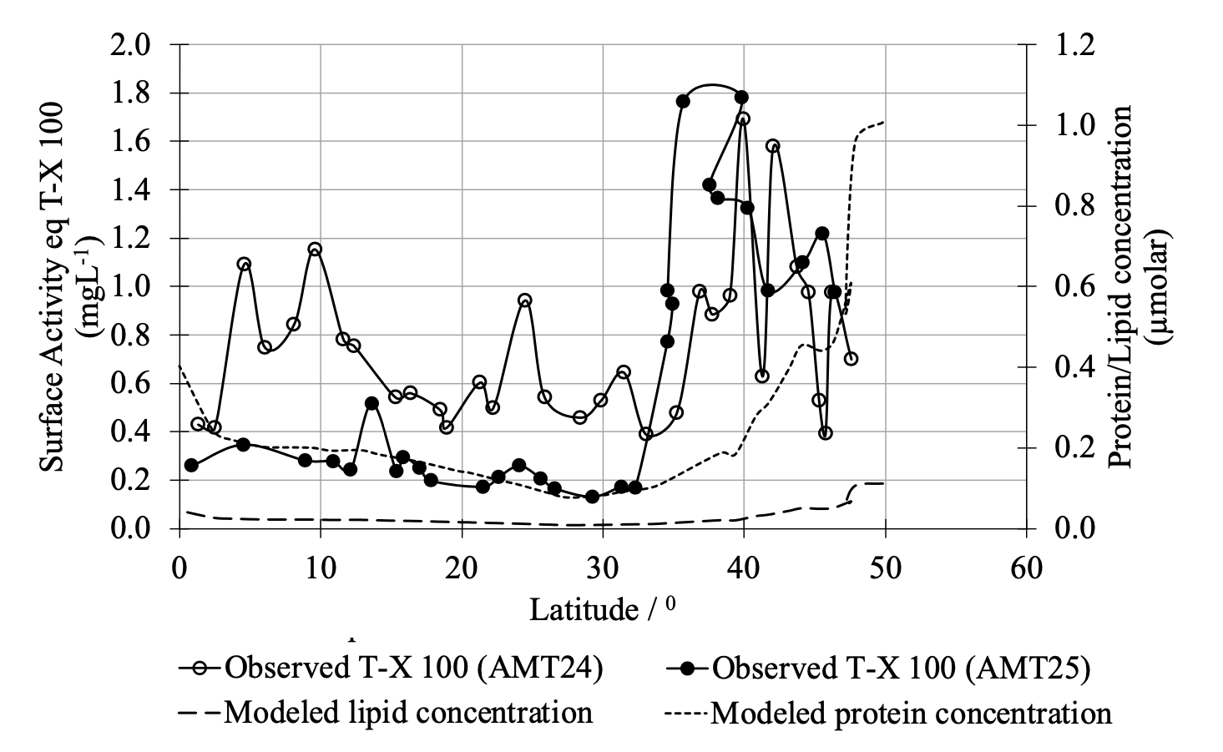
The Role of Phytoplankton Biomacromolecules in Controlling Ocean Surface Roughness
Objective
Oceanic altimetry data is known to carry contamination due to high return signals; the phenomenon is termed Sigma-0 bloom. We provide a biogeochemical-based explanation for the origins of the Sigma-0 bloom(σ₀) phenomenon.
Approach
Develop a reduced model for calculating capillary wave height which includes a set of biogeochemical equations.
Determine the capillary wave height based on the planktonic carbon concentration and the regional wind speed value.
Explore the connection between the return signal and the reflectivity of the surface.
Impact
Biological surfactants reduce the roughness of the surface by diminishing capillary wave heights.
The biological activity (phytoplankton bloom events) is necessary to consider when interpreting signals from radar altimetry and when developing ocean hydrology models.
Comparison of observed North Atlantic surface activity measured as T-X-100 concentration and estimated surface activity (surface adsorption concentration) as determined by modeled protein
and lipid concentrations. Regions with high surface activity have higher biomacromolecular (protein and lipids) concentrations.
Jayasinghe, A., S.M. Elliott, G. A. Gibson, and D. Vandemark. The Role of Phytoplankton Biomacromolecules in Controlling Ocean Surface Roughness. Atmosphere 13, no. 12 (2022): 2101.

