Slide 1
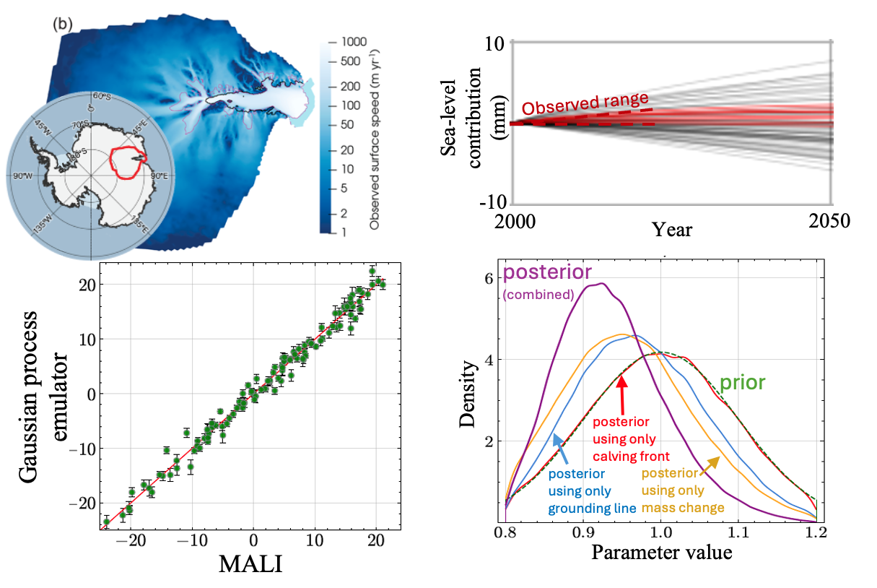
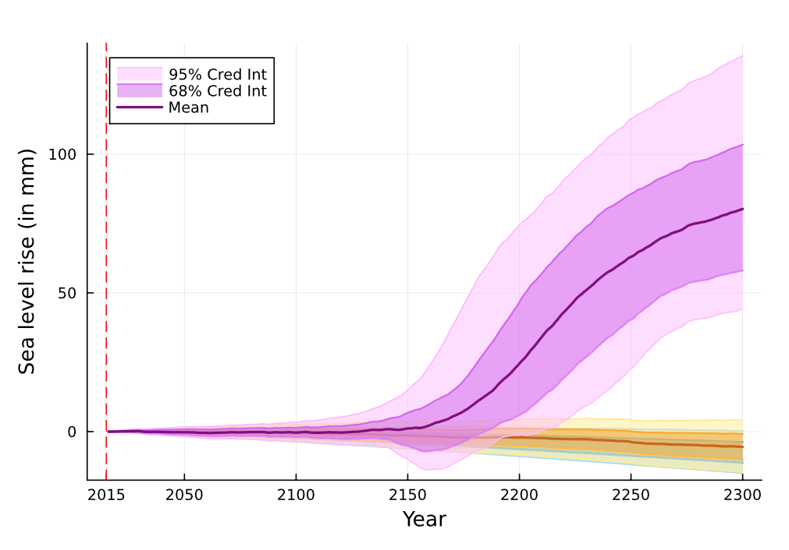
Probabilistic projections of sea-level contribution from an Antarctic Ice Sheet sector
Objective
The Amery Ice Shelf sector of Antarctica is believed to be resilient to climate change, but recent climate model projections indicate the potential for >100x increase in melt rates by 2200
Use uncertainty quantification methods to produce probabilistic projections of the sea-level contribution from this region constrained by historical observations
Approach
Run perturbed-parameter ensembles of E3SM’s ice-sheet component, MALI, augmented by statistical emulation, under low and high greenhouse gas emissions scenarios through 2300
Perform Bayesian calibration (Fig. 1-4) using historical observations of glacier change to produce probabilistic projections of the future sea-level contribution from this region (Fig. 5)
Findings & Impact
Under low greenhouse gas emissions the sea-level contribution is negligible, but under the high emissions scenario is 46 to 133 mm at 2300 (Fig. 5), up to 5 times larger than previous estimates
The emulation and uncertainty quantification workflow developed here can be applied to the entire Antarctic Ice Sheet
Ice-sheet modeling and uncertainty quantification workflow
1. Optimized initial condition for MALI
2. MALI perturbed parameter ensemble
200 simulations
3. MALI
emulation
4. Bayesian calibration
(Applied to 6 parameters)
High
emissions
5. Probabilistic projections of sea-level contribution under different scenarios
Low
emissions
Control
Citation: S. Jantre, M.J. Hoffman, N.M. Urban, T. Hillebrand, M. Perego, S. Price, and J.D. Jakeman. 2024. “Probabilistic Projections of the Amery Ice Shelf Catchment, Antarctica, under Conditions of High Ice-Shelf Basal Melt.” The Cryosphere 18 (11): 5207–38. https://doi.org/10.5194/tc-18-5207-2024.
Department of Energy • Office of Science • Biological and Environmental Research

