Slide 1
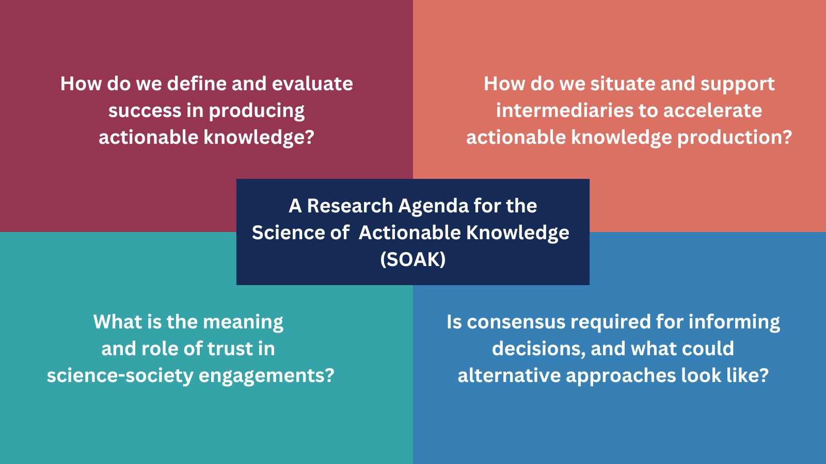
A research agenda for the Science Of Actionable Knowledge (SOAK)
Background & Objectives
SOAK is an emerging scientific field that examines how science becomes used to inform decisions that enhance social and environmental well-being
SOAK builds on many prior fields related to science-society interactions, such as science-policy interface (SPI), transdisciplinarity, translational science, co-production, etc.
This research systematically reviews SPI literature to identify ‘claims’ or key assertions about science-society interactions and shape a future research agenda for SOAK
Approach
26 claims about science-society interactions were identified from the SPI literature
These claims were further examined and deliberated through expert elicitation
From this, a research agenda for SOAK was constructed, prioritizing areas that experts identified as critical gaps in understanding of the science-society interface
Significance & Impact
This work combines an extensive literature review, expert assessments and deliberations, to identify the differences, tensions, & ambiguities that exist when considering how science can inform societal actions
The resultant research agenda questions (See Fig) can direct actionable science researchers towards specific gaps and areas that warrant further research
Four key questions that were identified as most warranting further SOAK research. Specific sub-questions under each of the four topical areas are detailed in the manuscript.
Jagannathan, K., Emmanuel, G., Arnott, J., Mach, K. J., Bamzai-Dodson, A., Goodrich, K., ... & Klenk, N. (2023). A research agenda for the science of actionable knowledge: Drawing from a review of the most misguided to the most enlightened claims in the science-policy interface literature. Environmental science & policy, 144, 174-186.

