Slide 1
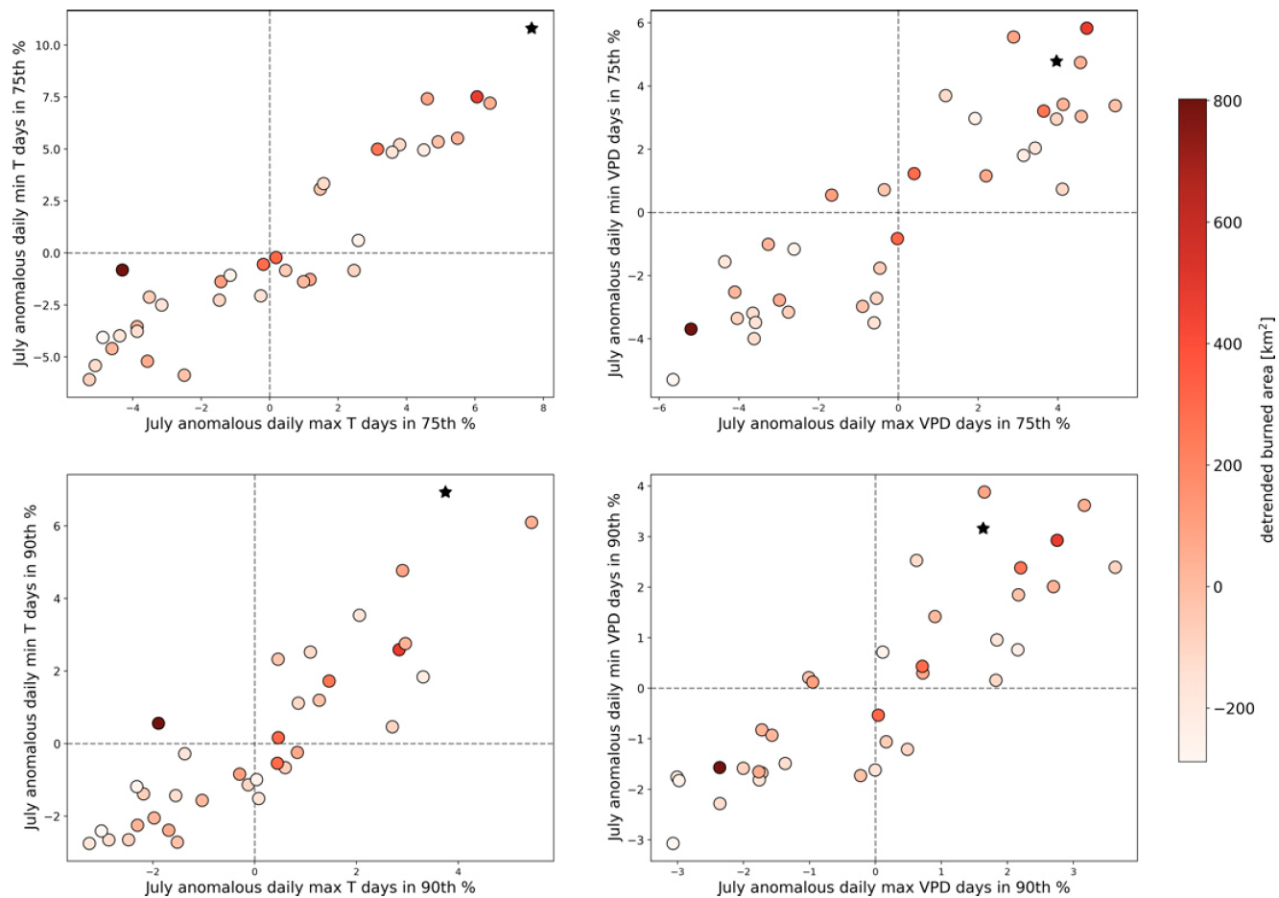





Climate Dynamics Preceding Summer Forest Fires in California and the Extreme Case of 2018
Jacobson, T. W. P., R. Seager, A. P. Williams, and N. Henderson, 2022, Journal of Applied Meteorology and Climatology, 61, 989-1002
Objective
The purpose of this study is to identify the local and global climate patterns in the preceding seasons that influence how the burned summer forest area in California varies year-to-year.
Approach
We find that a dry atmosphere, high temperatures, dry soils, less snowpack, low precipitation, subsiding air, and high pressure centered west of California all correlate significantly with large summer burned area as far back as the preceding January. These climate anomalies occur as part of a hemispheric scale pattern with weak connections to the tropical Pacific Ocean. We also describe the climate anomalies preceding the extreme and record-breaking burned-area year of 2018, and how these compared with the more general patterns found.
Impact
These results give important insight into how well and how early it might be possible to predict the severity of an upcoming summer wildfire season in California.
Figure. Detrended July California-averaged anomalous number of days in the (top) 75th and (bottom) 90th percentile for that day of daily (left) maximum and minimum 2-m temperatures and (right) maximum and minimum VPD for each year 1984–2018, detrended using the 1984–2017 trend; 2018 is plotted as a black star. The circles are colored by the detrended burned forest area in July of that year (km²).

