Slide 1
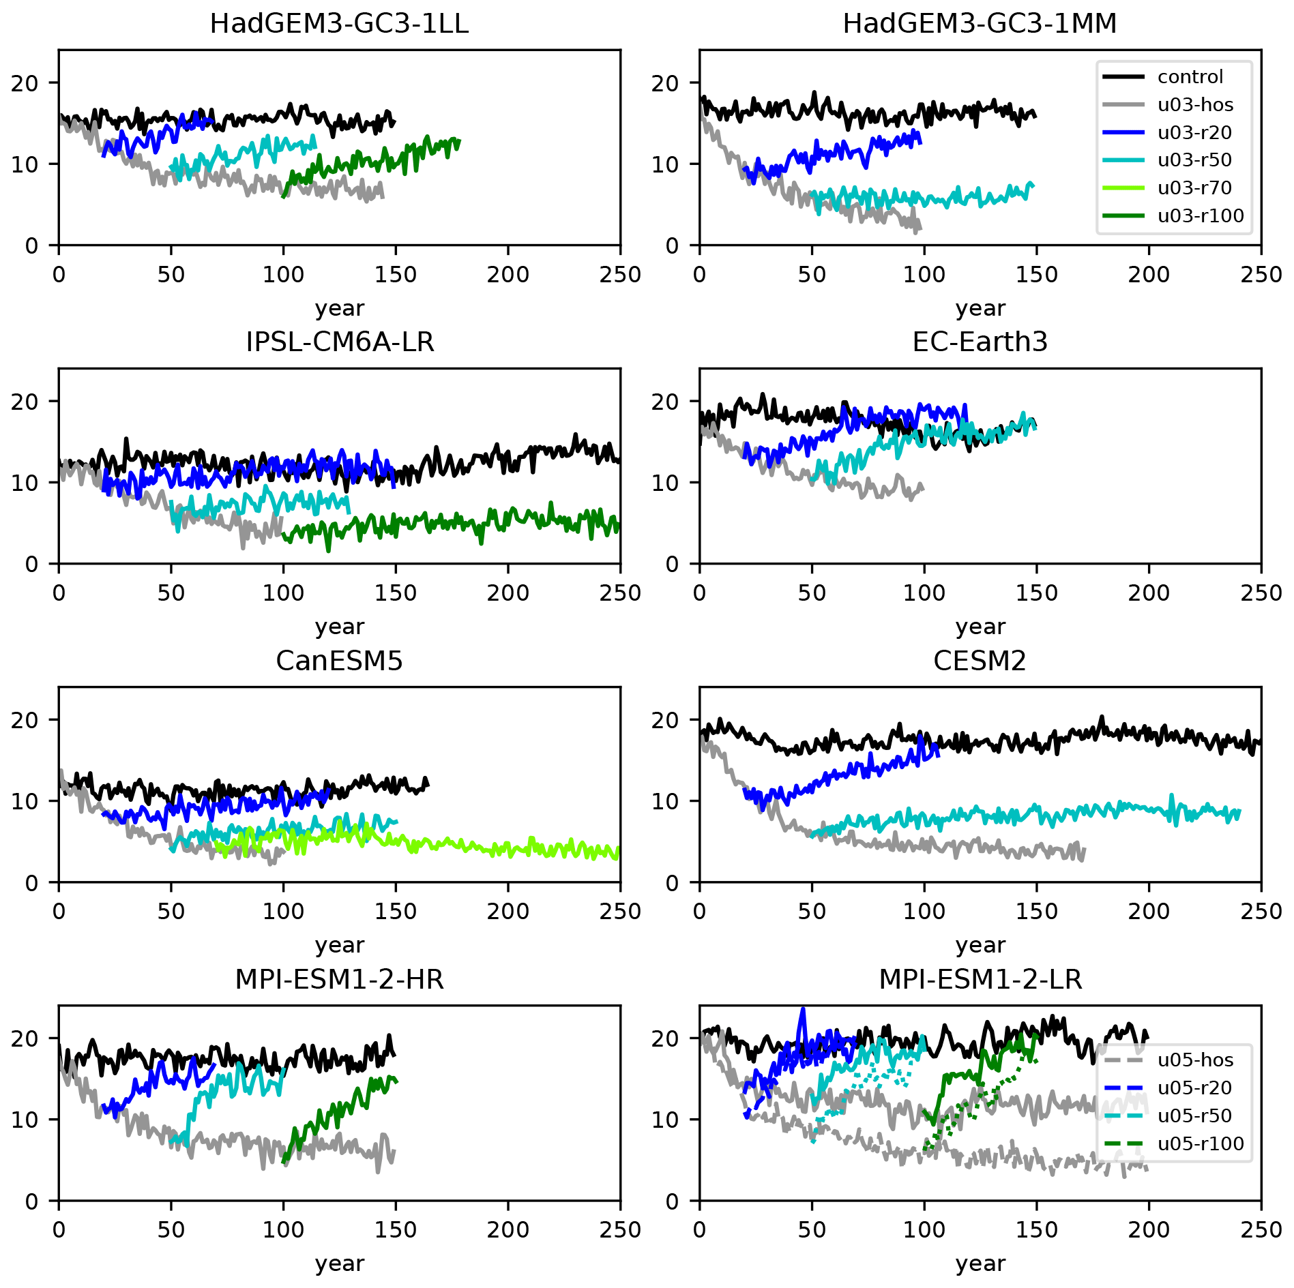
Understanding AMOC stability: the North Atlantic Hosing Model Intercomparison Project
Objective: The Atlantic meridional overturning circulation (AMOC) is an important part of our climate system. The AMOC is predicted to weaken under climate change; however, theories suggest that it may have a tipping point beyond which recovery is difficult, hence showing quasi-irreversibility (hysteresis). Although hysteresis has been seen in simple models, it has been difficult to demonstrate in comprehensive global climate models. Here, we outline a set of experiments designed to explore AMOC hysteresis and sensitivity to additional freshwater input as part of the North Atlantic Hosing Model Intercomparison Project (NAHosMIP). These experiments include adding additional freshwater (hosing) for a fixed length of time to examine the rate and mechanisms of AMOC weakening and whether the AMOC subsequently recovers once hosing stops.
Approach: Coordinated experiments are run by different modeling groups, including CESM2. 0.3 Sv freshwater flux is uniformly added into the North Atlantic (north of 50N) and the Arctic, this forcing is stopped at year 20 and year 50 to see whether AMOC will recover in comparison to the 1850 control run and the run with the freshwater continuously on.
Results/Impacts: Initial results are shown from eight climate models participating in the Sixth Coupled Model Intercomparison Project (CMIP6). The AMOC weakens in all models as a result of the freshening, but once the freshening ceases, the AMOC recovers in half of the models, and in the other half it stays in a weakened state. The difference in model behavior cannot be explained by the ocean model resolution or type nor by details of subgrid-scale parameterizations. Likewise, it cannot be explained by previously proposed properties of the mean climate state such as the strength of the salinity advection feedback. Instead, the AMOC recovery is determined by the climate state reached when hosing stops, with those experiments where the AMOC is weakest not experiencing a recovery.
Jackson, C. L., E. Alastrué de Asenjo, K. Bellomo, G. Danabasoglu, H. Haak, A. Hu, J. Jungclaus, W. Lee, V. L Meccia, O. Saenko, A. Shao, and D. Swingedouw, 2023, Understanding AMOC stability: the North Atlantic Hosing Model Intercomparison Project, Geoscientific Model Development, 16, 1975-1995.
Figure 1. AMOC strength (maximum in depth at 26.5 N) for UH experiments. Each panel shows experiments conducted with different models. Experiments are the control (black), u03-hos (grey), u03-r20 (blue), u03-r50 (cyan), u03-r70 (light green), and u03-r100 (green). MPI-ESM1-2-LR also shows the same experiment with a stronger hosing rate of 0.5 Sv (dashed lines).

