Slide 1
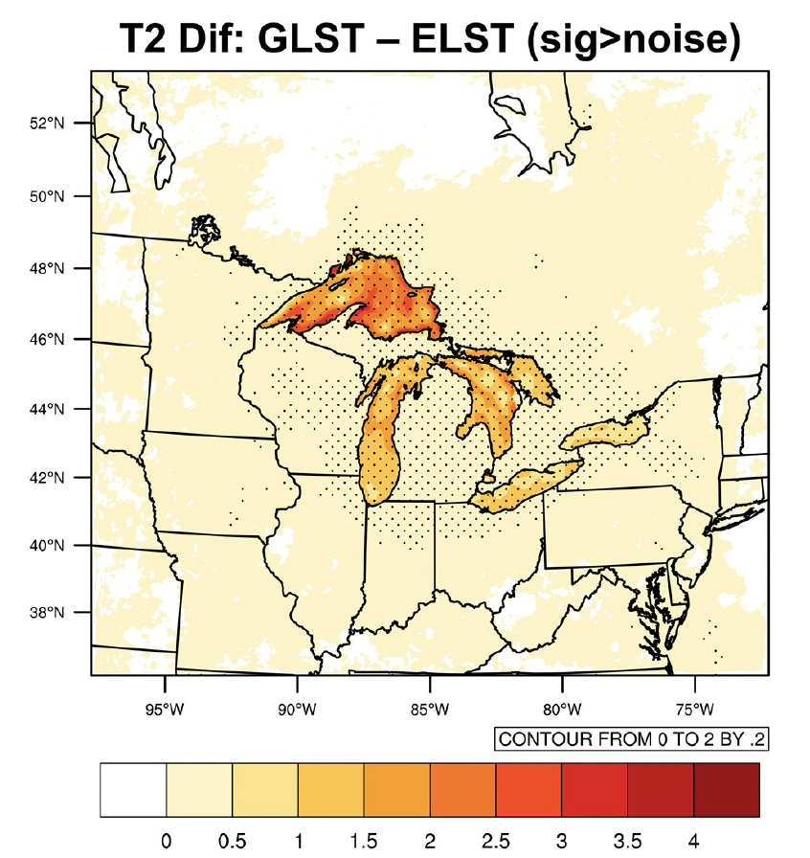
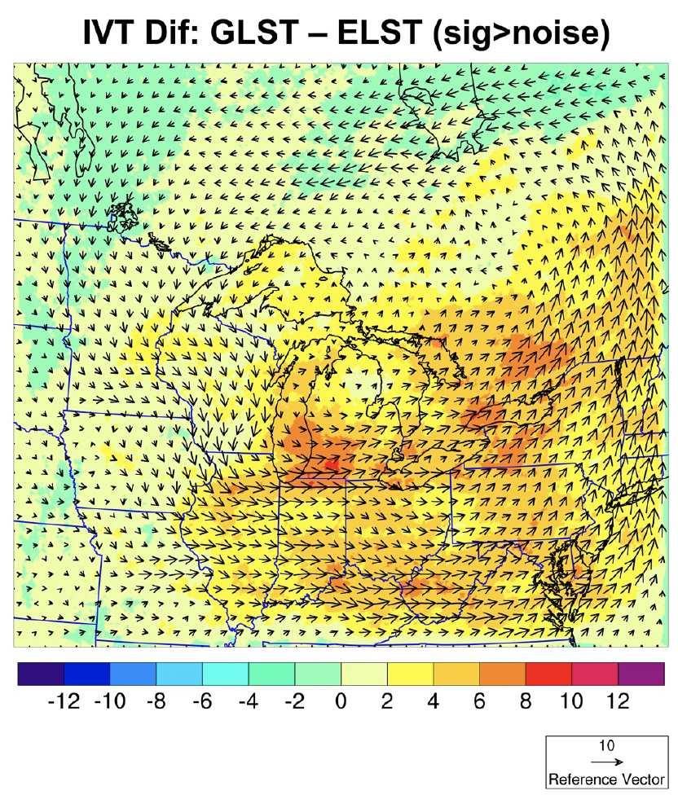
Impacts of Lake Surface Temperature on the Summer Climate Over the Great Lakes Region
Scientific Challenge
The Great Lakes substantially influence the regional weather and climate via their effects on the atmospheric energy and water budget. However, most climate models were not designed with sufficient emphasis on lake–atmosphere interactions, which could potentially cause model biases over the Great Lakes Region (GLR).
Approach and Findings
We conducted twin experiment in numerical simulations, and found that, with lake-wide averaged 1.4°C difference in lake surface temperature, air temperatures over Lake Superior and Lake Erie were significantly different (by 1.93°∆C and 0.97°∆C, respectively).
The warmer lake surface temperature source increase latent heat flux over the lakes and provide extra moisture for precipitation development. The impact on precipitation could also expand beyond the Great Lakes basin, e.g., decrease in precipitation over the west while increase over the east of Great Lakes Region.
Figure
Significance and Impact
This finding indicates that use of inaccurate LST data can lead to biased air temperature and precipitation over the lake surface and near-coastal land surface, which can affect both short- and long-term forecasting of lake levels as well as convective precipitation near the lakes.
A realistic model with atmosphere–lake interaction fully resolved is critical in order to properly represent the regional climate across the GLR.
Wang, J., Xue, P., Pringle, W., Yang, Z., & Qian, Y. (2022). Impacts of lake surface temperature on the summer climate over the Great Lakes Region. Journal of Geophysical Research:Atmospheres, 127, e2021JD036231. https://doi.org/10.1029/2021JD036231
Differences in air temperature (top) and integrated water vapor transport (bottom) when the simulations are driven by different lake surface temperatures.
Department of Energy • Office of Science • Biological and Environmental Research
Notes:
Word highlight text here.

