Slide 1
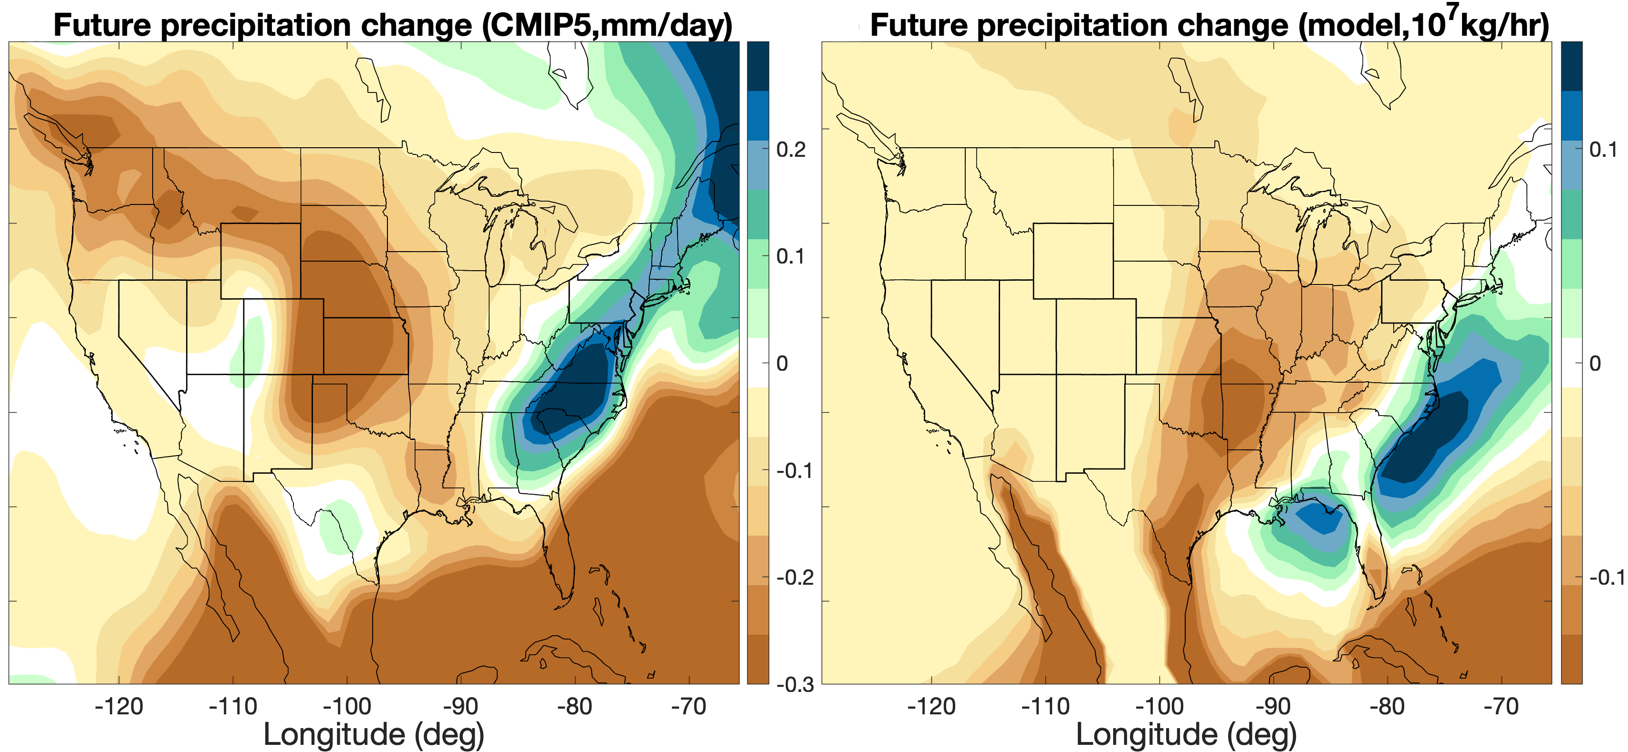
Using a Theoretical Model to Predict Future Thunderstorm Changes over the United States
Objective
Investigate the effects of global warming on the convective initiation and genesis of summertime mesoscale convective systems (MCSs) over the U.S.
Approach
Parcel behavior in a single-column model is used to assess environmental favorability for convective initiation, while the collective behavior of parcels in a multi-column model is interpreted as the upscale growth feature during MCS genesis.
Impact
The parcel model projects a shift towards more intense convection, suggesting a potential increase in the frequency of damaging thunderstorms and severe weather under global warming.
The parcel model suggests cold pool dynamics play an essential role in determining the state of MCSs and should be incorporated in the convection parameterizations used in coarse-resolution global climate models.
The parcel model results can be used to explain potential changes in MCS genesis under global warming and identify important factors for controlling the upscale growth of MCS.
The mechanistic processes underpinning MCS changes under global warming may help researchers analyze convection permitting climate change simulations to understand how convection aggregation may respond to global warming and affect cloud-radiation feedback.
The future changes in climatological mean summertime precipitation from 37 Coupled Model Intercomparison Project 5 (CMIP5) model projections (left) and the single-column model results (right). The single-column model projects precipitation decreases over the central U.S., the Pacific coast of Mexico, and the Atlantic Ocean, as well as precipitation increases along the East Coast of the U.S., resembling the changes projected by the CMIP5 models.
Yang, Q., Leung, L. R., Feng, Z., and Chen, X. 2023. “Impact of Global Warming on U.S. Summertime Mesoscale Convective Systems: A Simple Lagrangian Parcel Model Perspective.” Journal of Climate, 36, 4597. [DOI: 10.1175/JCLI-D-22-0291.1]

