Slide 1
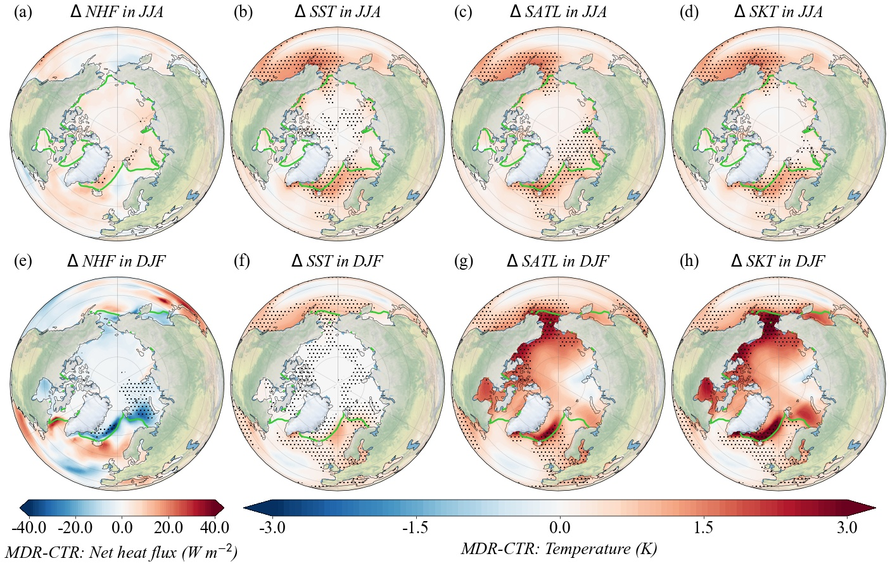
Sensitivity of Arctic Surface Temperature to Including a Comprehensive Ocean Interior Reflectance to the Ocean Surface Albedo within the Fully Coupled CESM2
Scientific Challenge
Few climate models resolve ocean interior light attenuation across the water column. Generally, the representation of the ocean interior's contribution to ocean surface albedo (OSA) is ignored in the current generation of Earth system models.
Approach and Findings
This research investigates Arctic surface temperature responses through the assessment of two OSA methods, one incorporating ocean interior reflectance and the other without. The results indicate that ocean interior reflectance leads to heightened absorption of solar radiation, resulting in ocean warming. This, in turn, intensifies seasonal heat storage and release throughout the Arctic Ocean, leading to increased reduction of sea ice and positive climate feedbacks, ultimately elevating Arctic surface temperatures. The warmer Arctic surface is predominantly caused by changes in near-surface vertical air motion, latent heat released during cloud formation, longwave radiative energy budget, and conductive heat transport from the ocean especially in winter.
Figure
Significance and Impact
Significant effects of ocean interior reflectance on the Arctic Ocean, including sea surface warming and sea ice reduction, justify the importance of ocean interior reflectance in climate models for better understanding of ongoing Arctic climate changes. Climate responses due to integrating ocean interior reflectance in the ocean surface albedo need more attention in earth system modeling.
Figure. (a, e) 30-year mean MDR minus CTR net heat flux difference (Δ NHF = NHF_{MDR} – NHF_{CTR}; NHF = NSW + NLW + SENH + LATH) for JJA and DJF. (b, f), (c, g), and (d, h) As in (a, e), but for mean sea surface temperature difference (Δ SST), mean surface air temperature difference (Δ SATL), and mean skin temperature difference (Δ SKT), respectively. Negative (positive) values denote increased (decreased) fluxes from the surface into the atmosphere. Differences significant at the 95% level are stippled. Green lines mark the sea ice edges in the CTR. Note: SATL is the surface air temperature in the lowest atmospheric model output level. SKT is the skin temperature of any surface, e.g., water, sea ice, or snow surface. CTR: control run without considering ocean interior reflectance. MDR: modified run with including ocean interior reflectance.
Wei, J. Ren, T., Yang, P., DiMarco, S. F., & Huang, X. (2023b). Sensitivity of Arctic surface temperature to including a comprehensive ocean interior reflectance to the ocean surface albedo within the fully coupled CESM2. Journal of Advances in Modeling Earth Systems. *********
Department of Energy • Office of Science • Biological and Environmental Research
Notes:
Word highlight text here.

