Slide 1
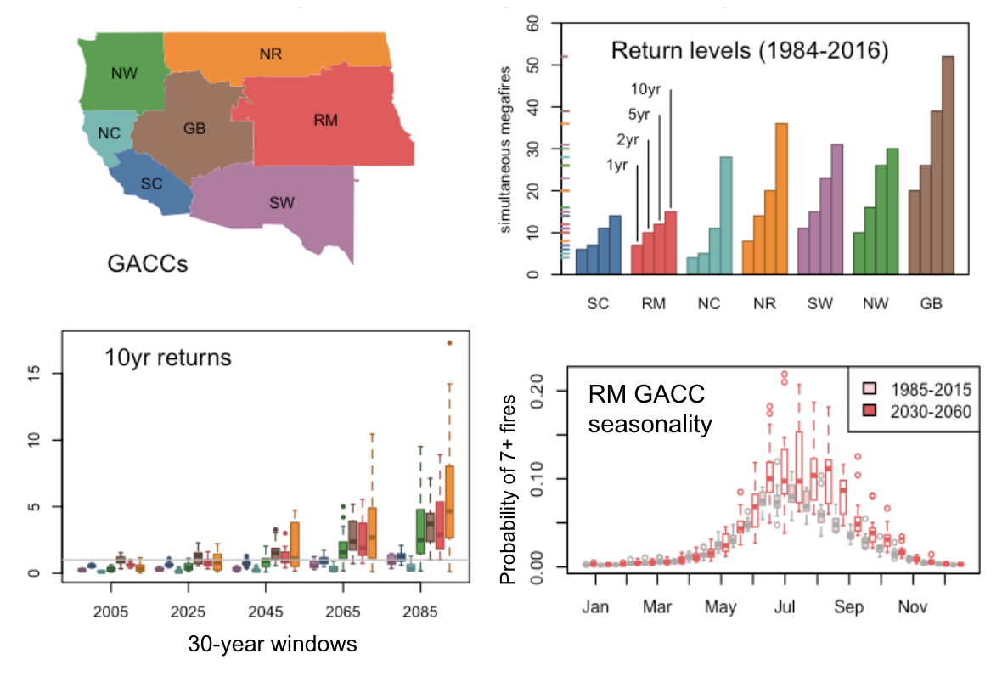
Simultaneous large wildfires will increase in the Western US
Scientific Challenge
Multiple small fires require more resources to fight than one large fire; wildfire simultaneity therefore affects the availability and distribution of resources for fire management, and is considered in decision-making. This study projects the effects of climate change on simultaneous large wildfires in the Western US, regionalized by administrative divisions used for wildfire management.
Approach and Findings
We modelled historical wildfire simultaneity as a function of fire weather index using statistical models trained on observed climate and fire data. We then applied these models to regional climate model simulations of the 21st century from the NA-CORDEX data archive. The results project increases in the number of simultaneous 1000+ acre fires in every part of the Western US at multiple return periods. These increases are more pronounced at higher levels of simultaneity, especially in the Northern Rockies region.
Figure
Significance and Impact
In all regions, the models project a longer season of high simultaneity when wildfires compete for suppression resources, with a slightly earlier start and notably later end. Most of the Western US is projected to see numbers of simultaneous 1000+ acre fires that historically occurred once every ten years happening once every five years, or even more frequently. These changes would negatively impact the effectiveness of fire response.
Map of Western US GACCs (Geographic Area Coordination Centers, administrative divisions used in wildfire management, upper left) and their associated historical 1-, 2-, 5-, and 10-year return levels of simultaneity (upper right). Lower left boxplot shows projected increases in 10-year returns for different 30-year windows, color-coded by GACC. Lower-right boxplot shows projected changes in seasonal variation of simultaneity at the 1-year return level for the Rocky Mountain GACC (red).
McGinnis S, Kessenich L, Mearns L, Cullen A, Podschwit H, Bukovsky M (2023) Future regional increases in simultaneous large Western USA wildfires. International Journal of Wildland Fire, 32(9):1304–1314. https://doi.org/10.1071/WF22107
Department of Energy • Office of Science • Biological and Environmental Research
Notes:
Word highlight text here.

