Slide 1
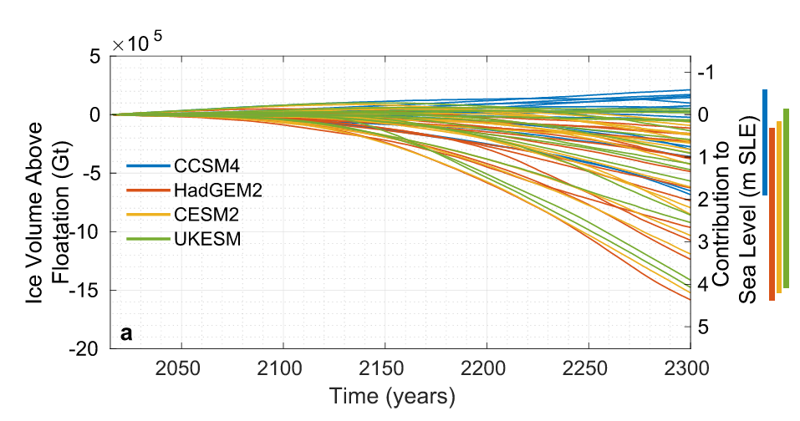
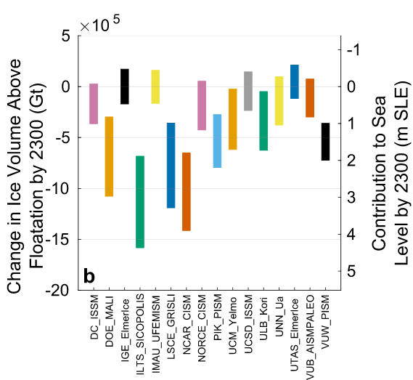
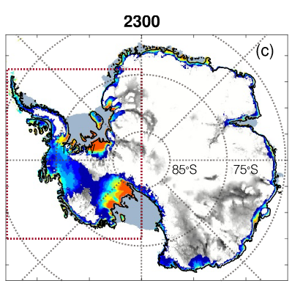
Extending Projections of the Antarctic Ice Sheet Contribution to Sea-Level Rise to 2300
Objective
Generate community-based projections of the contribution of the Antarctic Ice Sheet to sea-level rise through 2300, extending previous model intercomparison results that ended in 2100
Approach
16 ice-sheet models, including E3SM’s ice-sheet component, MALI, performed experiments forced by atmosphere and ocean conditions from 4 climate models run through 2300
The MALI configuration was among the models with highest resolution and best match to historical observations and the model with highest fidelity velocity solver
Findings & Impact
Sea-level contribution from Antarctica under high greenhouse gas scenarios is less than 0.3 meter at 2100
At 2300, sea-level rise contribution ranges from -0.6 to over 4 meters, indicating large uncertainty in future Antarctic Ice Sheet behavior (Fig. 1)
Projections with MALI tend to be higher than most other high resolution models (Fig. 2)
About one third of participating models predict loss of West Antarctic Ice Sheet by 2300 under high emissions (Fig. 3)
Climate model forcing
Including ice-shelf collapse
Figure 1: Ice-sheet model projections of Antarctica through 2300. Range of results including prescribed ice-shelf collapse shown with purple bar.
Figure 2: Range in projections for each ice-sheet model with MALI highlighted
Figure 3: Likelihood of modeled retreat across ensemble
Citation: H. Seroussi and 52 others, incl. X. Asay-Davis, H. Han, T. Hillebrand, M. Hoffman. 2024. “Evolution of the Antarctic Ice Sheet Over the Next Three Centuries From an ISMIP6 Model Ensemble.” Earth’s Future 12 (9): e2024EF004561. https://doi.org/10.1029/2024EF004561.
Department of Energy • Office of Science • Biological and Environmental Research

