Slide 1
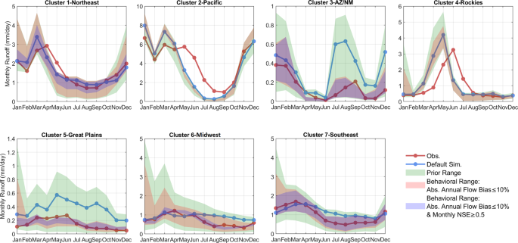
Improving Hydrological Predictions from the Community Land Model version 5
Objective
Characterize the uncertainty of meteorological forcing and hydrological parameters in Community Land Model version 5 (CLM5) hydrological applications over the United States.
Approach
Run CLM5 for 464 basins across the United States using ~1,300 ensemble parameter sets and 5 commonly used meteorological forcing datasets.
Cluster the basins into 7 clusters for regional analysis and then extend the 7 clusters to cover the conterminous United States (CONUS) at a resolution of 1/8° grid cell.
Quantify the sensitivity scores of 15 hydrological parameters to 28 hydrological metrics using the Delta moment-independent sensitivity analysis method.
Impact
This study identifies the limitations of the default hydrological parameter values in CLM5.
This study provides a benchmark dataset of CLM5 default hydrological performance, parameter sensitivities for 28 hydrological metrics, and large-ensemble outputs for CLM5 hydrological predictions.
The CLM5 hydrological datasets can be directly used for a wide variety of applications such as evaluating drought and flood vulnerabilities over different spatial scales ranging from local, to regional, to the full CONUS.
Technical validation of regional mean monthly flow using the NLDAS-2 forcing data in the 7 clusters. The green spread indicates all ~1,300 ensemble members. The red shading indicates the spread for parameter sets that have annual flow bias within 10% of the observed flows. The blue shading indicates the spread for parameter sets that have annual flow bias within 10% of the observed flows and a Nash-Sutcliffe Efficiency (NSE) value of monthly flow above or equal to 0.5.
Yan, H., Sun. N., Eldardiry, H., Thurber, T., Reed, P., Malek, K., Gupta, R., Kennedy, D., Swenson, S., Wang, L., Li, D., Vernon, C., Burleyson, C., and Rice, J. “Characterizing uncertainty in Community Land Model version 5 hydrological applications in the United States.” Scientific Data, 10, 187 (2023). [DOI: 10.1038/s41597-023-02049-7]

