Slide 1
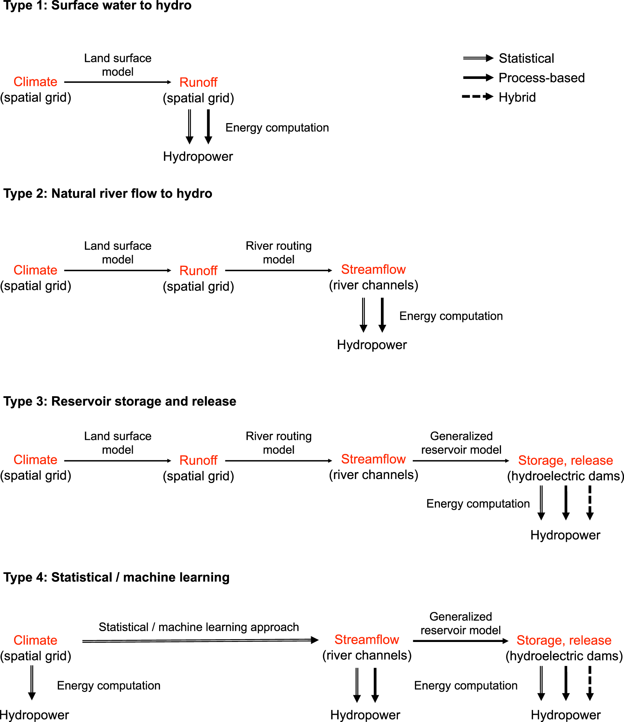
Simulating Large-Scale Hydropower under Climate Change: A State-of-the-Art Review
Objective
Examine the methods of climate-driven hydropower simulation at large spatial scales, from multi-basin regions to the globe, in order to study the effects of changing hydropower on power system reliability and performance as well as identify opportunities for further research and development in the field.
Approach
Review 45 studies of methods for climate-driven hydropower simulation at large spatial scales.
Identify four approach types based on the complexity of tools and richness of data applied to the problem and categorize the studies.
Impact
Studies that include models of reservoir operations have come to dominate the field, while studies that replace detailed hydrological models with statistical or machine learning techniques have yet to proliferate.
The transition to increased detail in hydrological and water management modeling is both driven by and beneficial for simulating sub-annual (monthly, weekly) generation during extreme conditions, including drought.
This review identifies four types of approaches for climate-driven hydropower simulation at large spatial scales based on complexity of tools and richness of data applied to the problem.
Turner SWD and Voisin N. “Simulation of hydropower at subcontinental to global scales: a state-of-the-art review.” Environmental Research Letters 17 023002.[DOI: 10.1088/1748-9326/ac4e38]

