Slide 1
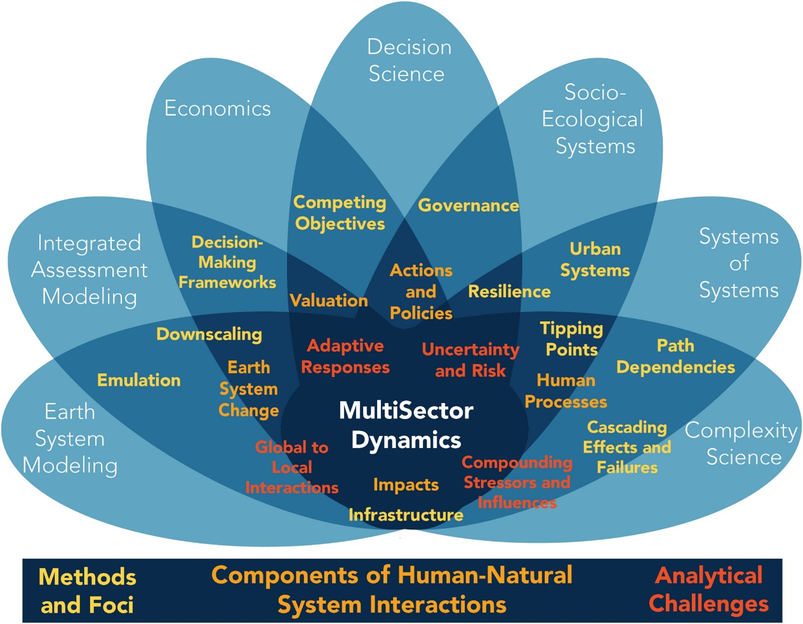
Setting the Stage for the Future of MultiSector Dynamics Research
Objective
This commentary defines key terms and concepts for the field of MultiSector Dynamics and identifies important science questions driving the field forward.
Approach
MultiSector Dynamics (MSD) is a scientific field that studies the co-evolution of human and Earth systems. Example research areas include sustainability, climate change, and energy transitions.
In this commentary we provide definitions for core concepts and themes in the field. We also describe important science questions, ongoing activities, and provide a vision for the field moving forward.
A key part of the future vision is the goal to facilitate a diverse, transdisciplinary workforce and to leverage open science to tackle MSD problems.
Impact
This is the first paper that comprehensively describes the field of MultiSector Dynamics, carefully laying out key terms and concepts for the community.
The survey of existing research in the field is a useful marker for where we are and where we want and need to go.
This paper will help grow the MSD community by making it easier for new researchers to assimilate into the field.
Focal and methodological connections of Multisector Dynamics with other disciplines.
Reed, P. M., Hadjimichael, A., Moss, R. H., Brelsford, C., Burleyson, C. D., Cohen, S., et al. (2022). Multisector dynamics: Advancing the science of complex adaptive human-Earth systems. Earth's Future, 10, e2021EF002621. https://doi.org/10.1029/2021EF002621

