Slide 1
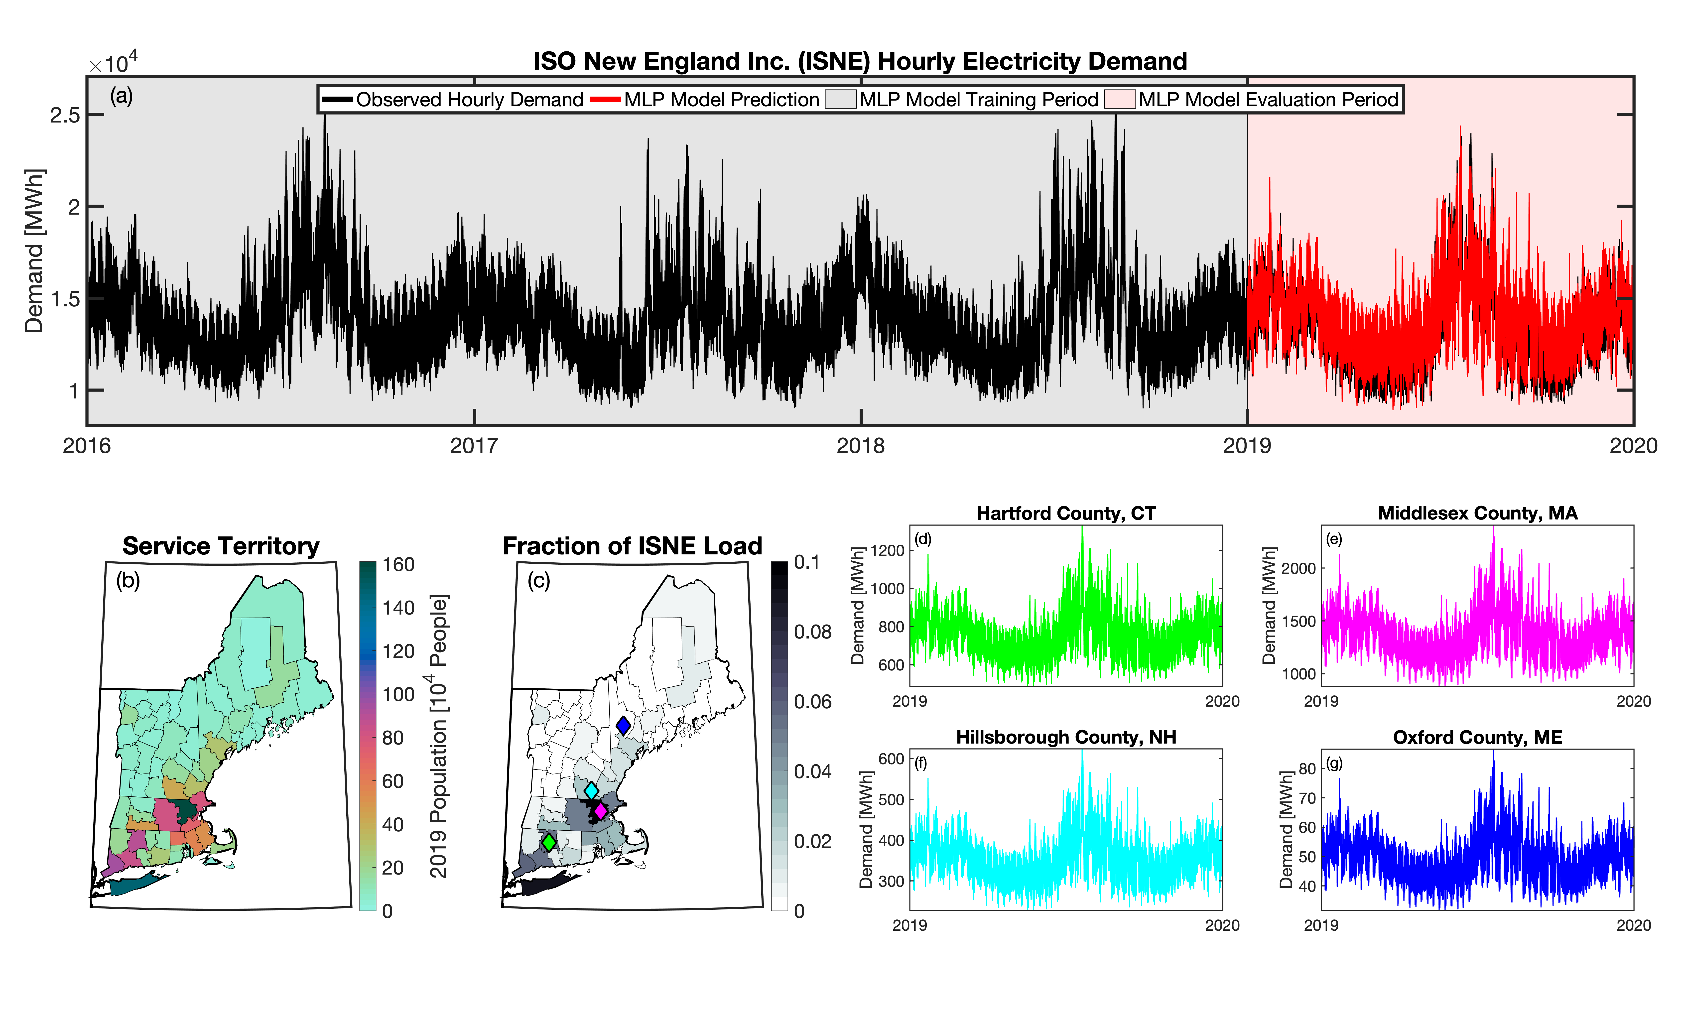
Generating Hourly Electricity Load Profiles for Resilient Grid Planning
Objective
To simulate future U.S. electricity demand at spatial and temporal scales useful for energy system planning and operations while considering future human and natural system impacts, such as climate change.
Approach
Use a series of machine learning models trained on historical (2015-2019) loads and meteorology.
Produce hourly load projections for each Balancing Authority (BA) and then scale them to match GCAM-USA’s projections of state-level, annual loads, using future climate and population projections.
Output yearly 8,760-hr time-series of total electricity demand at the county-, state-, and BA-scale that are consistent across scales.
Develop an entirely open-source model available through a GitHub repository.
Impact
The Total ELectricity Load (TELL) model provides load projections that are responsive to compounding human and natural stressors. The projections have sufficient spatial and temporal resolution for grid stress modeling, filling a crucial gap in understanding and planning for electricity system resilience.
This figure presents an example of the Balancing Authority-scale electricity demand and population data used to train TELL and shows the performance of TELL’s multilayer perceptron (MLP) model.
McGrath et al. "tell: a Python package to model future total electricity loads in the United States." Journal of Open Source Software, 7(79), 4472 (2022). [DOI: doi.org/10.21105/joss.04472]

