Slide 1
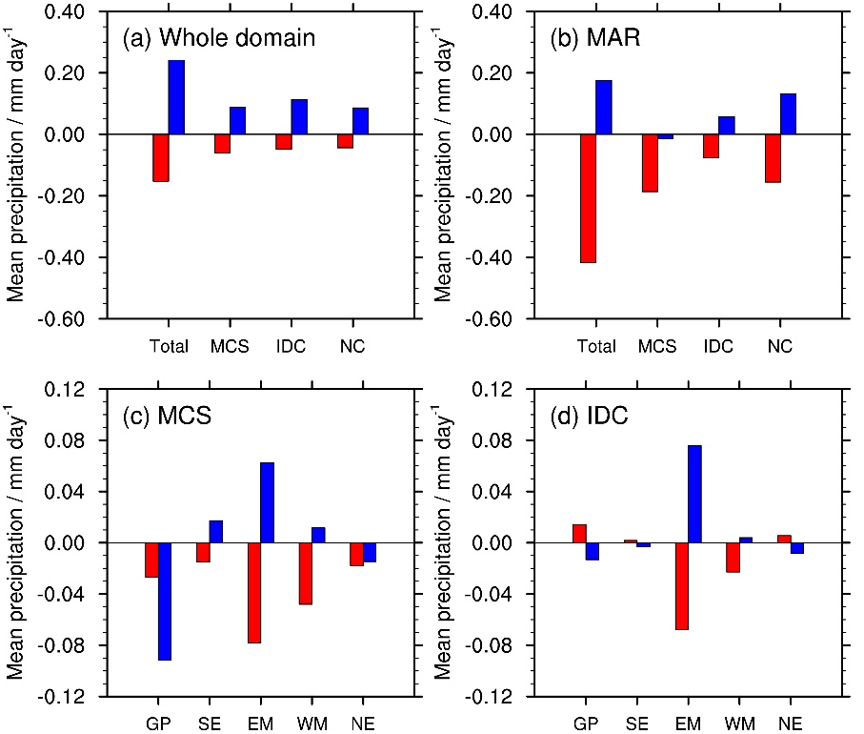
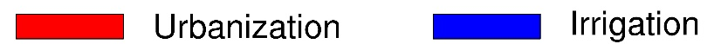
Contrasting How Urbanization and Irrigation Affect Mid-Atlantic Summer Precipitation
Objective
Investigate the effects of large-scale urbanization and irrigation on three types of summer precipitation (MCS: mesoscale convective system; IDC: isolated deep convection; NC: non-convective) in the mid-Atlantic region.
Approach
Compare convection-permitting Weather Research and Forecasting model simulations with and without urbanization or irrigation in summers from 2008 to 2012.
Separate precipitation into three types using the updated Flexible Object Tracker algorithm.
Classify MCS and IDC events in the mid-Atlantic region into five groups based on their initiation location.
Analyze how large-scale urbanization and irrigation affect different groups of MCS and IDC precipitation.
Impact
Identifies the mechanisms underlying the contrasting effects of large-scale irrigation on mid-Atlantic precipitation from locally and remotely initiated MCSs.
Highlights the diverse effects of human activities on total rainfall and its distribution across different rain types.
The effects of urbanization and irrigation on different rain types and different groups in the Mid-Atlantic region. Urbanization suppresses all three rain types. Irrigation enhances IDC and NC but slightly suppresses MCS precipitation. While irrigation enhances locally initiated MCSs (EM), it induces a mid-level cyclonic circulation anomaly that inhibits MCSs initiated in the Great Plains and Midwest from propagating to the Mid-Atlantic region.
J. Li, Y. Qian, L. R. Leung, Z. Feng, C. Sarangi, Y. Liu, and Z. Yang. “Impacts of large-scale urbanization and irrigation on summer precipitation in the Mid-Atlantic region of the United States.” Geophysical Research Letters, 49(8), e2022GL097845, (2022). [DOI: 10.1029/2022GL097845].

