Slide 1
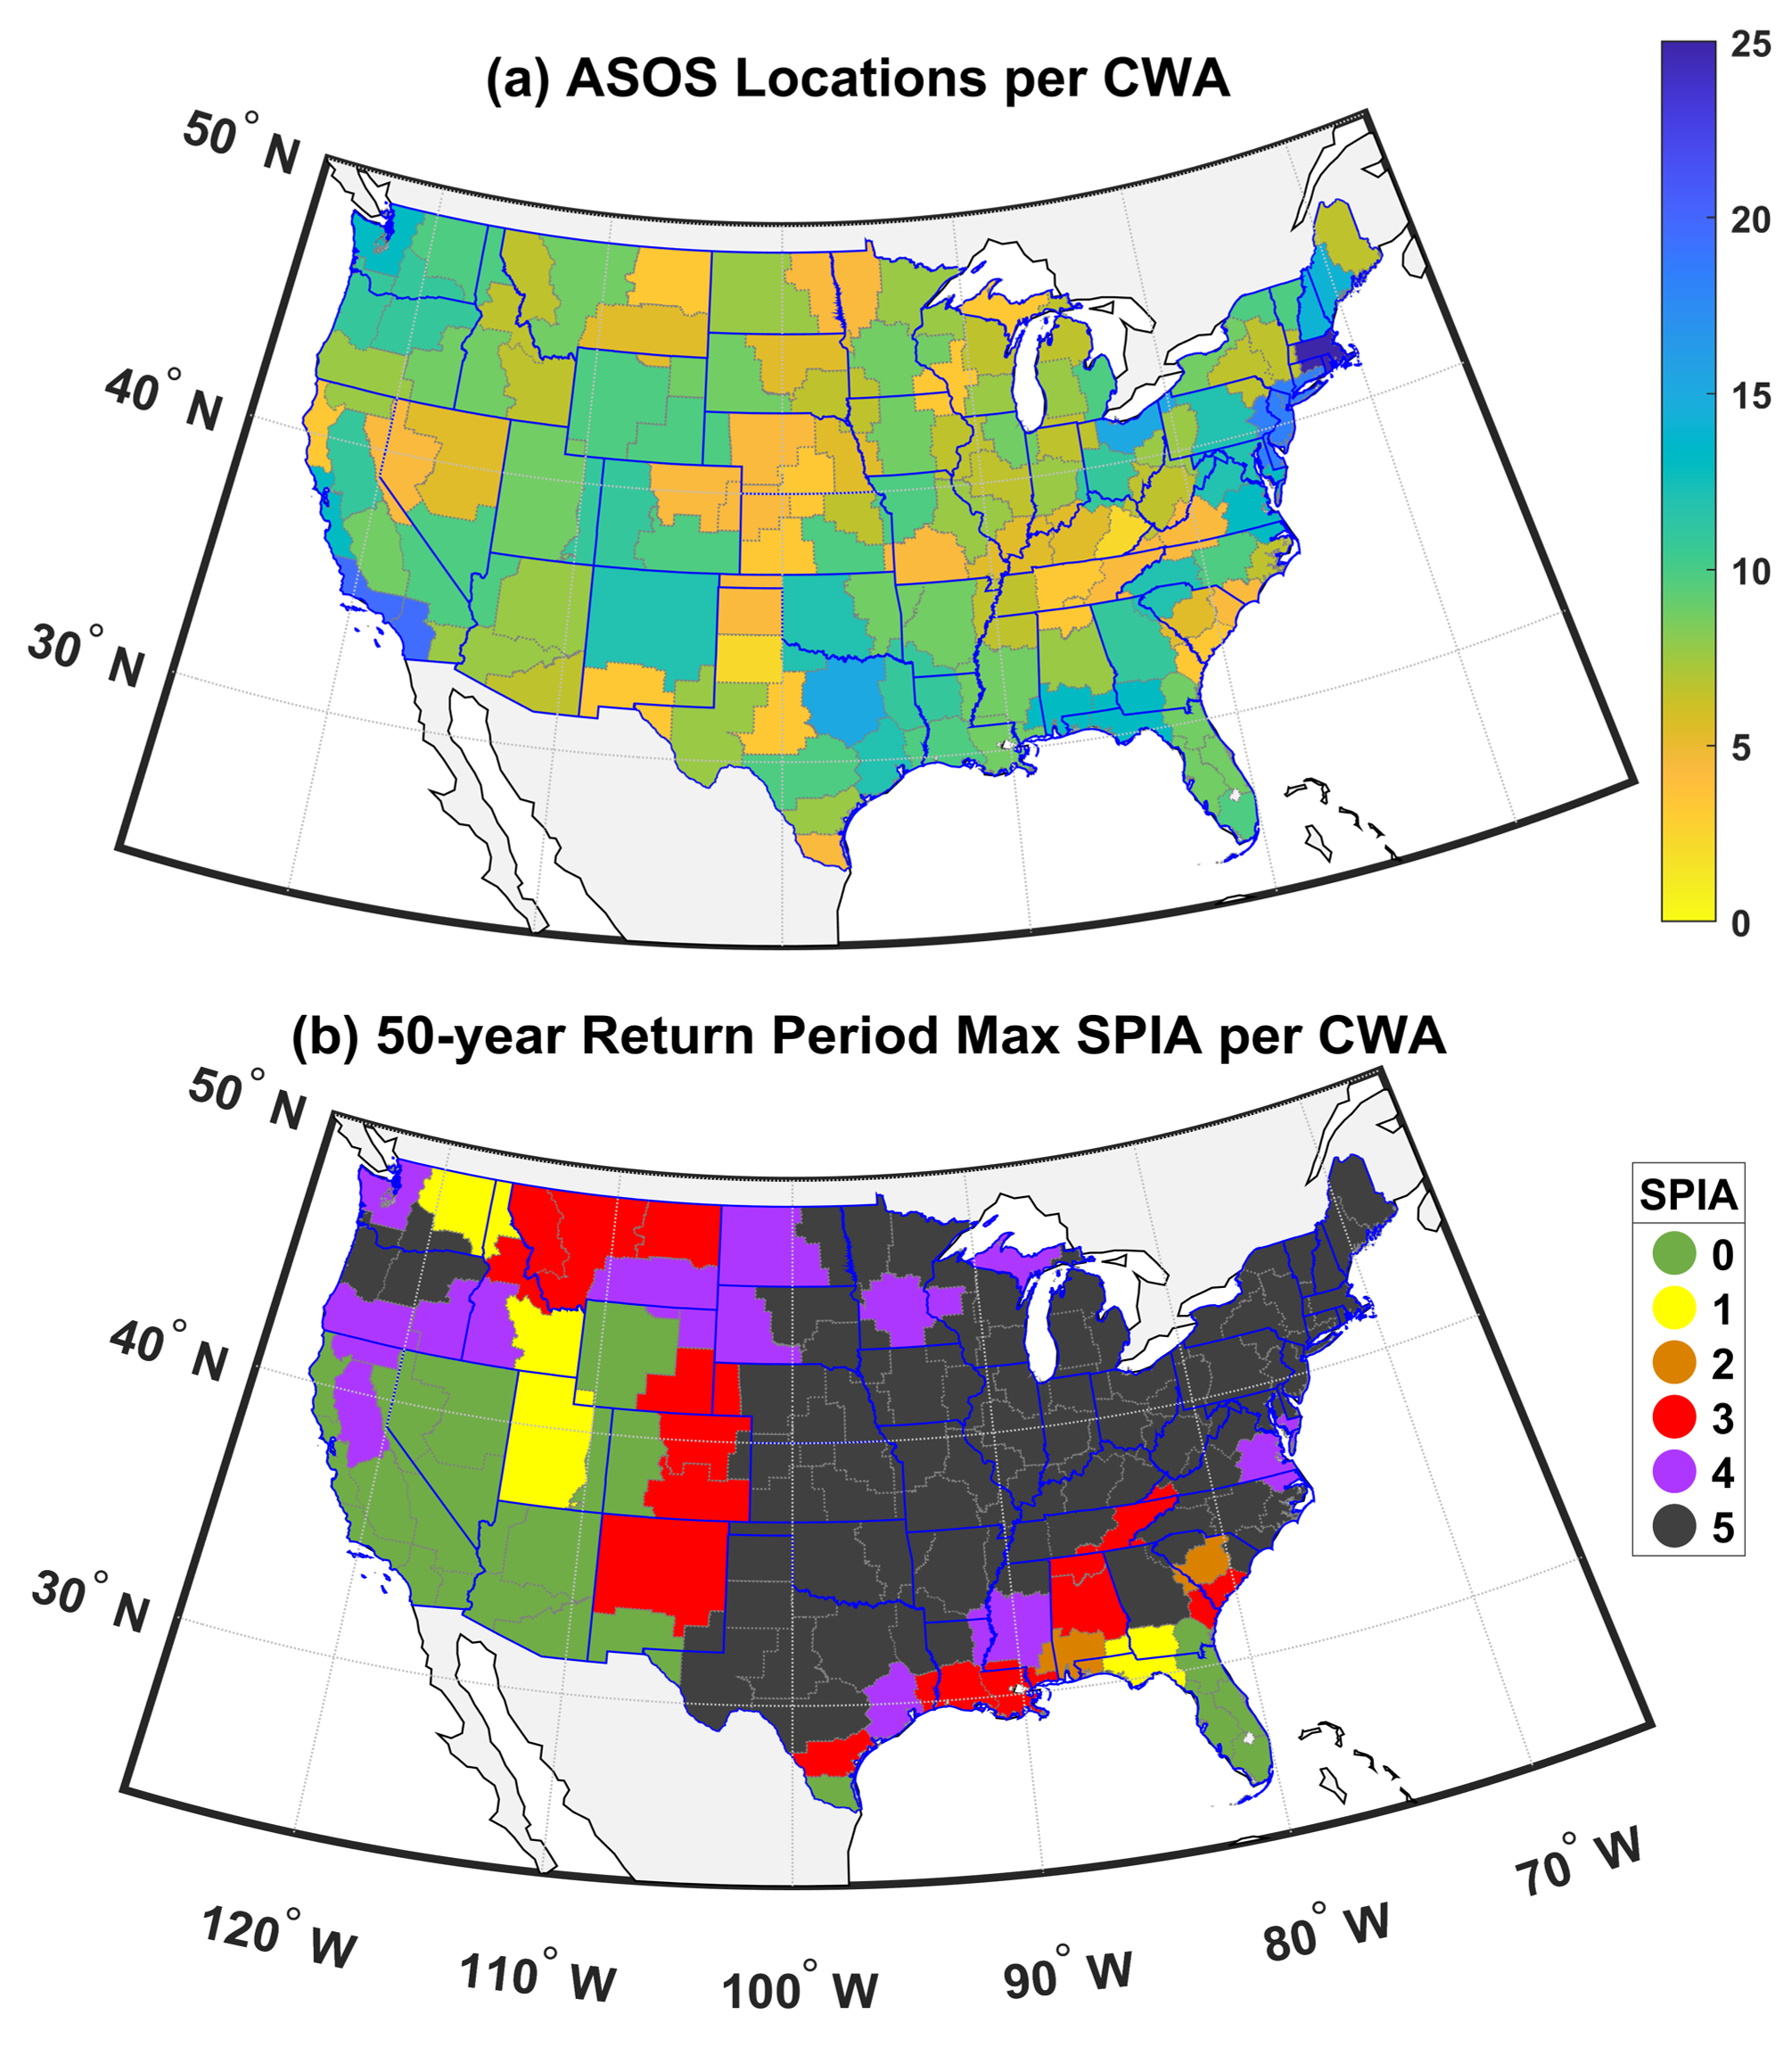
Compound hazard of freezing rain and wind gusts across CONUS
Time series of hourly freezing rain, ice accumulation and wind gusts (expressed as SPIA) at each NWS Automated Surface Observing Station (ASOS) across CONUS are computed and used to (i) derive a geospatial atlas of this hazard including the 50 yr return period event intensities for each US state and NWS CWA area using a superstation approach, and (ii) describe storylines of significant events in terms of meteorological drivers and socioeconomic impacts.
The co-occurrence of freezing rain, ice accumulation and wind gusts (FZG) poses a significant hazard to infrastructure and transportation. However, quantification of the frequency and intensity of FZG is challenged by the lack of direct icing measurements. Here we generate a spatial explicit atlas of this compound hazard.
High-frequency data collected during 2005–2022 are used to derive hourly ice accumulation and concomitant wind gusts (expressed using the Sperry-Piltz (SPIA) index) at 883 stations across the contiguous USA.
(a) Number of ASOS sites within each County Warning Area (CWA). (b) 50 yr return period maximum SPIA within each CWA (lowest = 0 and highest hazard = 5).
Coburn J., Barthelmie R.J and Pryor S.C. (2024): Quantifying the compound hazard of freezing rain and wind gusts across CONUS. Environmental Research Letters 19 044016 doi: 10.1088/1748-9326/ad30a4
.

