Slide 1
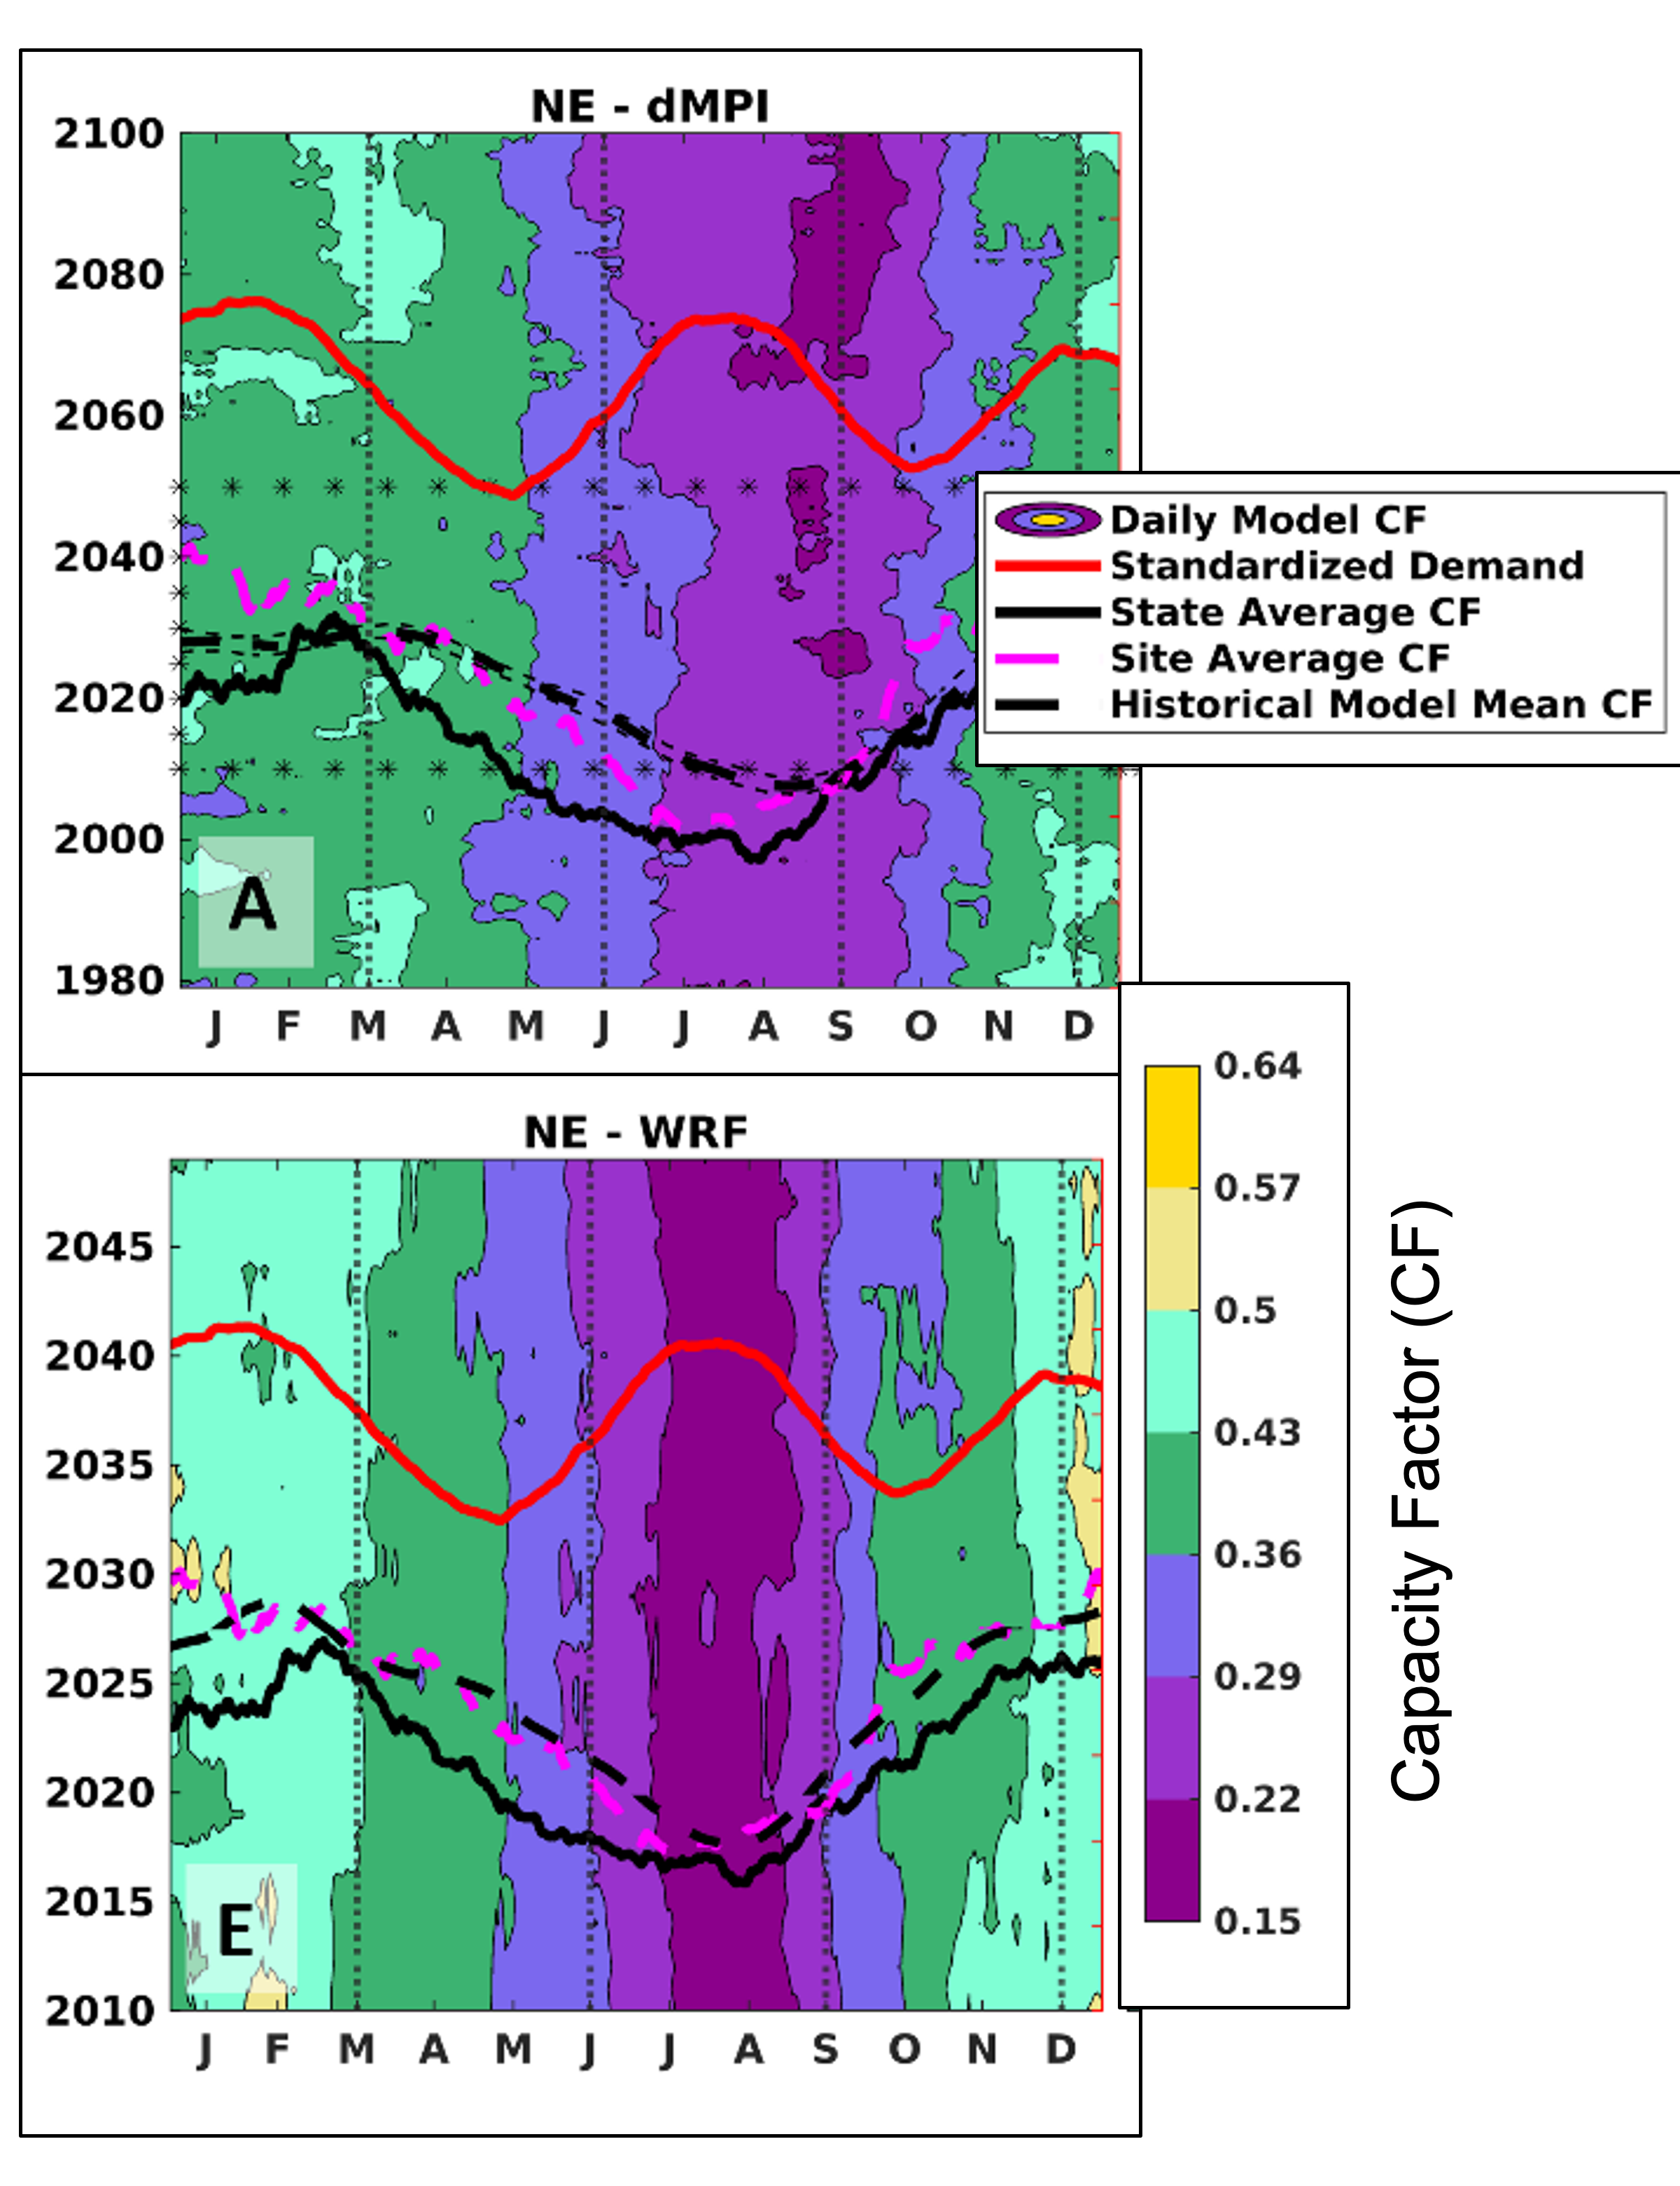
Projecting future energy production from wind farms – Part 3
Currently wind-generated electricity over most of North America is lowest in summer when electricity demand is highest. New projections indicate reductions in summertime wind-generated electricity, which would amplify this offset. However, wintertime wind-generation of electricity across most of North America is projected to remain high and coupled with electrification of domestic heating may lead to greater demand matching.
Enhancement of renewable energy penetration into the electricity supply is a critical component of national and international plans to achieve net zero greenhouse gas emissions. Here we examine the ability of wind energy to meet future electricity demand at locations across North America.
Dynamical and statistical downscaling of the Max Planck Institute global model are used to make projections of wind power generation across North America and evaluate future variability and electricity demand matching.
Capacity factor (CF) by day of year and year for wind farms in the Northeast from statistical (top, dMPI) and dynamical (bottom, WRF) downscaling. Higher CF = more electricity generation. Also shown; mean year-day CF from; grid supply data (black, solid), operating wind farms (magenta dashed), and from dMPI and WRF (black dashed) for current climate. Current normalized electricity demand (red line).
.
Coburn J.J. and Pryor S.C. (2023): Projecting future energy production from operating wind farms in North America: Part 3: Variability. Journal of Applied Meteorology and Climatology 62 1523-1537 doi: 10.1175/JAMC-D-23-0104.1
.

