Slide 1
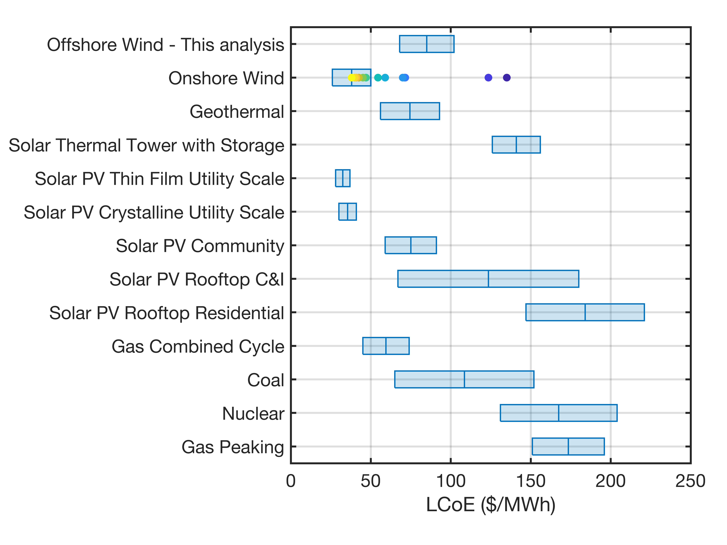
Cost of Energy from large offshore wind arrays
Uniquely detailed estimates of likely power production and levelized cost of electricity from planned offshore wind farms along the US east coast are generated using numerical modeling.
Enhancement of renewable energy penetration into the electricity supply is a critical component of national and international plans to achieve net zero greenhouse gas emissions. Reducing the cost of offshore wind-generated electricity is a key goal of DoE and is critically dependent on optimizing wind turbine layouts.
Data from large-scale atmospheric models are used to drive simulations of electricity production across a range of possible wind turbine layouts for the whole of the US east coast.
Levelized Cost of Energy (LCoE in $/MWh) modeled for proposed US east-coast offshore wind deployments (this analysis) and selected other electricity generation sources (all sources are shown without subsidies)
.
Barthelmie R.J., Larsen G.C. and Pryor S.C. (2023): Modeling annual electricity production and levelized cost of energy from the US East coast offshore wind energy lease areas. Energies 16 4550 doi: 10.3390/en16124550.

