Slide 1
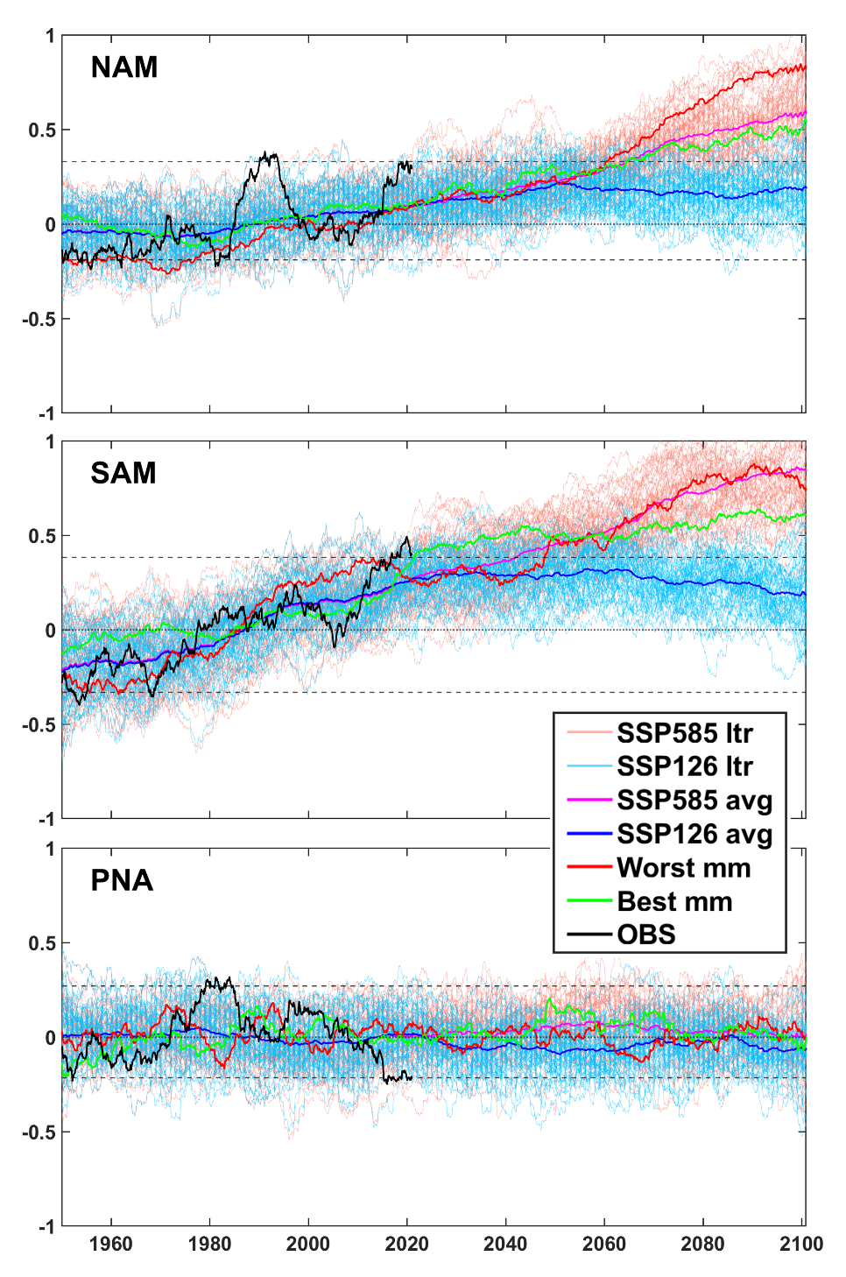
Evolution of the internal climate modes under future warming
Output from 58 realizations from a wide range of CMIP6 generation ESMs are used to derive projections of spatiotemporal characteristics of key internal climate modes. NAM, SAM and ENSO tend to evolve towards increased prevalence of the positive phase. The degree to which modes change scale with skill in the contemporary period (generally smaller for higher skill) and radiative forcing (larger changes for higher forcing).
Climate modes forced by internal processes play an important role in weather and climate variability over multiple spatial and temporal scales. Future climate changes will not only be affected by the variability arising from these modes, but the modes will themselves change in response to the externally-forced changing climate. This work quantifies how these modes may evolve.
A wide range of CMIP6 generation ESMs are used to derive projections of three key internal atmospheric and three oceanic modes under high (SSP585) and low (SSP126) radiative forcing scenarios.
Projections of key climate modes under low and high radiative forcing, with the best and worst performing ESM in the contemporary climate highlighted.
Coburn J.J. and Pryor S.C. (2023): Evolution of the internal climate modes under future warming. Journal of Climate 36 511-529 doi: 10.1175/JCLI-D-22-0200.1.

