Slide 2
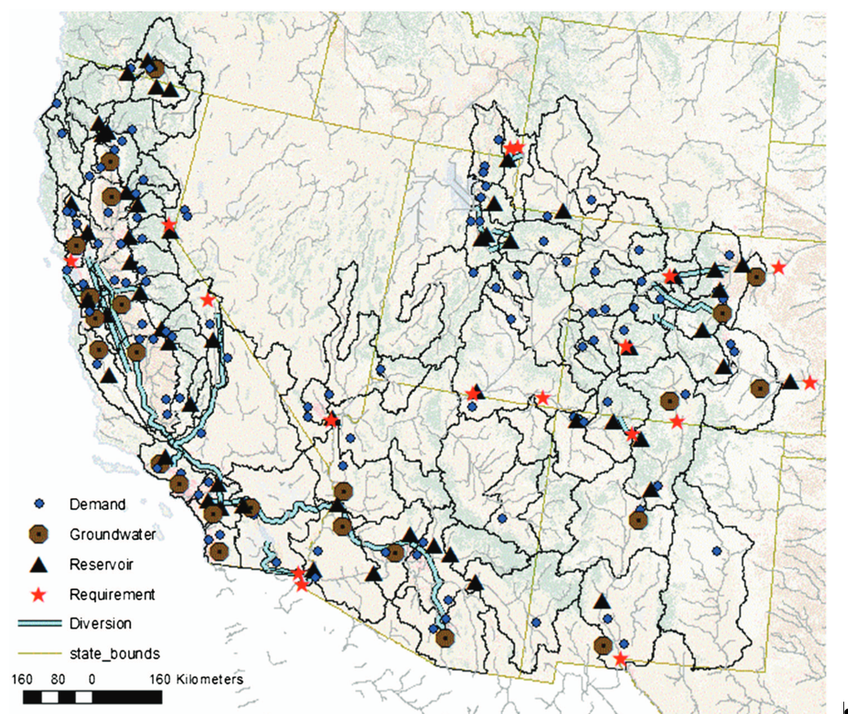
Exploring the Water-Energy Nexus in California via an
Integrative Modeling Approach
A climatically driven model of the Southwestern U.S. was developed within the Water Evaluation and Planning (WEAP) model. Generated streamflow, routed through both the natural and managed water system network was used to explore current and future water use and energy use and their interactions, with a detailed look at California under future drought and warming conditions.
Water is heavy, and in the western U.S., is one of the biggest consumers of electric energy, as treating and distributing water for both municipal and agriculture uses is energy intensive and for generating hydropower. Modeling frameworks that can be used to explore the interactions of climate, hydrology, water management and energy are critically important to better manage the water resources across the western U.S.
Monthly climate data across the Western U.S.
The 55 largest reservoirs storing 136 Billion M³ (BCM); 15 GW of installed hydropower capacity
20 Groundwater systems, storing 2,000 BCM.
Municipal indoor and outdoor water and agricultural water use across the SW.
Future model projections show groundwater overdrafting and increased energy use.
Autonomous conservation through reduced water use reduces impacts of energy use.

Slide 3
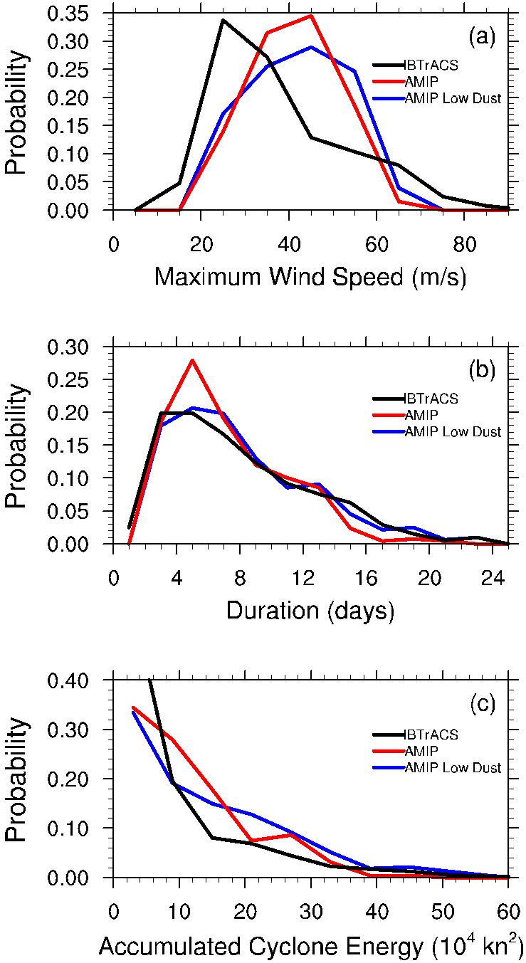

Exploring the Impact of Dust on North Atlantic Hurricanes in a High-Resolution Climate Model
The impact of African dust on the climatology of tropical cyclones (TCs) is explored using the high-resolution Community Atmosphere Model version 5 at a global horizontal resolution of 28 km, with a focus on the North Atlantic ocean basin.
Increased understanding on how dust impacts hurricanes in high-resolution climate models has implications for future projections and risk associated with resulting changes in hurricane activity.
The results call for future research on the mechanisms behind these interactions, such as parameterized convection and microphysics.
TC statistics and environments from two simulations, with aerosol models yielding standard and reduced amounts of dust, are compared.
In the reduced-dust simulation, TCs become more frequent globally, with the the North Atlantic basin seeing the largest increase.
In the reduced-dust simulation, North Atlantic TCs are more frequent (27%) and on average significantly longer lived (13%) but only slightly stronger (3%). The combined effect is an increase of 57% in accumulated cyclone energy per hurricane season.
Reed, K. A., Bacmeister, J. T., Huff, J. J. A., Wu, X., Bates, S. C., & Rosenbloom, N. A. (2019). Exploring the impact of dust on North Atlantic hurricanes in a high-resolution climate model. Geophysical Research Letters, 46. https://doi.org/10.1029/2018GL080642

Slide 4
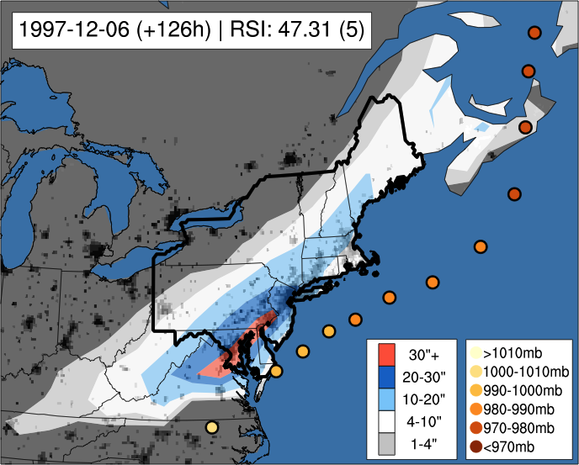


Projecting changes in societally impactful northeastern U.S. snowstorms
Example of an ”extreme” Category 5 snowstorm detected and tracked in CESM. Colored circles indicate storm center path and intensity, color contours are accumulated snowfall, and greyscale underlay shows population density.
Annual average snowfall projected to decrease across the northeastern United States by the end of the century
This decrease is primarily constrained to “weak” or “nuisance” snowfall events
Large, crippling storms with heavy snowfall over major population centers are unlikely to be mitigated in the future, even with warmer winters
Novel metric defined that quantities individual coastal snowstorms within large weather and climate datasets
Storm-level analysis important for stakeholders and other end users since rare and extreme events produce the largest societal, economic, and hydrological impacts
Automated algorithm to objectively track coastal extratropical storms developed, applied to Community Earth System Model (CESM) Large Ensemble
Data indicates non-linear decreases in snowstorms as a function of societal impact throughout the next century
Storm-level analysis shows coastal cyclones will be more moist in the future, so even with shorter, warmer winters, when temperatures can support snow, future storms will still possess high snowfall rates and total accumulations
Zarzycki, C. M. (2018). Projecting changes in societally impactful northeastern U.S. snowstorms.
Geophysical Research Letters, 45, 12,067–12,075. https://doi.org/10.1029/2018GL079820

