Slide 1
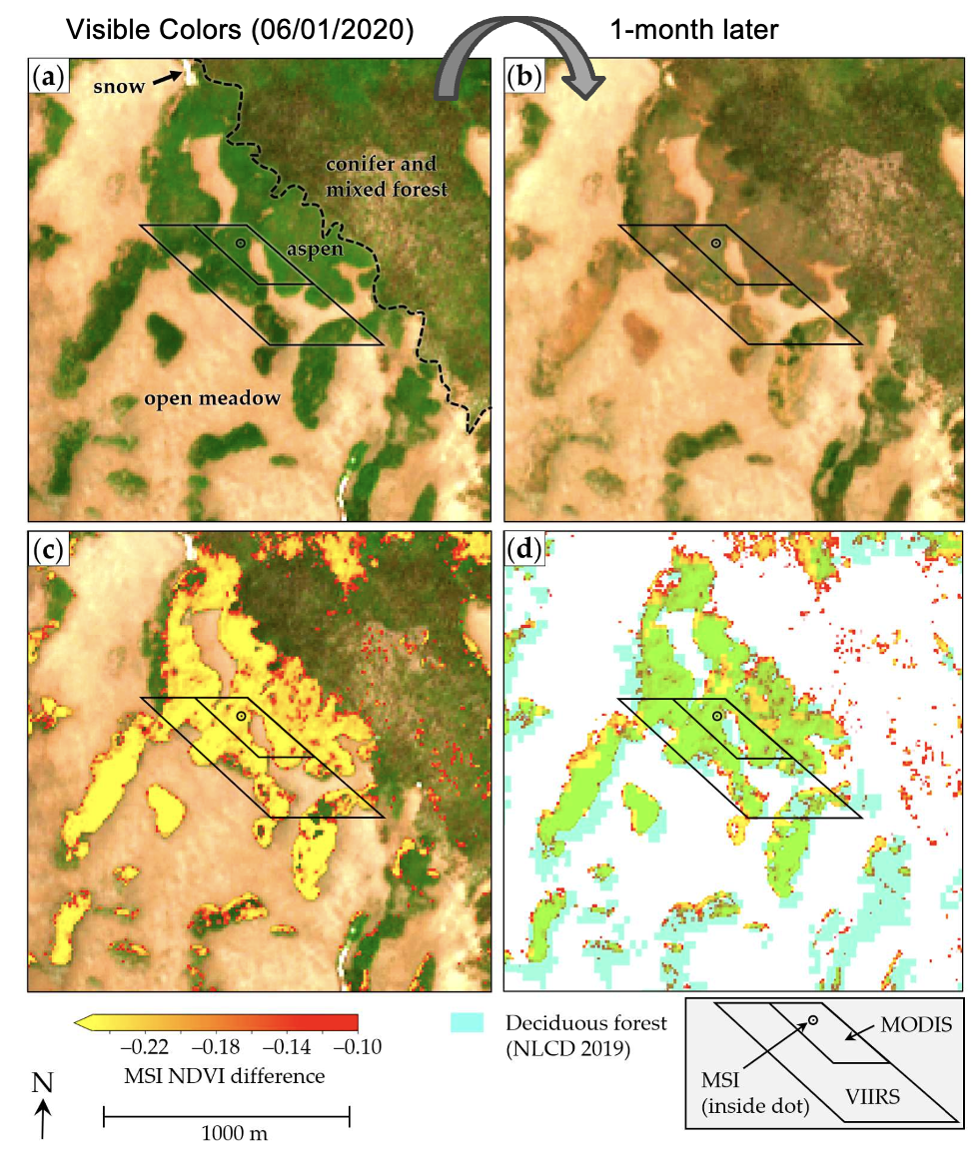
Remote Sensing Detection of Growing Season Freeze-Induced Defoliation of Montane Quaking Aspen (Populus tremuloides) in Southern Utah, USA
Objective
This study aims to detect and analyze the spatial extent and temporal progression of freeze-induced canopy damage in aspen in Southern Utah. By identifying the patterns and impacts of growing season freeze events, the research seeks to understand their effects on the health and survival of montane aspen populations in Western North America.
Approach
Utilizing multispectral remote sensing, this study maps freeze-induced canopy damage in Southern Utah's aspen populations from a June 2020 freeze event. The Normalized Difference Vegetation Index (NDVI) assesses vegetation changes post-freeze compared to historical and pre-freeze conditions, incorporating a novel pixel-based method to gauge freeze vulnerability based on growth flush and growing degree days.
Impact
The study enhances understanding of aspen resilience and vulnerability to freeze events, providing vital data for conservation and management. The developed remote sensing methods enable more precise monitoring and prediction of freeze impacts on these crucial ecosystems, supporting adaptive management strategies in the face of climate variability.
Wright, T.E., Chikamoto, Y., Birch, J.D., and Lutz, J.A. (2024): Remote Sensing Detection of Growing Season Freeze-Induced Defoliation of Montane Quaking Aspen (Populus tremuloides) in Southern Utah, USA. Remote Sensing, 16, 3477, doi:10.3390/rs16183477.
Figure: Satellite imagery from Sentinel 2 shows visible colors on (a) 06/01/2020 and (b) 07/01/2020, (c) changes in vegetation health (NDVI) between these dates, and (d) these changes with highlighted deciduous forests. The images are centered at 38.614 N, 111.496 W.

Slide 2
Examples

Slide 3
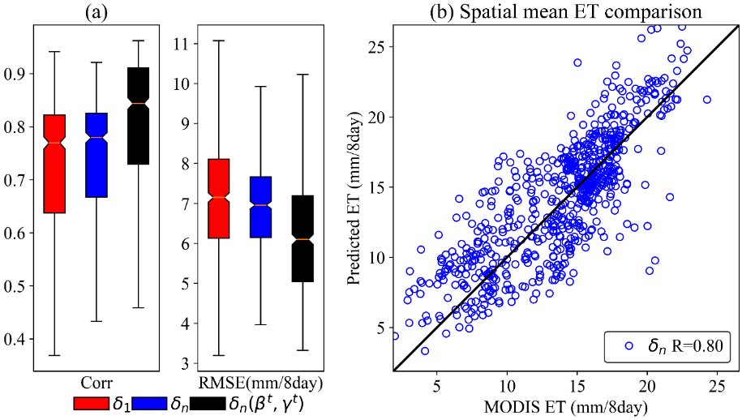
Differentiable, Learnable, Regionalized Process-Based Models with Multiphysical Outputs can Approach State-Of-The-Art Hydrologic Prediction Accuracy
Objectives
Develop differentiable hydrologic models to systematically integrate machine learning and physical models
Use differentiable modeling framework to learn from data and evolve the structure of physical models to gain better performance
Examine the performance level of differentiable models for streamflow prediction compared to state-of-the-art long short-term memory (LSTM) models
Examine the simulations of the untrained hydrologic variables from differentiable models such as ET and discharge components with independent observations
Conclusions
Differentiable hydrologic models integrating physical models and deep learning can achieve similar streamflow prediction performance as state-of-the-art LSTM models
The structure of physical models is flexible to evolve under the differentiable modeling framework to obtain both high performance level and physical process clarity
Unlike LSTM model, only trained on streamflow data, differentiable models can also give decent simulations for other untrained variables like evapotranspiration (ET) and baseflow component of streamflow
Figures: Top panels are the performance comparison of different models for streamflow prediction using (a) Daymet and (b) NLDAS meteorological forcings. Bottom panels are ET simulations of differentiable models compared with independent MODIS ET observations in (c) temporal correlation and (d) spatial correlation of long-term mean.
Feng, D., Liu, J., Lawson, K., & Shen, C. (2022) Differentiable, learnable, regionalized process-based models with multiphysical outputs can approach state-of-the-art hydrologic prediction accuracy. Water Resources Research, 58, e2022WR032404. https://doi.org/10.1029/2022WR032404

Slide 4
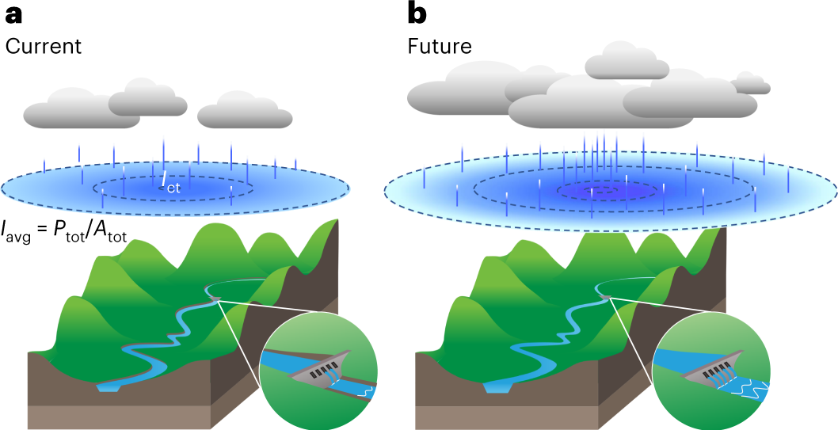
Future Sharpening of Winter Storms in the Western United States
Objective
Understand future changes in Western U.S. storm characteristics and their implications for flood risk and water resources management.
Approach
Conduct regional storm-resolving simulations for two periods, historical and future mid-century, under a high emissions scenario.
Track simulated storm events and evaluate storm spatial structure metrics (precipitation volume, area, and peak intensity).
Analyze how future warming affects the storm structure.
Impact
Identified a robust, ~31% increase in future storm precipitation by mid-century.
Decomposed the precipitation volume increase into contributions from increase in storm size (~22%) and mean intensity (~9%).
Revealed a storm-sharpening effect, with a larger increase in storm center intensity (~19%) compared to the mean intensity increase.
Future changes in storm spatial structure will challenge water infrastructure design and resource management.
Current and future winter storm characteristics in the Western United States. Compared to storms in the current climate (a), future storms (b) exhibit a 22% increase in spatial extent and a 9% increase in average intensity. This results in a 31% increase in total precipitation volume. The intensity near the storm center (+19%) increases faster than the overall average intensity (+9%), causing a spatial concentration of precipitation toward the storm center known as storm sharpening.
Chen, X., Leung, L. R., Gao, Y., Liu, Y. & Wigmosta, M. “Sharpening of cold-season storms over the western United States,” Nature Climate Change 13, 167–173 (2023). [DOI: 10.1038/s41558-022-01578-0]

Slide 5
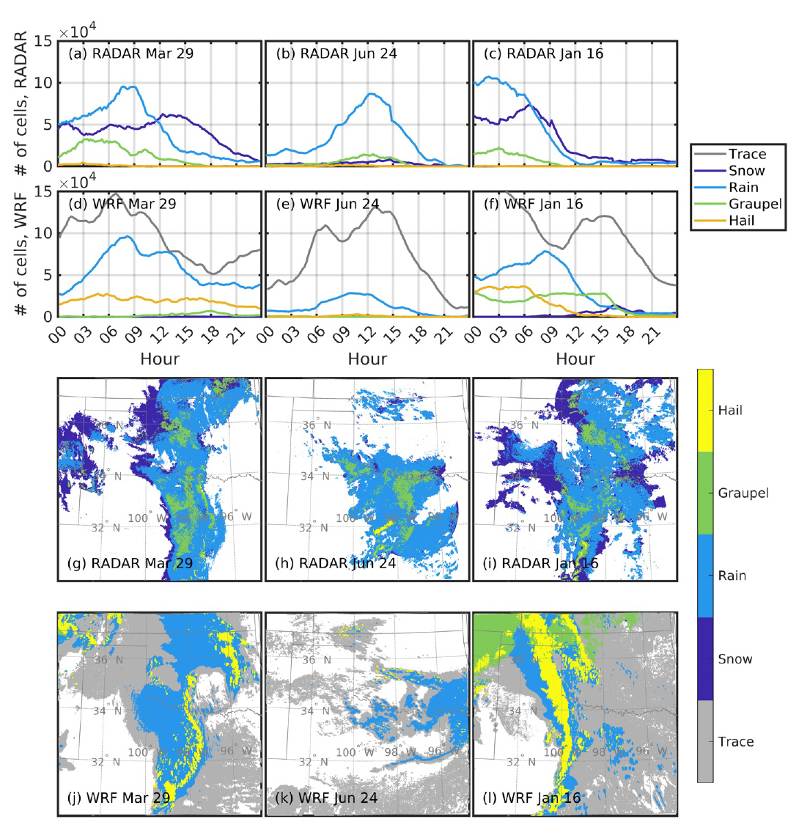
Deep convection in the Southern Great Plains (SGP)
Scientific Achievement
Very high-resolution simulations with the Weather Research and Forecasting (WRF) model are performed and subject to uniquely detailed fidelity assessment. Although this simulation exhibits fidelity for the marginal probabilities of wind speed, rainfall rates, and hail occurrence, the joint probabilities of these properties and the maximum size of hail are, as yet, not sufficient to characterize potential damage to key renewable energy industries.
Significance and Impact
Extremely heavy rain and hail during convective events is challenging to simulate but represent important atmospheric hazards including to the renewable energy industry. Understanding the degree to which convection permitting simulations represent these phenomena is critical to informing needed improvements and contingent risk assessments..
Research Details
7-months of WRF simulations with grid spacing of 1.3km are performed for a large domain centered over the SGP and evaluated in terms of the fidelity of critical variables for applications to the wind and solar industries.
Hydrometeor classes during March 29, June 24 and January 16, 2017 as derived from dual-polarization RADAR and simulated by WRF using the Milbrandt-Yau microphysics scheme.
Pryor S.C., Letson F.W., Shepherd T. and Barthelmie R.J. (2023): Evaluation of WRF simulation of deep convection in the US Southern Great Plains. Journal of Applied Meteorology and Climatology 62 41-62 doi: 10.1175/JAMC-D-22-0090.1

Slide 6
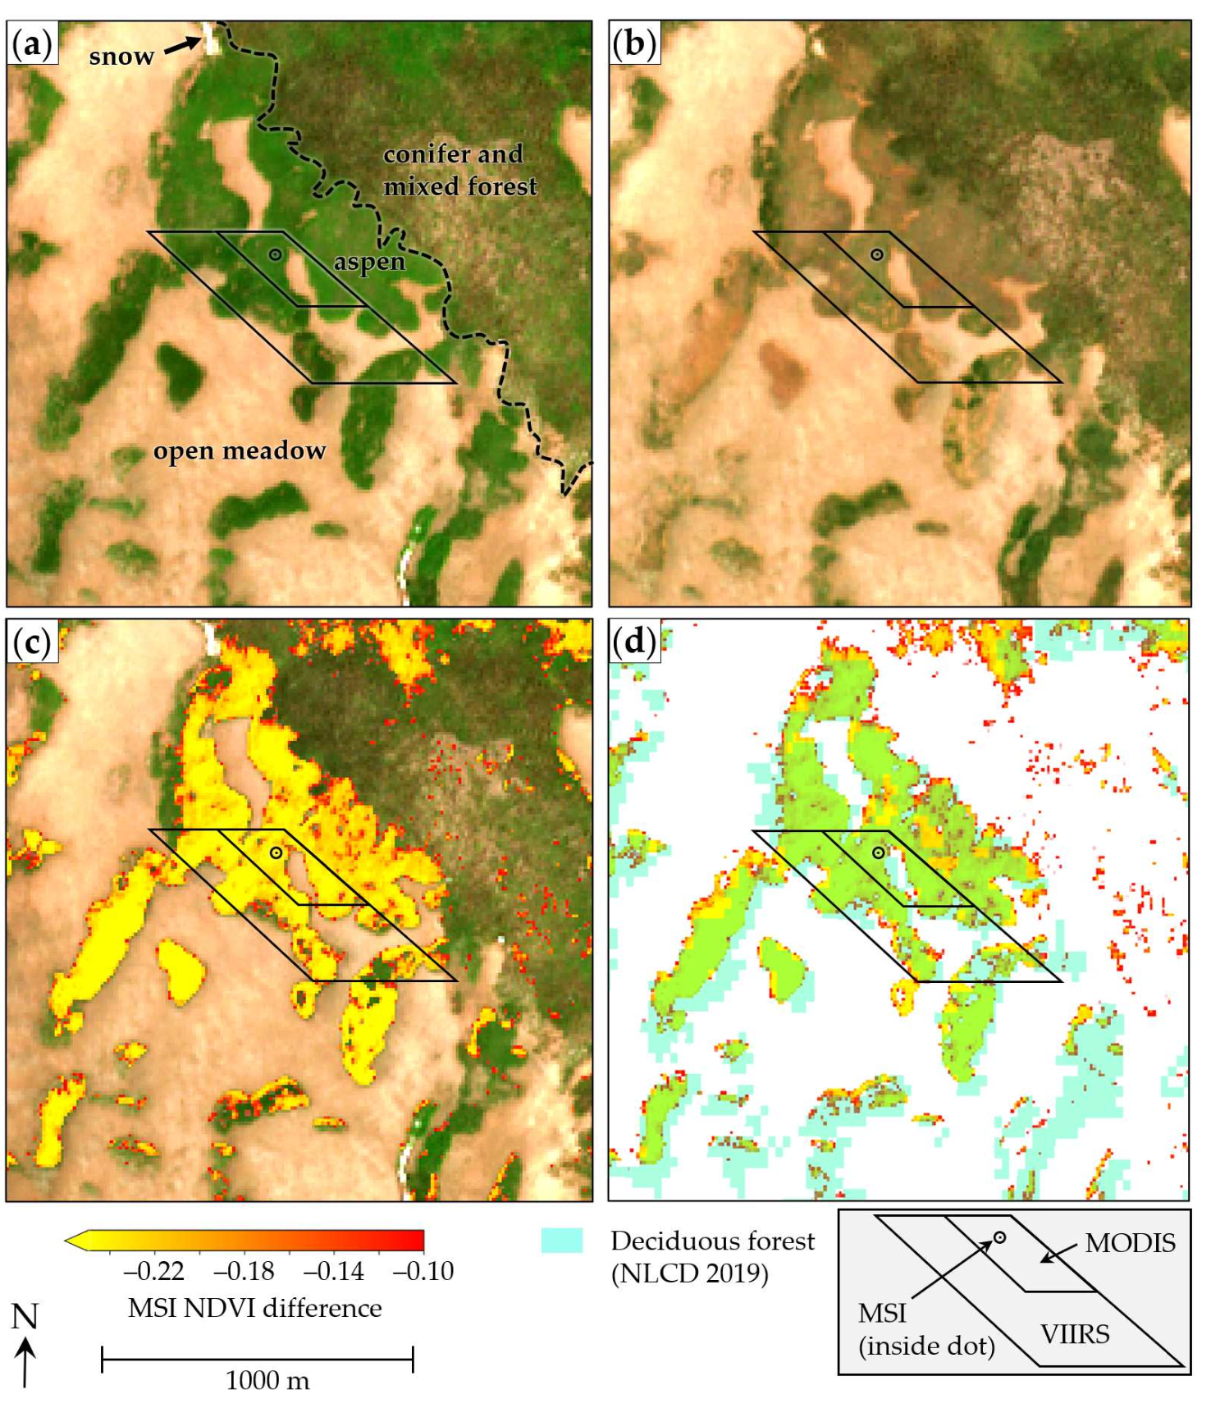
Visible Colors (06/01/2020)
1-month later

