Slide 1
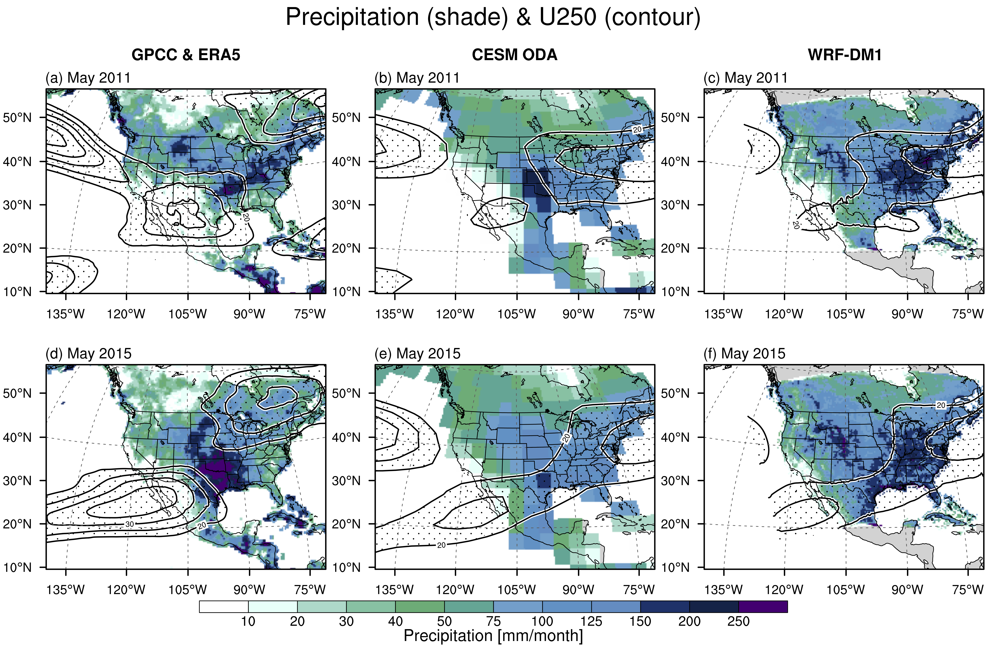
Enhancing Extreme Precipitation Predictions With Dynamical Downscaling:
A Convection-Permitting Modeling Study in Texas and Oklahoma
Objective
To enhance the prediction accuracy of extreme precipitation events, such as severe floods and droughts, in Texas and Oklahoma by using high-resolution dynamical downscaling techniques.
Approach
This study employs ensemble-based regional climate simulations using the Weather Research and Forecasting model (WRF) at the convection-permitting resolution, downscaled from the Community Earth System Model (CESM) coupled with an ocean data assimilation technique. The focus is on assessing model performance for two extreme wet and dry years.
Impact
The research demonstrates that dynamical downscaling can significantly improve the representation of extreme precipitation events, enhancing the predictive skill of climate models for future extreme weather events at sub-seasonal to seasonal lead times.
Figure: Jet stream and precipitation simulated by CESM ocean data assimilation run and WRF-downscaled product. This figure contrasts the observed upper-level wind patterns and the relative strengths of the subpolar and subtropical jet streams between May 2011 and May 2015. Both models captured the stronger subtropical jet in May 2015, as shown in the bottom panels. Additionally, WRF provides an improved simulation of the spatial pattern of heavy precipitation under this subtropical jet.
Chang, H.-I., Chikamoto, Y., Wang, S. S.-Y., Castro, C. L., LaPlante, M. D., Risanto, C. B., Huang, H, and Bunn, P. (2024): Enhancing extreme precipitation predictions with dynamical downscaling: A convection-permitting modeling study in Texas and Oklahoma. Journal of Geophysical Research: Atmospheres, 129, e2023JD038765. doi:10.1029/2023JD038765.

