Slide 1
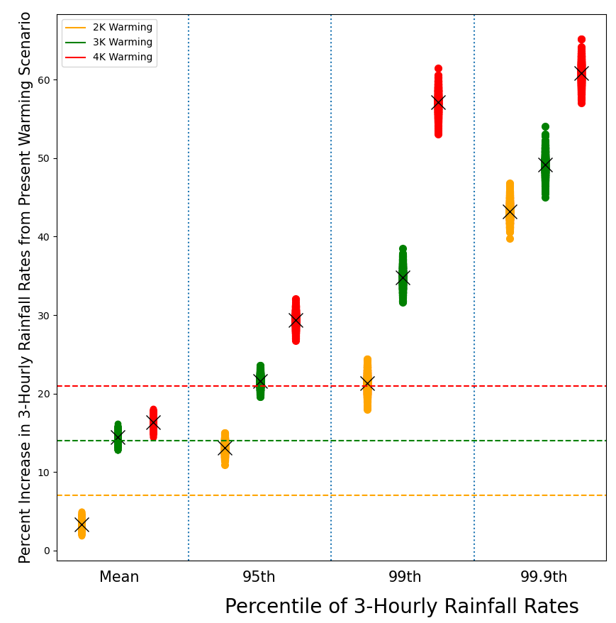
A storyline analysis of Hurricane Irma's precipitation under various levels of climate warming
Objective
Quantify how much more precipitation Hurricane Irma would produce if it occurred in a climate that was 2 K, 3 K, or 4 K warmer than the pre-industrial climate
Analyze both Hurricane Irma’s total precipitation over Florida and the full distribution of precipitation from the storm
Approach
Use CAM5 to run “hindcast” ensemble simulations of Hurricane Irma under a present climate scenario and three warming scenarios that are 2 K, 3 K, and 4 K warmer than the pre-industrial climate
Impact
Irma’s 3-hourly precipitation rates increased more at higher percentiles of the distribution (See figure to the right)
Over Florida, Irma’s mean rainfall accumulations increase by 16–26% K⁻¹ in the warming scenarios compared to the present climate scenario, with local maxima increasing by 18–43% K⁻¹. The increases monotonically increased by the scenario’s warming level.
Part of these increases in precipitation may come from the increase in Irma’s intensity in the warmer climate scenarios
Percent increases in Hurricane Irma's 3-hourly precipitation rates in the 2 K (yellow), 3 K (green), and 4 K (red) warming scenarios compared to the present warming scenario. The x-axis shows different precipitation metrics. The X markers denote the average percent increase of these samples, and the colored dots behind the X markers show the spread of the percent increases from the individual samples. The colored dashed horizontal lines show the expected precipitation increases based solely on the Clausius-Clapeyron relationship (e.g., 7% increase for the 2 K warming scenario, which is 1 K warmer than the present warming scenario).
Huprikar, A., A. M. Stansfield and K. A. Reed (2024): A Storyline Analysis of Hurricane Irma's Precipitation Under Various Levels of Climate Warming. Environmental Research Letters, 19, 014004, https://iopscience.iop.org/article/10.1088/1748-9326/ad0c89

