Slide 1
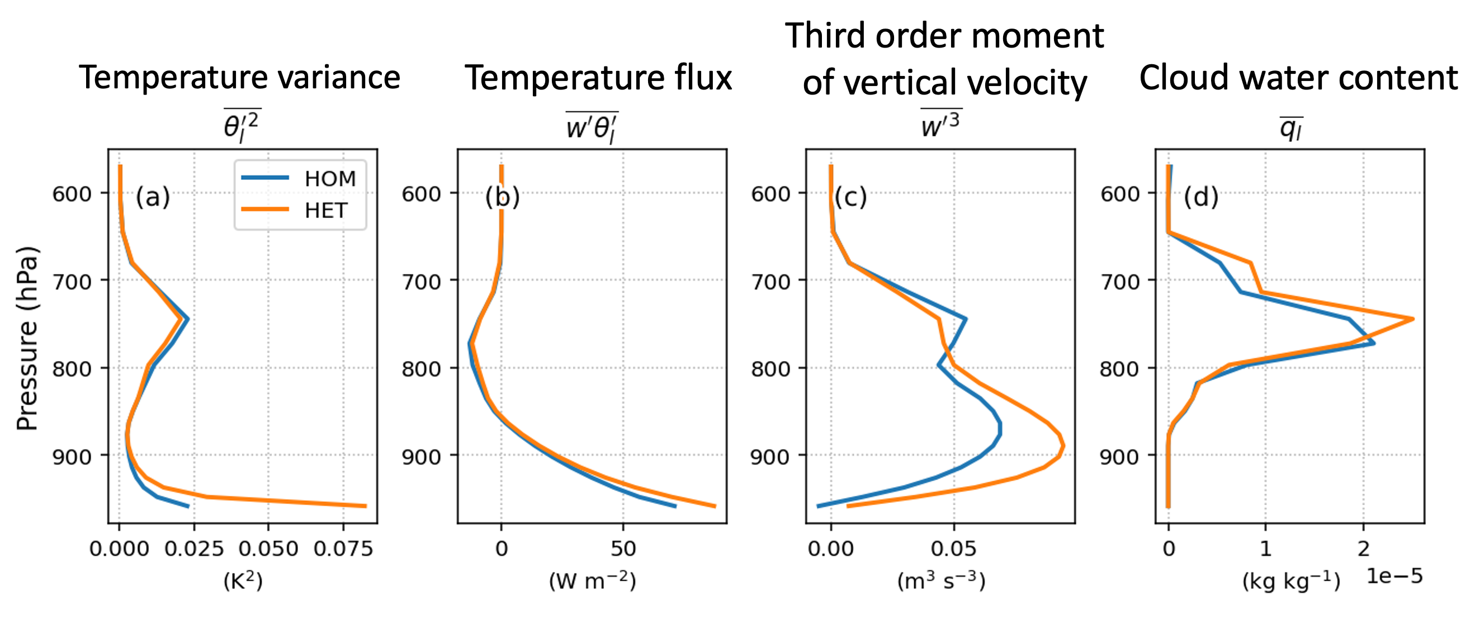
Assessing How the Atmosphere Responds to Land Surface Diversity
Objective
Present a new land-atmosphere coupling parametrization that accounts for the spatial diversity of land types and understand its implications for the evolution of the atmosphere and clouds.
Approach
Enable tight land-atmosphere coupling via temperature and moisture (co)variances calculated for each land surface type employed in the land model.
Compare the new parameterization with the original treatment used in the Energy Exascale Earth system model (E3SM) by running E3SM in a single-column mode configuration over a well-observed site in the central U.S.
Impact
Land surface diversity can influence low-level clouds via turbulent fluxes in the atmospheric boundary layer.
The cloud response to land surface conditions highlights the importance of better representing diverse landform types in land-atmosphere interactions and their further implementation in global E3SM simulations.
The new land-atmosphere coupling parameterization (orange lines) introduces more subgrid-scale surface variability than the original treatment (blue lines). This increase in temperature variance extends from the surface to the lower atmospheric boundary layer, affects the turbulent fluxes, and ultimately leads to a significant increase in the cloud water mixing ratio.
Huang, M., Ma, P.-L., Chaney, N. W., Hao, D., Bisht, G., Fowler, M. D., Larson, V. E. and Leung, L. R. “Representing surface heterogeneity in land-atmosphere coupling in E3SMv1 single-column model over ARM SGP during summertime”, Geoscientific Model Development, 15, 6371-6384 (2022). [DOI: 10.5194/gmd-15-6371-2022]
Notes:
http://www.pnnl.gov/science/highlights/highlights.asp?division=749

