Slide 1
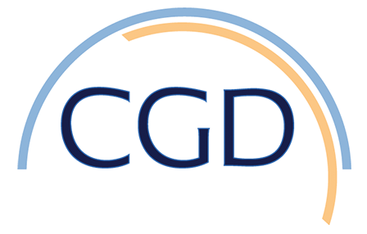

Diverse Impacts of the Indian Ocean Dipole on El Niño–Southern Oscillation
Objective: Exploring the interactions between Indian Ocean Dipole (IOD) and ENSO is not only important for predicting climate but also crucial for understanding and predicting marine ecosystem changes. In this study, we present a new mechanism for the impact of positive IOD on ENSO, in which the warm pool dipole acts as a bridge between the IOD and ENSO, and our conclusions are drawn from observational analyses combined with model experiments using a state-of-the-art climate model.
Approach: SST datasets are HadISST and ERSSTv3b, winds are from ERA-20C reanalysis, sea level data is from AVISO; Model simulations are the Pacific and Indian Ocean pacemaker experiments using CESM1.
Results/Impacts:Through analysis of observational datasets and numerical experiments using a state-of-the-art climate model, we investigate the impacts of the pIOD on the simultaneous development of ENSO. Our results show that approximately one-third of the historical pIOD events are forced by El Niño, and they in turn tend to amplify El Niño. This result seems consistent with some of the previous findings, but different from the studies that use observational data in more recent periods. The discrepancy could be attributable to the decadal variations in the IOD–ENSO relationship and/or data quality issue during the early twentieth century due to the sparse observations. Furthermore, although changes in the IOD–ENSO correlation may be due to decadal variations in the ENSO variance and changes in the ENSO flavors, its causes may need further investigation. In addition, the IOGA experiments also show that 45% of the pIOD events were followed by La Niña in the next year in the model (not shown), which is consistent with the previous finding that a pIOD may favor La Niña in the following year.
Figure 1. (a) The SON DMI during observed pIOD years. Blue denotes DMI in observations, and red is for POGA pacemaker experiments. The pIOD years are separated into ENSO independent events, denoted by ‘‘Ind.’’ (left side; 13 events) and ENSO-dependent events, denoted by ‘‘D.’’ (right side; 7 events), based on whether the DMI in the ensemble average of POGA experiments (which isolates the tropical Pacific forcing) exceeds 25% of the DMI in observations. The error bar denotes the uncertainty defined as 90th confidence interval across the 10 ensemble members. The blue dashed line denotes 1 standard deviation of the DMI in observations. (b) As in (a), but for DJF Niño-3.4 index during the pIOD years in observations (blue) and IOGA pacemaker experiments (red). The red ovals mark the five years when the Ind. pIOD causes El Niño, and the blue ovals mark the three years when the pIOD causes La Niña.
Zhang, L., W. Han, G. A. Meehl, A. Hu, N. Rosenbloom, T. Shinoda, M. J. McPhaden, 2021, Diverse impacts of Indian Ocean Dipole on El Niño-Southern Oscillation, J Climate, 34, 9057-9070.

