Slide 1
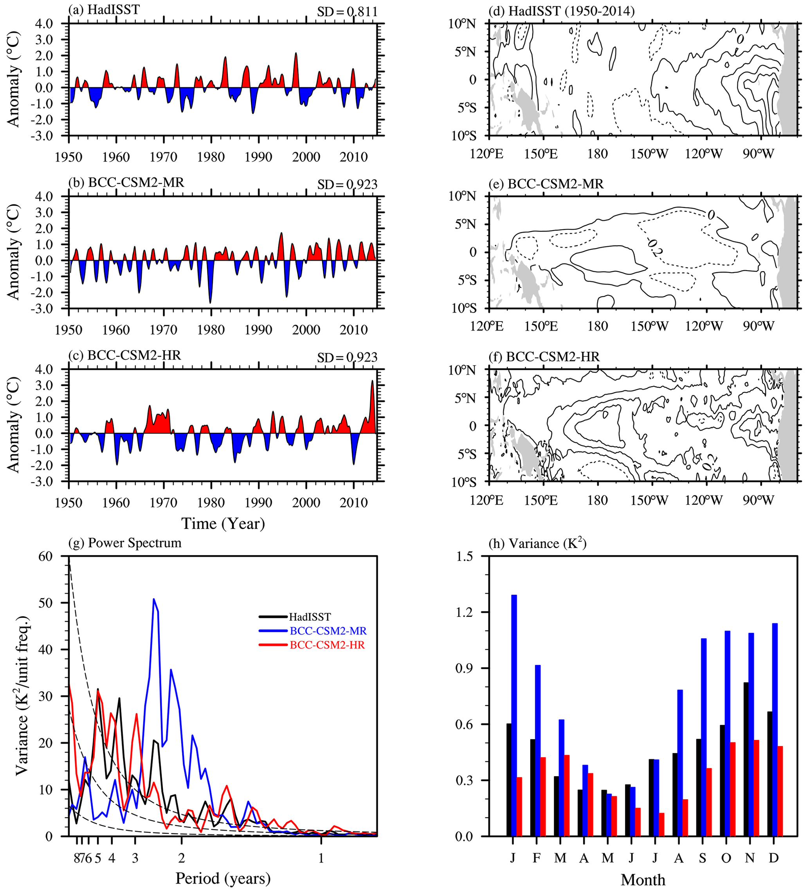
BCC-CSM2-HR: A High-Resolution Version of the Beijing Climate Center Climate System Model
Objective: This study documents the high-resolution model, highlights major improvements in the representation of atmospheric dynamical core and physical processes. BCC-CSM2-HR is evaluated for historical climate simulations from 1950 to 2014, performed under CMIP6-prescribed historical forcing, in comparison with its previous medium-resolution version BCC-CSM2-MR.
Approach: Here two versions of the BCC climate models are compared: BCC-CSM2-MR and BCC-CSM2-HR.
Results/Impacts: BCC-CSM2-HR represents the global energy balance well and can realistically reproduce the main patterns of atmospheric temperature and wind, precipitation, land surface air temperature, and sea surface temperature (SST). It also improves the spatial patterns of sea ice and associated seasonal variations in both hemispheres. The bias of the double intertropical convergence zone (ITCZ), obvious in BCC-CSM2-MR, almost disappears in BCC-CSM2-HR. TC activity in the tropics is increased with resolution enhanced. The cycle of ENSO, the eastward propagative feature and convection intensity of MJO, and the downward propagation of QBO in BCC-CSM2-HR are all in a better agreement with observations than their counterparts in BCC-CSM2-MR. Some imperfections are, however, noted in BCC-CSM2-HR, such as the excessive cloudiness in the eastern basin of the tropical Pacific with cold SST biases and the insufficient number of tropical cyclones in the North Atlantic.
Figure 1. The time series of monthly Niño3.4 SST (5∘ N–5∘ S, 170–120∘ W) anomalies and spatial distribution of their skewness for (a, d) HadISST observation, (b, e) BCC-CSM2-MR, and (c, f) BCC-CSM2-HR during the period 1950–2014. Panels (g) and (h) show their power spectrums and variances, respectively, and the black, blue, and red solid lines denote the results from HadISST, BCC-CSM2-MR, and BCC-CSM2-HR.
Wu, T., R. Yu, Y. Lu, W. Jie, Y. Fang, J. Zhang, L. Zhang, X. Xin, L. Li, Z. Wang, Y. Liu, F. Zhang, F. Wu, M. Chu, J. Li, W. Li, Y. Zhang, X. Shi, W. Zhou, J. Yao, X. Liu, H. Zhao, J. Yan, M. Wei, W. Xue, A. Huang, Y. Zhang, Y. Zhang, Q. Shu, A. Hu, 2021, BCC-CSM2-HR: A High-Resolution Version of the Beijing Climate Center Climate System Model, Geoscientific Model Development, 14, 2977-3006.

