Slide 1
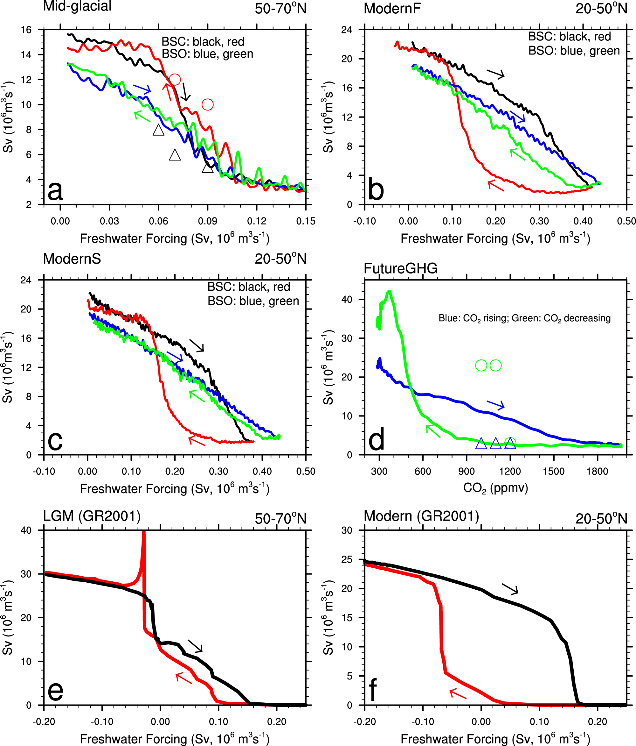
Dichotomy between freshwater and heat flux effects on oceanic conveyor belt stability and global climate
Objective: The Atlantic meridional overturning circulation is an important global-scale oceanic circulation, and its changes may be responsible for past abrupt climate change events. By using two versions of a coupled climate model, we study whether the stability of this circulation will depend on the background climate and the type of primary external forcing: freshwater vs. greenhouse gases.
Approach: CCSM3 is used to run three paired simulations with everything identical except one with open Bering Strait and the other a closed Bering Strait. These simulations are run for 3000 years under glacial condition, and 4500/9000 years under modern conditions. CCSM4 is used to run one simulation from 1850 to 2300 under historical and RCP8.5 forcings, then with stabilized 2300 level forcing for 300 year before the forcing is reversed from RCP8.5 at 2300 level back to historical 1850 level.
Results/Impacts: The existence of AMOC hysteresis due to freshwater forcing alone does not depend on the background mean climate but rather on the status of the Bering Strait. AMOC hysteresis exists/absence with a closed/open Bering Strait due to the negative feedback of the throughflow across the Bering Strait that prevents the AMOC from collapsing suddenly. With GHG forcing alone under modern geographic conditions, AMOC hysteresis can exist since the GHG forcing has modulated the negative feedback role for Bering Strait throughflow via changes in the hydrological cycle. Our results further suggest that with a collapsed AMOC, the surface temperature, precipitation, evaporation and cloudiness decrease in Northern Hemisphere, but increase in Southern Hemisphere. Under GHG forcing alone, the changes of these variables generally agree with those under freshwater forcing alone, and the differences show up mainly in the Polar Regions in association to the feedbacks due to the amplified warming there.
Hu A., G.A. Meehl, A. Abe-Ouchi, W. Han, B. Otto-Bliesner, F. He, T. Wu, N. Rosenbloom, W.G. Strand and J. Edwards, 2023, Dichotomy between freshwater and heat flux effects on oceanic conveyor belt stability and global climate, Communications Earth & Environment, 4, article number 246.
Figure 1. The AMOC hysteresis due to freshwater and GHG forcings. a AMOC hysteresis loop under mid-glacial climate conditions (15 ka before present day) with an open (BSO) and closed (BSC) Bering Strait and freshwater is added between 50 and 70ºN to the Atlantic (Mid-glacial); (b) the same as (a) but under modern climate conditions (1990AD) and freshwater is added between 20 and 50ºN to the Atlantic (ModernF); (c) the same as (b), but with an annual freshwater increment at 50% of that in (b) (ModernS); (d) AMOC hysteresis loop due to changes in greenhouse gas forcing (from 285 to 1962 ppmv; FutureGHG); (e) and (f) are partially adopted from Fig. 1a, b in ref. ¹² and labeled as GR2001.
Notes:
Full figure caption: a AMOC hysteresis loop under mid-glacial climate conditions (15 ka before present day) with an open (BSO) and closed (BSC) Bering Strait and freshwater is added between 50 and 70ºN to the Atlantic (Mid-glacial); (b) the same as (a) but under modern climate conditions (1990AD) and freshwater is added between 20 and 50ºN to the Atlantic (ModernF); (c) the same as (b), but with an annual freshwater increment at 50% of that in (b) (ModernS); (d) AMOC hysteresis loop due to changes in greenhouse gas forcing (from 285 to 1962 ppmv; FutureGHG); (e) and (f) are partially adopted from Fig. 1a, b in ref. ¹² and labeled as GR2001. Here we only included the AMOC hysteresis loop under last glacial maximum (LGM) conditions with freshwater being added into 50–70ºN of the Atlantic (e) and under modern conditions with freshwater being added into 20–50ºN of the Atlantic (f) in order to make these two panels comparable to (a–c). For (a–c), back/red lines are for closed Bering Strait simulations and blue/green lines for open Bering Strait simulations, and black/blue lines are the freshwater increasing phase and red/green lines for freshwater decreasing phase. Blue/green lines in (d) represent the greenhouse gas increasing/decreasing phase. For (e, f) which is created using data from Ganopolski and Rahmstorf¹², black line represents the freshwater flux increase phase and red line the decrease phase. To partially adapt Fig. 1a, b from ref. ¹², we used an online digitizer tool called “WebPlotDigitizer” (https://automeris.io/WebPlotDigitizer/) which is a free online software. The arrows indicate the direction of the freshwater or GHG changes, such that the arrows pointing right and down are for freshwater or GHG increasing phase and the arrows pointing left and up are for freshwater or GHG decreasing phase. The color of the arrows matches the color of the lines. The triangles and circles in Figs. 1a and d represent the quasi-equilibrium state of AMOC under different stabilized freshwater or CO₂ levels in the sensitivity experiments (see Table 1 and the method section for details). The triangles represent the AMOC states in rising freshwater or CO₂ phase and the circles represent the AMOC states in decreasing freshwater or CO₂ phase, and the color of the triangles and circle also matches the color of the corresponding experiments.

