Slide 1
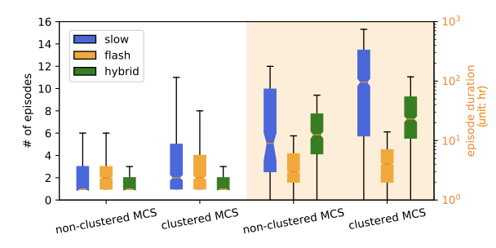
Clustered Mesoscale Convective Systems Produce Frequent and Long-Lasting Floods in the Central-Eastern U.S.
Objective
Examine the likelihood of flooding associated with mesoscale convective systems (MCSs) clustered in space and time and understand the factors that contribute to an increased flood risk for clustered MCSs compared to non-clustered MCSs.
Approach
Identify MCS clusters using a high-resolution MCS dataset.
Link clustered and non-clustered MCSs with flooding events from the Storm Events Database.
Examine how MCS characteristics and initial soil wetness affect flood occurrence.
Impact
Of flood-producing MCSs, a clustered MCS produces more and longer-lasting floods than a non-clustered MCS in the studied regime.
Clustered MCSs are more effective at producing floods than non-clustered MCSs due to their significantly greater rainfall volumes as well as wetter initial soil conditions.
The wetter initial soil conditions associated with clustered MCSs are induced by the successive rainfall from multiple MCSs within the same cluster in overlapping areas.
The significant role of clustered MCSs in producing floods highlights the importance of better understanding and modeling clustered MCSs.
Flood occurrence (left y-axis) and duration (right y-axis) associated with non-clustered and clustered MCSs over the central-eastern U.S. during April–August 2007–2017. The colors on the boxplots represent different flood types and show that clustered MCSs produce more floods than non-clustered MCSs. This is particularly clear for slow rising floods (blue). The floods associated with clustered MCSs also last significantly longer for all flood types.
Hu, H., Z. Feng, and L. R. Leung, “Quantifying Flood Frequency Associated with Clustered Mesoscale Convective Systems in the United States,” J. Hydrometeorol., 23, (2022). [DOI: 10.1175/JHM-D-22-0038.1]

