Slide 1
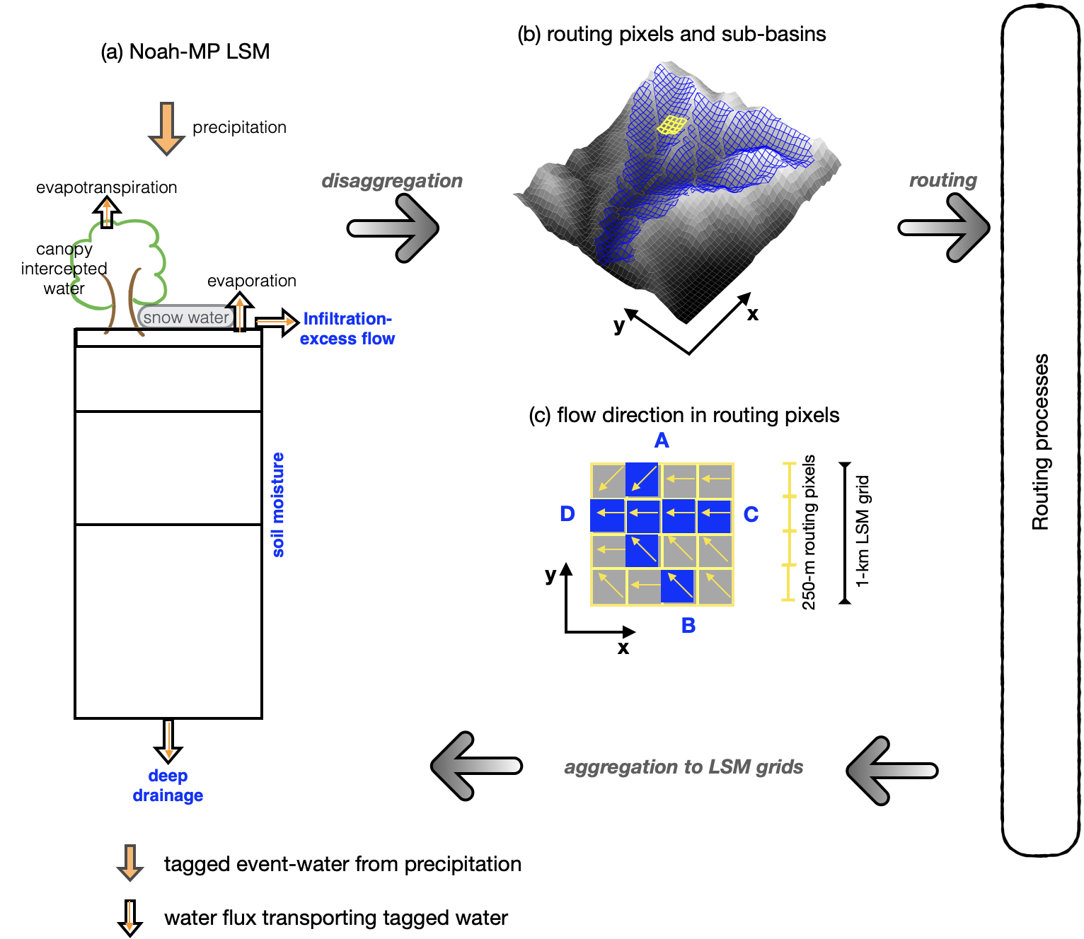
A Water Tracer Tool to Understand the Role of Lateral Flow in Hydrologic Simulations
Objective
Develop a water tracer tool and implementing it in the Weather Research and Forecasting Model Hydrological (WRF-Hydro) modeling system.
Use this tool to enhance physical understanding of the role of modeling lateral flow at the watershed scale.
Approach
In two sets of simulations with and without lateral flow, precipitation event-water is tagged using the water tracer tool to track how modeling lateral flow affects the process and timescale from precipitation to streamflow.
Test over two watersheds characterized by dry and wet hydroclimate regimes.
Impact
Lateral flow from ridges to valleys are fundamental organizers of water and energy at watershed scale, but lateral flow has been neglected in traditional land models. Integrate a water tracer model into WRF-Hydro revealing the role of modeling lateral flow in modulating the pathways and timescale that water moves from precipitation to streamflow.
Compared with simulations without lateral flow, accounting for lateral flow lengthens the time water travels in a watershed in the dry basin, while shortening the time in the wet basin.
The simulated time water spends in the wet watershed is substantially shorter than observations, indicating potential areas for improvement.
A schematic depiction of the water tracer tool in the WRF-Hydro framework. Precipitation-event water can be tagged using the water tracer tool as it interacts with different storages and fluxes in a vertical column (a) and lateral pathways at routing pixels (b). The lateral flow is mainly terrain driven, shown by an example in (c).
Hu, H., L. R. Leung, F. Dominguez, D. Gochis, X. Chen, S. Good, et al (2024), “Integrating a water tracer model into WRF-Hydro for characterizing the effect of lateral flow in hydrologic simulations”, Water Resources. Research, 60, e2023WR034938, doi:10.1029/2023WR034938

