Slide 1
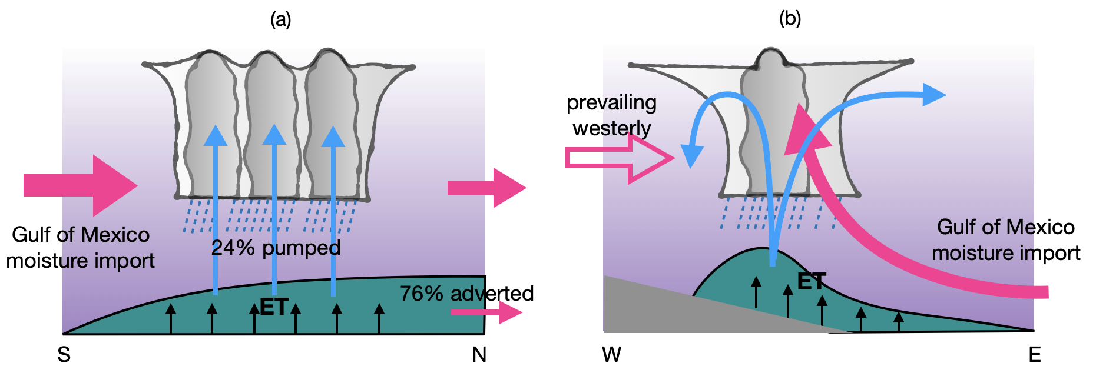
Mesoscale Convective Systems Pump Local Evapotranspiration Moisture Upward to Boost Moisture Recycling
Objective
Examine the contribution of moisture from local evapotranspiration (ET) to local precipitation (i.e., moisture recycling) associated with mesoscale convective systems (MCSs).
Understand the role of MCSs in mixing moisture from local ET vertically.
Approach
Use a water vapor tracer-enabled climate model to simulate May 2015, when more than 20 MCSs occurred over the southern Great Plains.
Use water vapor tracers to tag moisture from local ET and track its transport and contribution to MCS precipitation.
Impact
During May 2015, 76% of local ET is transported away from the southern Great Plains, while the remaining 24% is transported upward and contribute to moisture recycling.
MCSs play a key role in boosting moisture recycling due to their strong upward motion, particularly in the early phases of their lifecycle that pumps local ET to the upper atmosphere.
Local ET is not completely mixed with the background moisture, challenging traditional methods that quantify moisture recycling by assuming that moisture from local ET is well-mixed vertically with the background moisture.
A schematic depiction to illustrate moisture recycling associated with MCSs in the south-north cross-section (a) and west-east cross-section (b). Local evapotranspiration (green shading) from the southern Great Plains is mostly transported northward leaving the southern Great Plains (76%) while the remaining 24% is pumped upward due to the strong upward motion as MCS develops (a). The 24% local evapotranspiration pumped upward by the MCS splits into two branches in the upper atmosphere, with the westward branch primarily contributing to MCS precipitation (b). It is important to note that moisture from the Gulf of Mexico also provides important moisture supply for MCS precipitation (pink solid arrows in a and b).
Hu, H., L. R. Leung, Z. Feng and J. Marquis. “Moisture Recycling through Pumping by Mesoscale Convective Systems”, J Hydrometeorol., 25, 867–880 (2024). [DOI:10.1175/JHM-D-23-0174.1]

