Slide 1
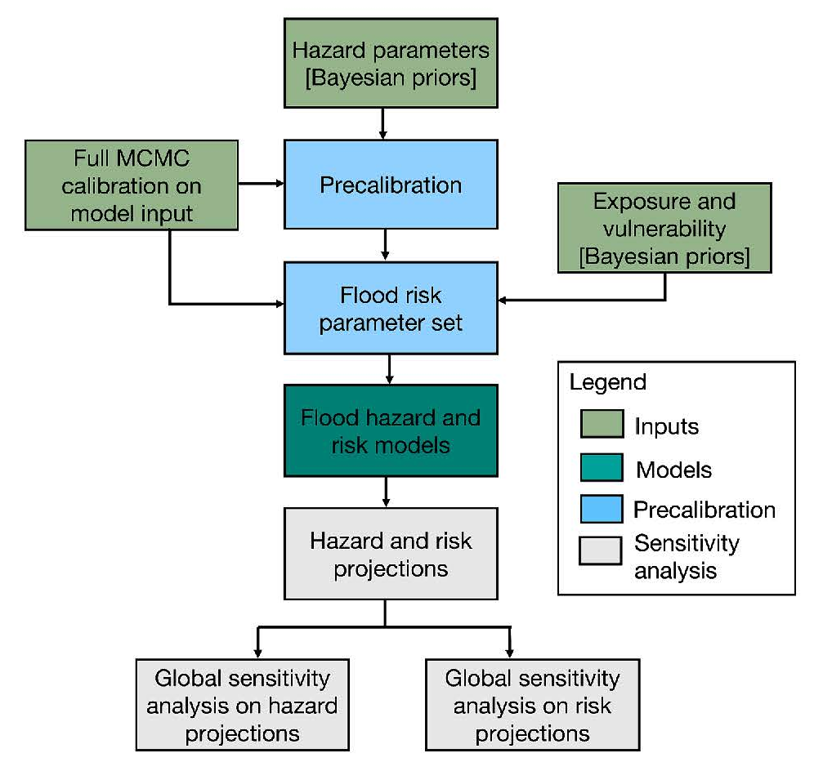
What drives uncertainty surrounding riverine flood risks?
Objective
Managing flood risks can be challenging due to significant uncertainties in flood risk projections, attributable to several factors such as boundary and initial conditions, model structures, parameters, and interactions between hazards, exposures, and vulnerabilities. These components and their interactions are frequently deeply uncertain.
Approach
Using a case study of Selinsgrove (Pennsylvania), we analyze and rank the drivers of uncertainties in riverine flood hazards and risks. With Sobol’ sensitivity analysis and a large number of simulations, we thoroughly examine the interactions among various sources of uncertainty following these steps: 1) sampling key uncertainties affecting estimates of hazard, exposure, and vulnerability; 2) propagating these factors to assess the uncertainty in risk estimates; 3) performing a global sensitivity analysis to quantify the relative contributions of these input uncertainties to the overall uncertainty in flood risk estimates.
Impact
We find that uncertainties about the flood hazards are the most important factor determining the uncertainty about flood risks. This insight is important to inform the design of studies to reduce future uncertainties about flood risks. Our findings suggest that reducing the uncertainties surrounding estimates of flood hazards (as opposed to factors influencing estimates of exposure and vulnerability) is a promising step.
Figure: Work flow diagram of global sensitivity analysis on flood hazard and flood risk.
Hosseini-Shakib, I., Alipour A., Lee B. S., Srikrishnan V., Nicholas R., Keller K., Sharma S. (2024). What drives uncertainties surrounding riverine flood risks? Journal of Hydrology (634). https://doi.org/10.1016/j.jhydrol.2024.131055

