Slide 1
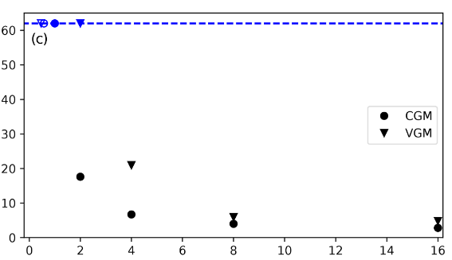
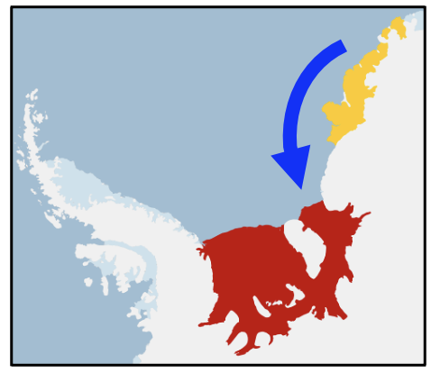
Meltwater Triggers for an Antarctic Ice-Shelf Melt Tipping Point
Objective
Filchner-Ronne Ice Shelf (FRIS), the 2nd largest ice shelf in Antarctica, is susceptible to a tipping point from a low to high ice-shelf basal melt regime and E3SM is prone to this occurring erroneously (Fig. 1)
Identify the controls on the FRIS instability and how they should be treated in a low-resolution global Earth system model
Approach
Compare E3SM v1.2 simulations with different treatments of 1) freshwater flux from icebergs; 2) mesoscale eddy parameterization; and 3) melting from ice shelves near FRIS
Evaluate FRIS melting behavior and ocean model biases under historical climate conditions
Findings & Impact
To avoid ocean model biases that lead to FRIS erroneously crossing the melt tipping point under historical climate conditions, E3SM requires a realistic distribution of iceberg melt and an ocean eddy parameterization that is spatially dependent.
Freshwater from increased melting of nearby ice shelves could potentially trigger the FRIS tipping point in a domino effect (Fig. 2)
Figure 1: Simulation of intrusion of warm offshore water mass into Filchner-Ronne Ice Shelf cavity as near-shore density blockage (turquoise line) becomes shallower. Ice-shelf basal melt rates subsequently increase by an order of magnitude.
No modeled tipping point occurs
Figure 2: Modeled occurrence of FRIS (red) melt tipping point with increasing meltwater release from nearby ice shelves (yellow).
Present day melt rate
Time to FRIS tipping point (yr)
Melt rate at nearby ice shelves (m yr⁻¹)
Citation: M.J. Hoffman, C.B. Begeman, X.S. Asay-Davis, D. Comeau, A. Barthel, S.F. Price, and J.D. Wolfe. 2024. “Ice-Shelf Freshwater Triggers for the Filchner–Ronne Ice Shelf Melt Tipping Point in a Global Ocean–Sea-Ice Model.” The Cryosphere 18 (6): 2917–37. https://doi.org/10.5194/tc-18-2917-2024.
Department of Energy • Office of Science • Biological and Environmental Research

