Slide 1
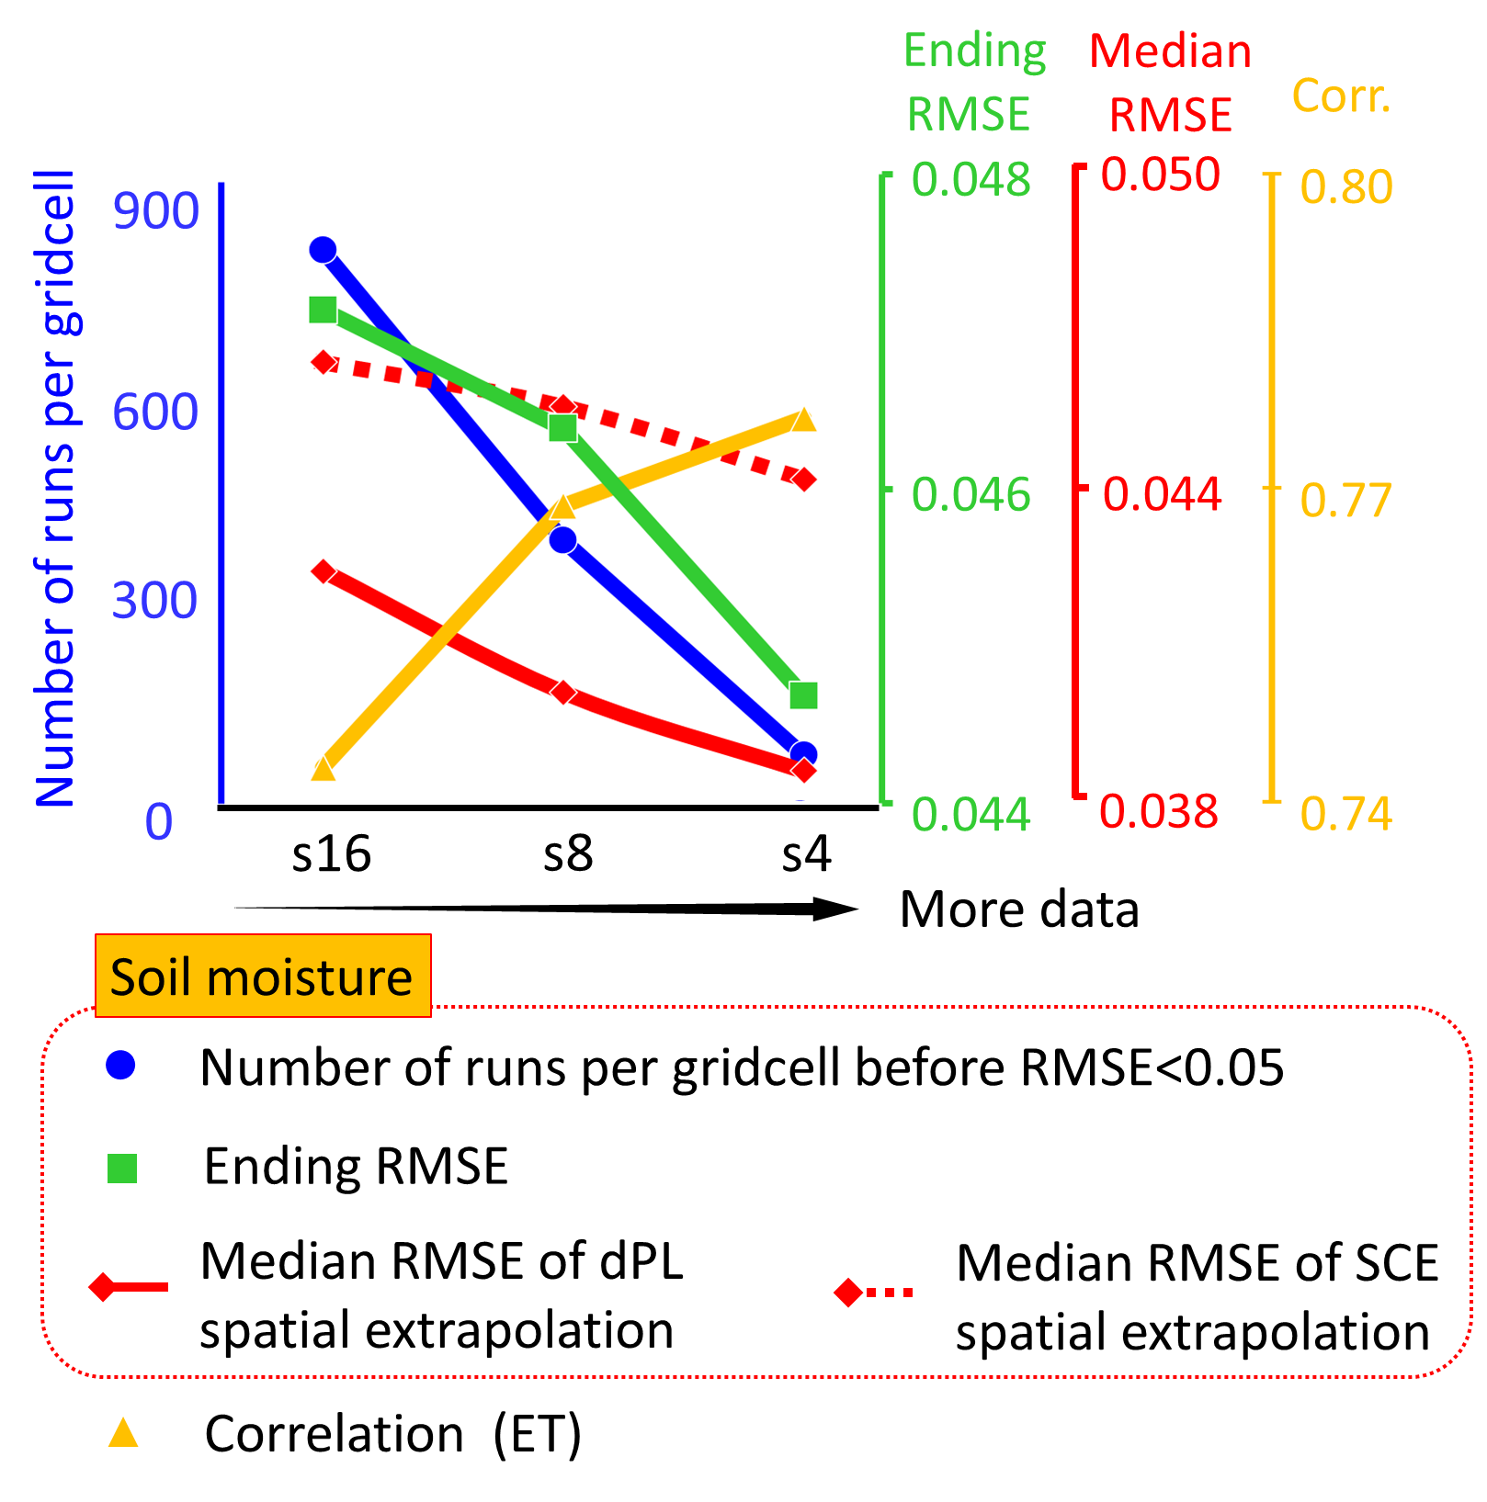
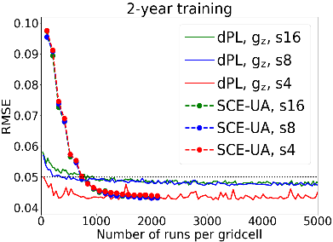
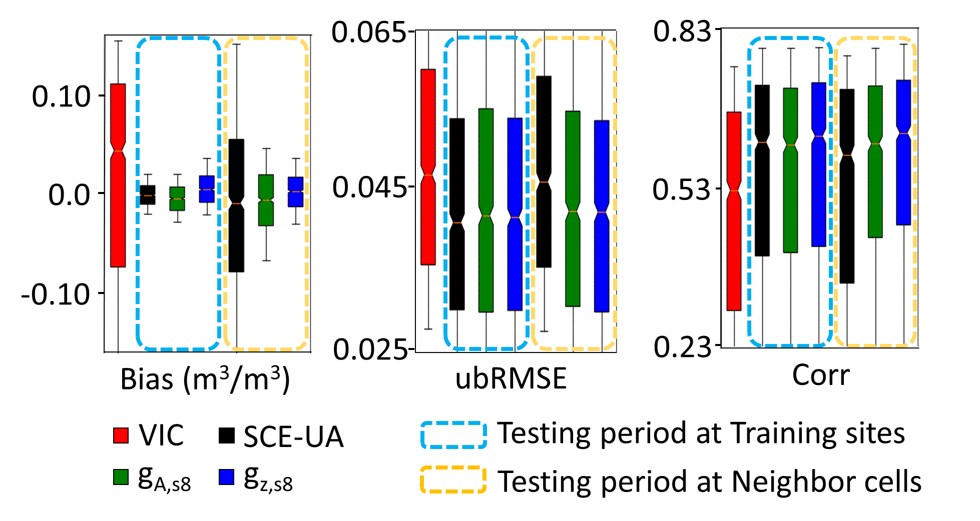
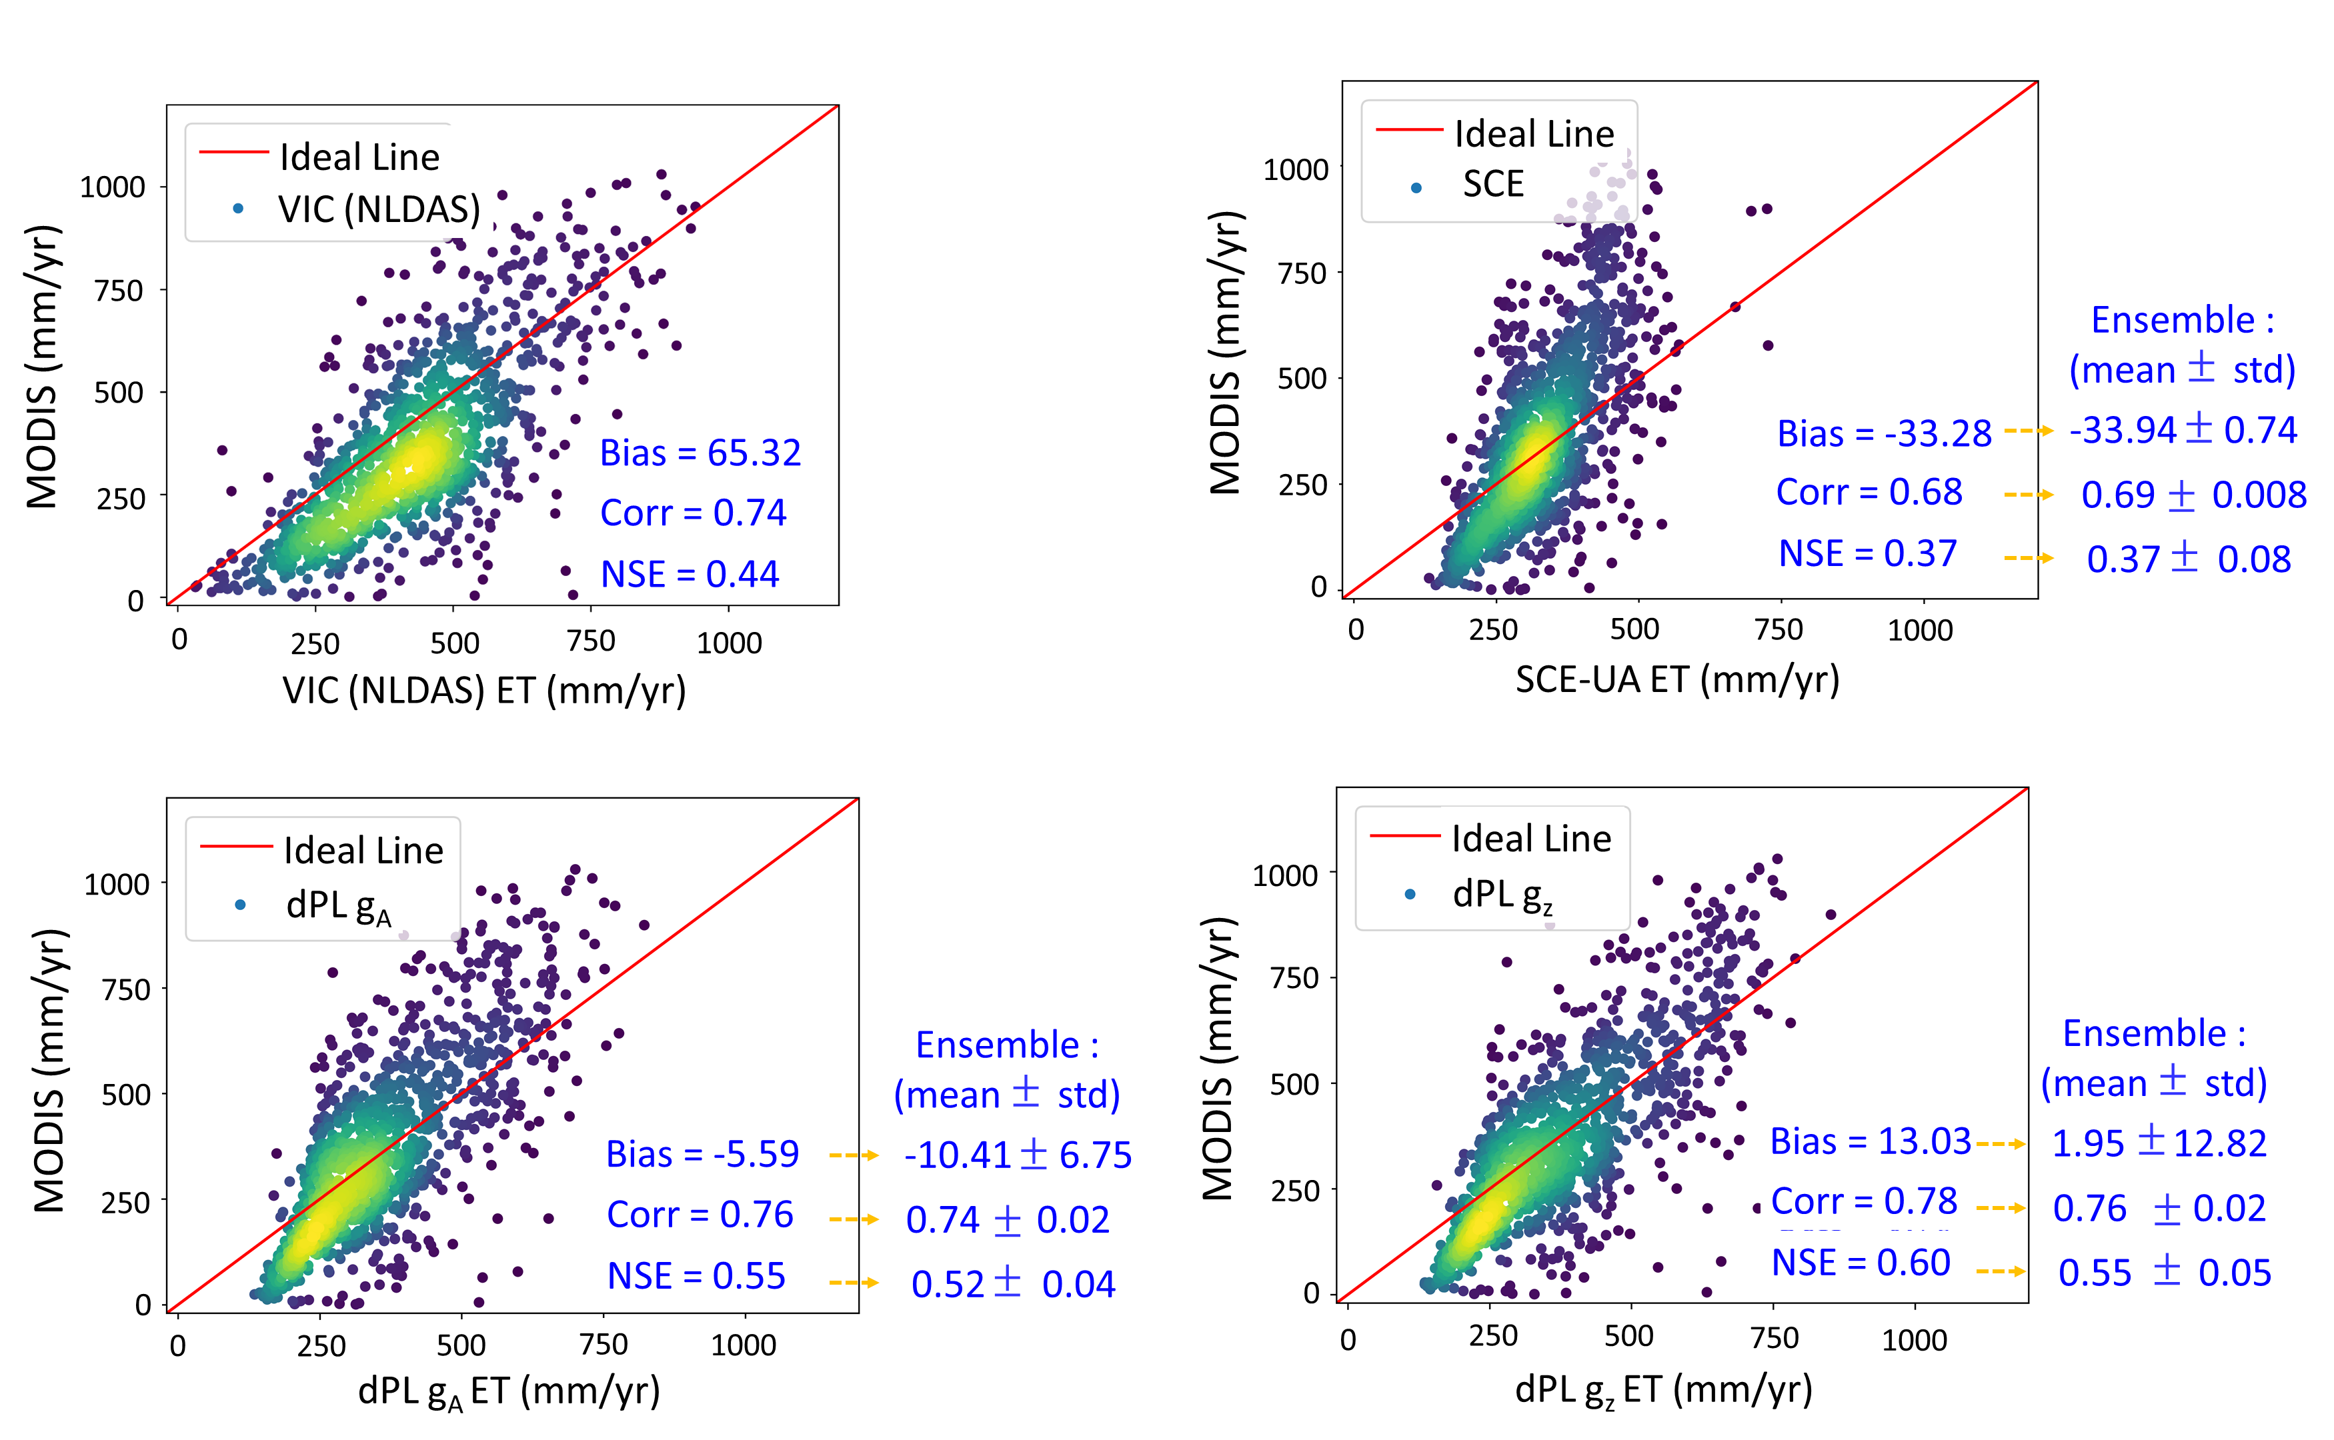
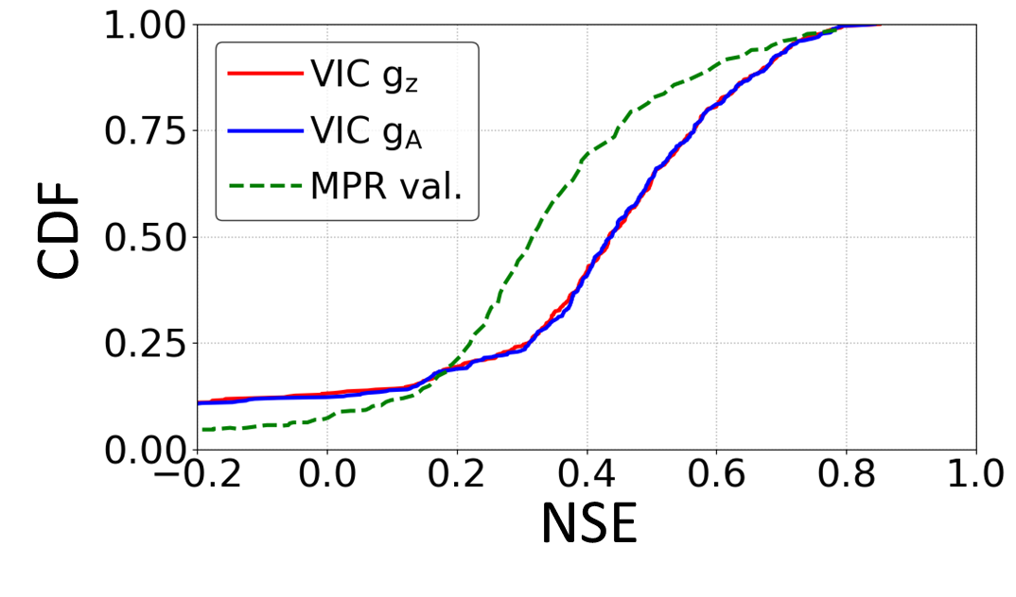
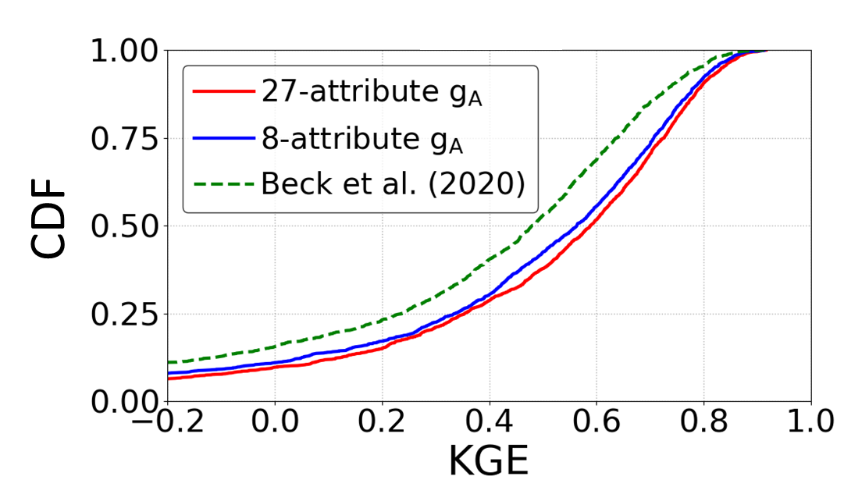
From calibration to parameter learning: Harnessing the scaling effects of big data in geoscientific modeling
(a)
(b)
(c)
Objective
Proposing a novel framework that efficiently learns a global mapping between inputs (and optionally responses) and parameters.
Approach
We proposed a differentiable parameter learning (dPL) framework based on deep neural networks, with two versions suitable for different use cases in geosciences.
The dPL framework contains a parameter estimation module that maps from raw input information to PBM parameters, which are then fed into a differentiable PBM.
Our framework transformed the typically inverse parameter calibration problem into a big-data DL problem, leveraging the efficiency and performance of the modern DL computing infrastructure.
(d)
(e)
(f)
Figures (a) RMSE for the models trained with 2 year’s worth of data; (b) Boxplots for temporal generalization and spatial generalization; (c) Scaling curves of dPL; (d) Uncalibrated variable (evapotranspiration, ET) metrics; (e) & (f) Comparison of dPL and regionalization schemes for streamflow calibration: (e) shows in comparison to Multiscale Parameter Regionalization (MPR), (f) shows in comparison to the Beck20 regionalization scheme.
Conclusions
dPL’s advantages largely arise from leveraging big data and the process commonalities and differences found therein.
dPL demonstrates the considerable advantage of binding DL training infrastructure with existing process-based geoscientific models via differentiable computing.
DL-supported dPL offers a generic, adaptive, and highly efficient solution to a large variety of models in geosciences and beyond.
Tsai, WP., Feng, D., Pan, M. et al. From calibration to parameter learning: Harnessing the scaling effects of big data in geoscientific modeling. Nat Commun. 12, 5988 (2021). https://doi.org/10.1038/s41467-021-26107-z

