Slide 1
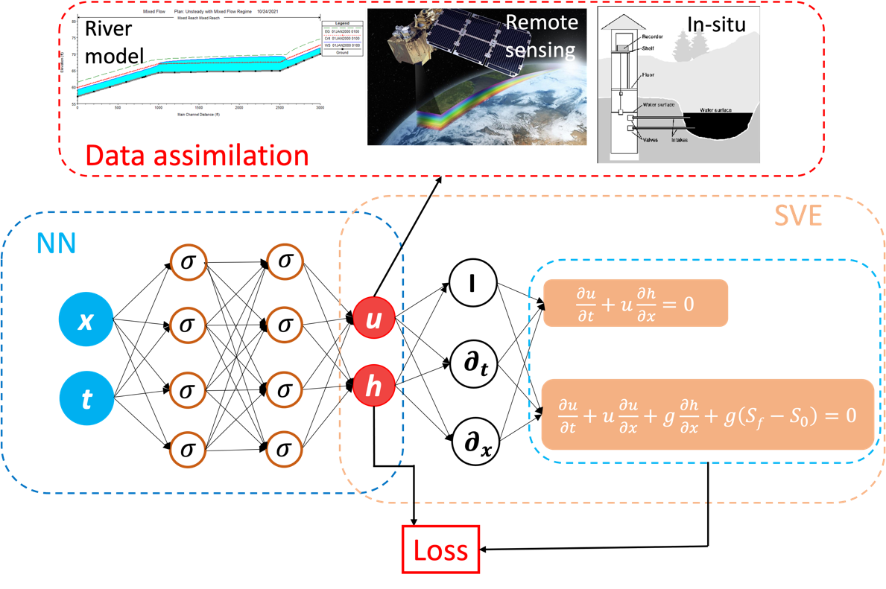
Downscaling a Large-Scale River Model Using Deep Learning
Objective
Propose a physics-informed deep learning approach to provide more accurate downscaled solutions for subregions of a large-scale river model, with a focus on resolving complex river-ocean flow dynamics.
Approach
Develop a data assimilation method based on physics-informed deep learning.
Create a framework to resolve the downscaled flow data within a large-scale river model subgrid by assimilating observational data.
Devise a new neural network architecture based on Fourier feature embeddings to address the periodic tidal boundary.
Impact
The proposed deep learning method can provide downscaled solutions of a large-scale model by integrating physics, numerical solutions, and observations.
The devised neural network architecture can be used to address the periodicity in the ocean boundary conditions.
This study presents a promising path toward supplementing large-scale models and better characterizing river-ocean dynamics in Earth system models.
A physics-informed neural network can be used to obtain the downscaled solution of a large-scale river model by solving one-dimensional flow equations and assimilating the numerical solution from the large-scale model, remote sensing images, and in situ measurements.
Feng, D., Tan, Z. and He, Q. “Physics-informed neural networks of the Saint-Venant equations for downscaling a large-scale river model,” Water Resources Research, 59, e2022WR033168
(2023). [DOI: 10.1029/2022WR033168]
Notes:
http://www.pnnl.gov/science/highlights/highlights.asp?division=749

