Slide 1
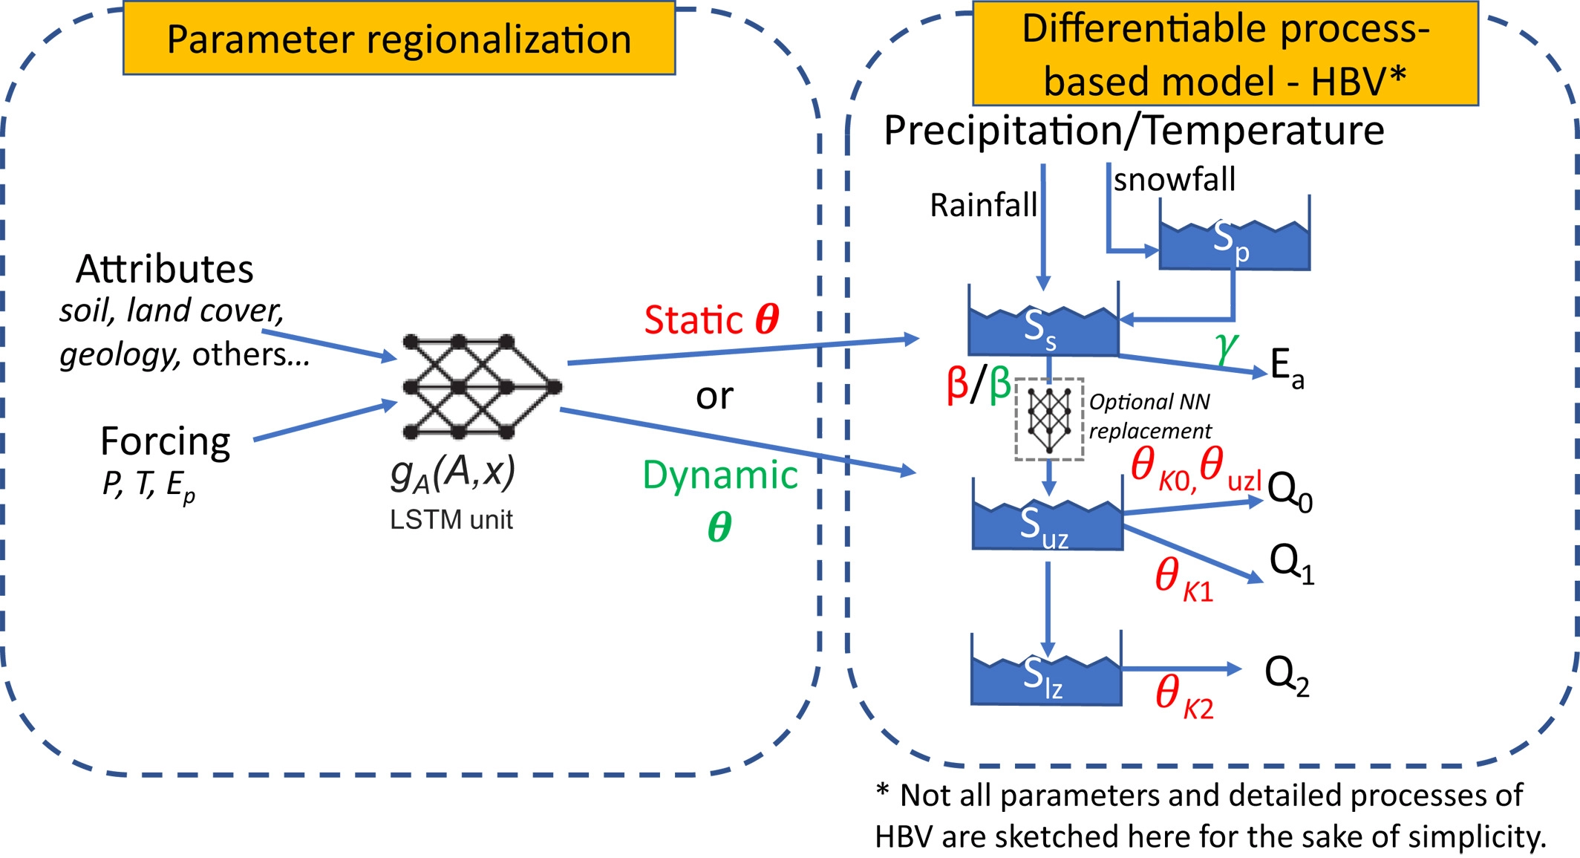
Differentiable, Learnable, Regionalized Process-Based Models With Multiphysical Outputs can Approach State-Of-The-Art Hydrologic Prediction Accuracy
Objective
Demonstrate a new hydrologic modeling paradigm where learnable, differentiable process-based models with embedded neural networks (NN) to provide parameterization or module replacements can achieve similar predictive performance as LSTM models
Approach
We used an existing process-based model (HBV) as a backbone, which can be based on either discrete (modifying from a backbone with discrete formulation) or continuous (written in a differential equation format) formulations.
The sketch of the differentiable model framework. A neural network gA (in this case a long short-term memory [LSTM] unit) outputs the physical parameters for a process-based model (here, the HBV hydrologic model). Each physical parameter can be set as either static or time-dynamic, and either way, there is no feedback from δ models' states to these LSTM-estimated parameters during a forward run. The process-based model supports differentiable programming as it is implemented on a machine learning platform. In the process-based models, certain parts of the model can be replaced by neural networks and the structure can be updated. Here, we also increased the number of storage components to represent sub-basin-scale heterogeneity. Notably, the framework is trained in an “end-to-end” fashion and there are no intermediate supervising data (or labels) for the outputs of the neural networks (either gA or the optional NN replacements). The main loss function is calculated between the process-based model output and observations—in our example, discharge—and the gradients are backpropagated all the way to these neural networks. Red symbols are static parameters and green symbols are time-dependent parameters.
Conclusions
Differentiable (δ) hydrologic models show that process clarity and a performance approaching deep learning (DL) can be both attained
Unlike DL, δ models can output untrained physical variables, which agreed well with alternative estimates
Dynamic parameterization has a moderate impact but is needed to narrow the gap to DL, suggesting that current model states are inadequate
Feng, D., Liu, J., Lawson, K., & Shen, C. (2022). Differentiable, learnable, regionalized process-based models with multiphysical outputs can approach state-of-the-art hydrologic prediction accuracy. Water Resources Research, 58(10), e2022WR032404. https://doi.org/10.1029/2022WR032404

