Slide 1
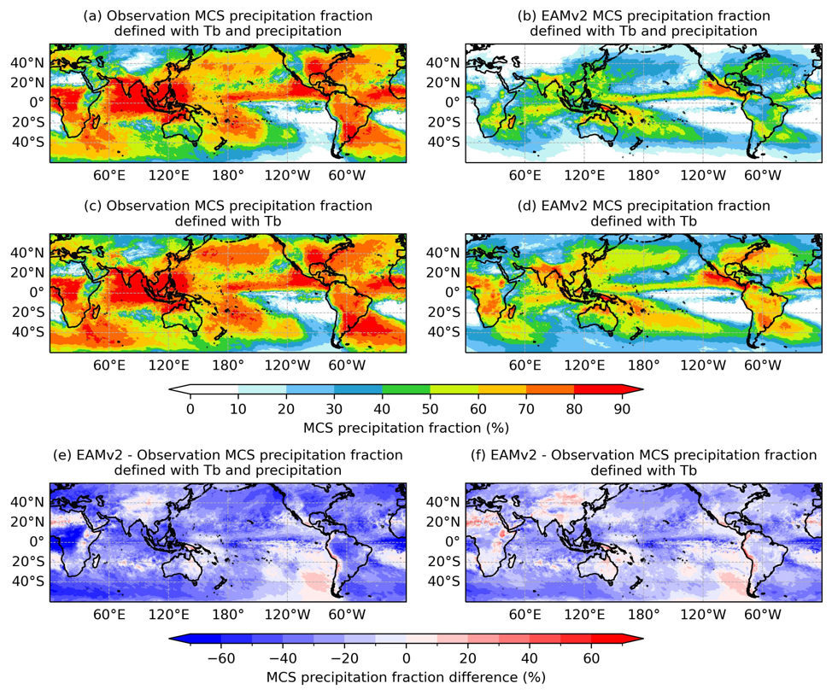
Mesoscale Convective Systems Represented in High Resolution E3SMv2 and Impact of New Cloud and Convection Parameterizations
Objective
Evaluate the E3SMv2 capability to capture mesoscale convective systems.
Approach
A series of 6-year AMIP simulations were conducted with E3SMv2 at ~ 25km grid spacing. The new physics tested include the predicted particle properties (P3) microphysics scheme, a two-moment convective cloud microphysics scheme, a new closure for the Zhang-McFarlane deep convection parameterization, and the multiscale coherent structure parameterization (MCSP) for mesoscale organization.
Two different MCS tracking methods are used to investigate its impact on MCS identification and provide more complete information.
Impact
Simulated MCS precipitation is substantially underestimated in E3SMv2 due to insufficient MCS genesis and rain rate in individual MCSs.
Utilizing different MCS tracking methods provides a more complete picture about the model capability in simulating MCSs.
MCS properties in E3SMv2 are not significantly improved with the new cloud and convection parameterizations developed for E3SMv3.
MCS Precipitation Fraction (%)
Annual mean MCS precipitation fraction defined using T_{b} and surface precipitation (a, b) and MCS precipitation fraction defined using T_{b} only (c, d). The IMERG observation is shown on the left and EAMv2 simulation is shown on the right.
Zhang, M., Xie, S., Feng, Z., Terai, C. R., Lin, W., Tao, C., et al. (2024). Mesoscale convective systems represented in high resolution E3SMv2 and impact of new cloud and convection parameterizations. Journal of Geophysical Research: Atmospheres, 129, e2024JD040828. https://dx.doi.org/10.1029/2024JD040828.

