Slide 1
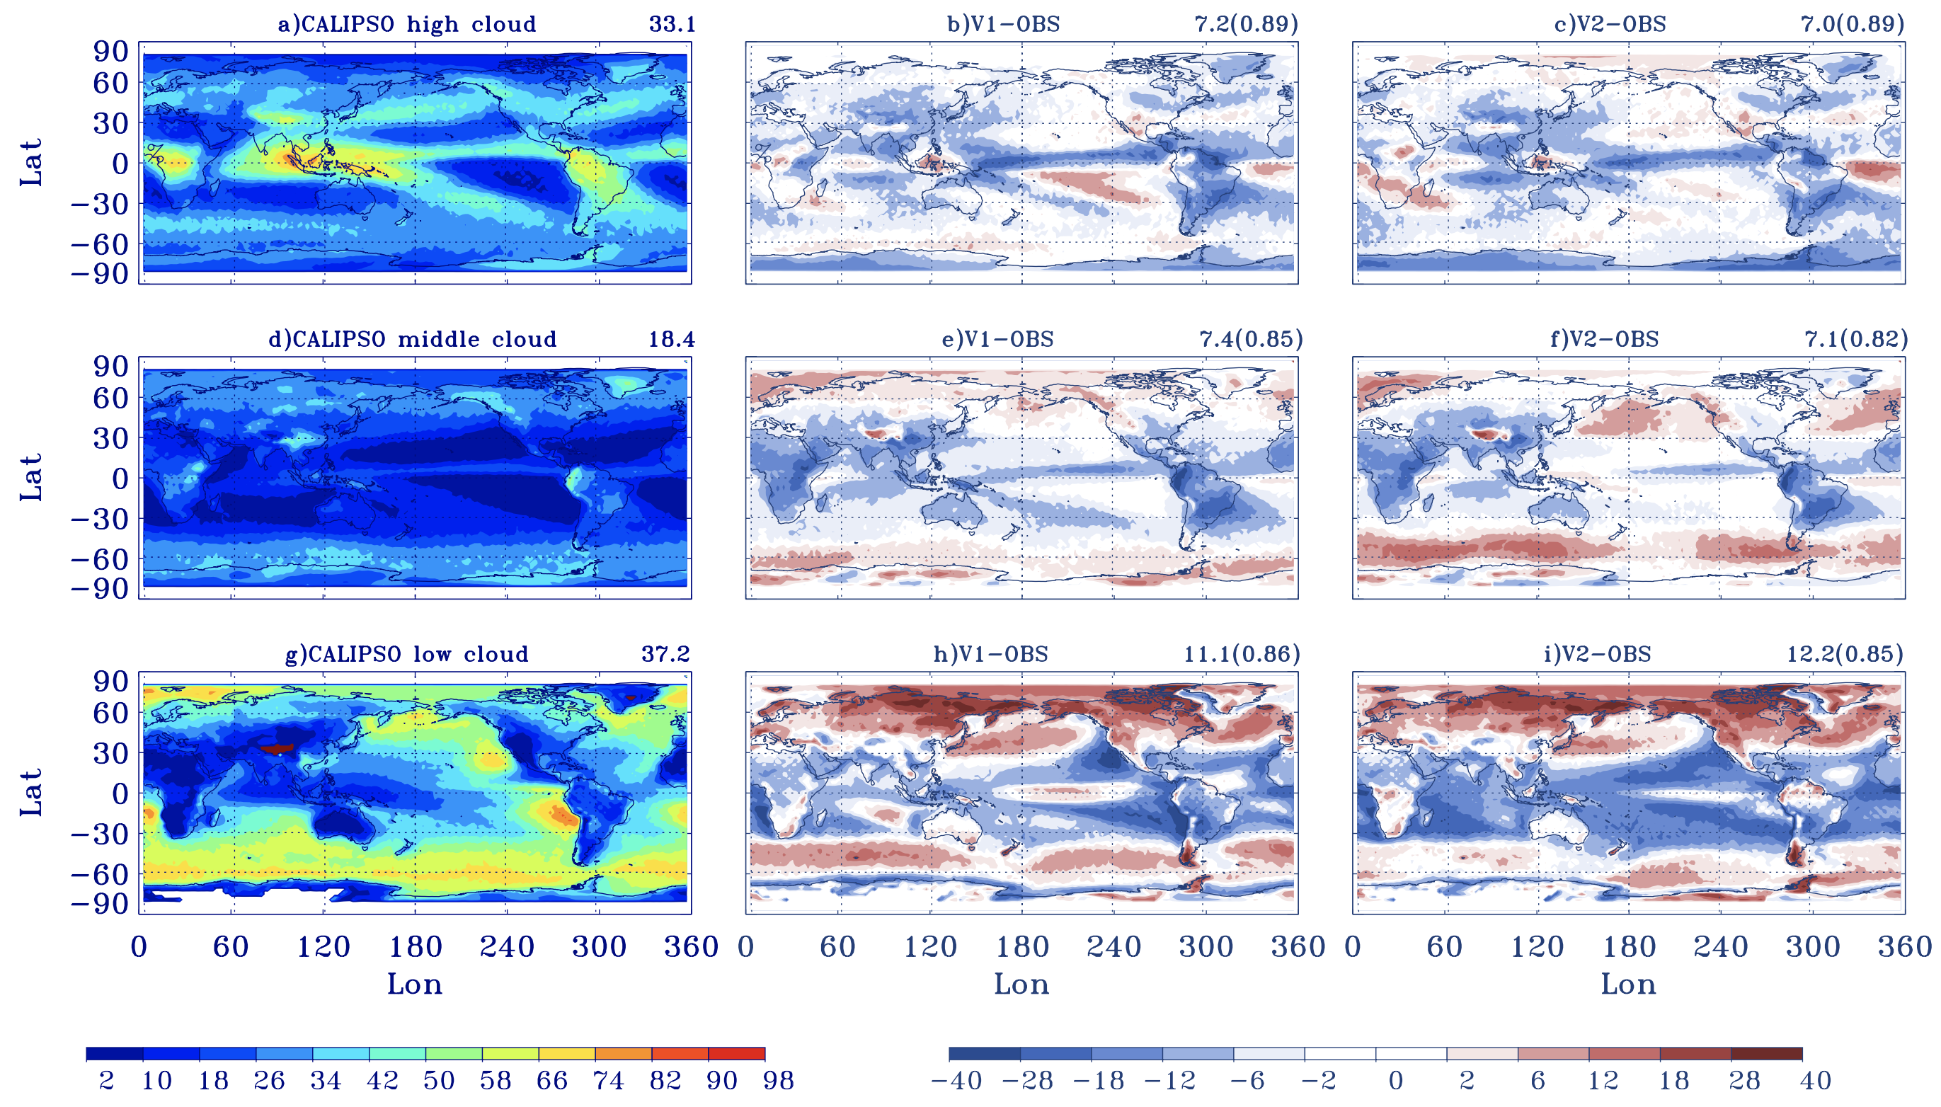
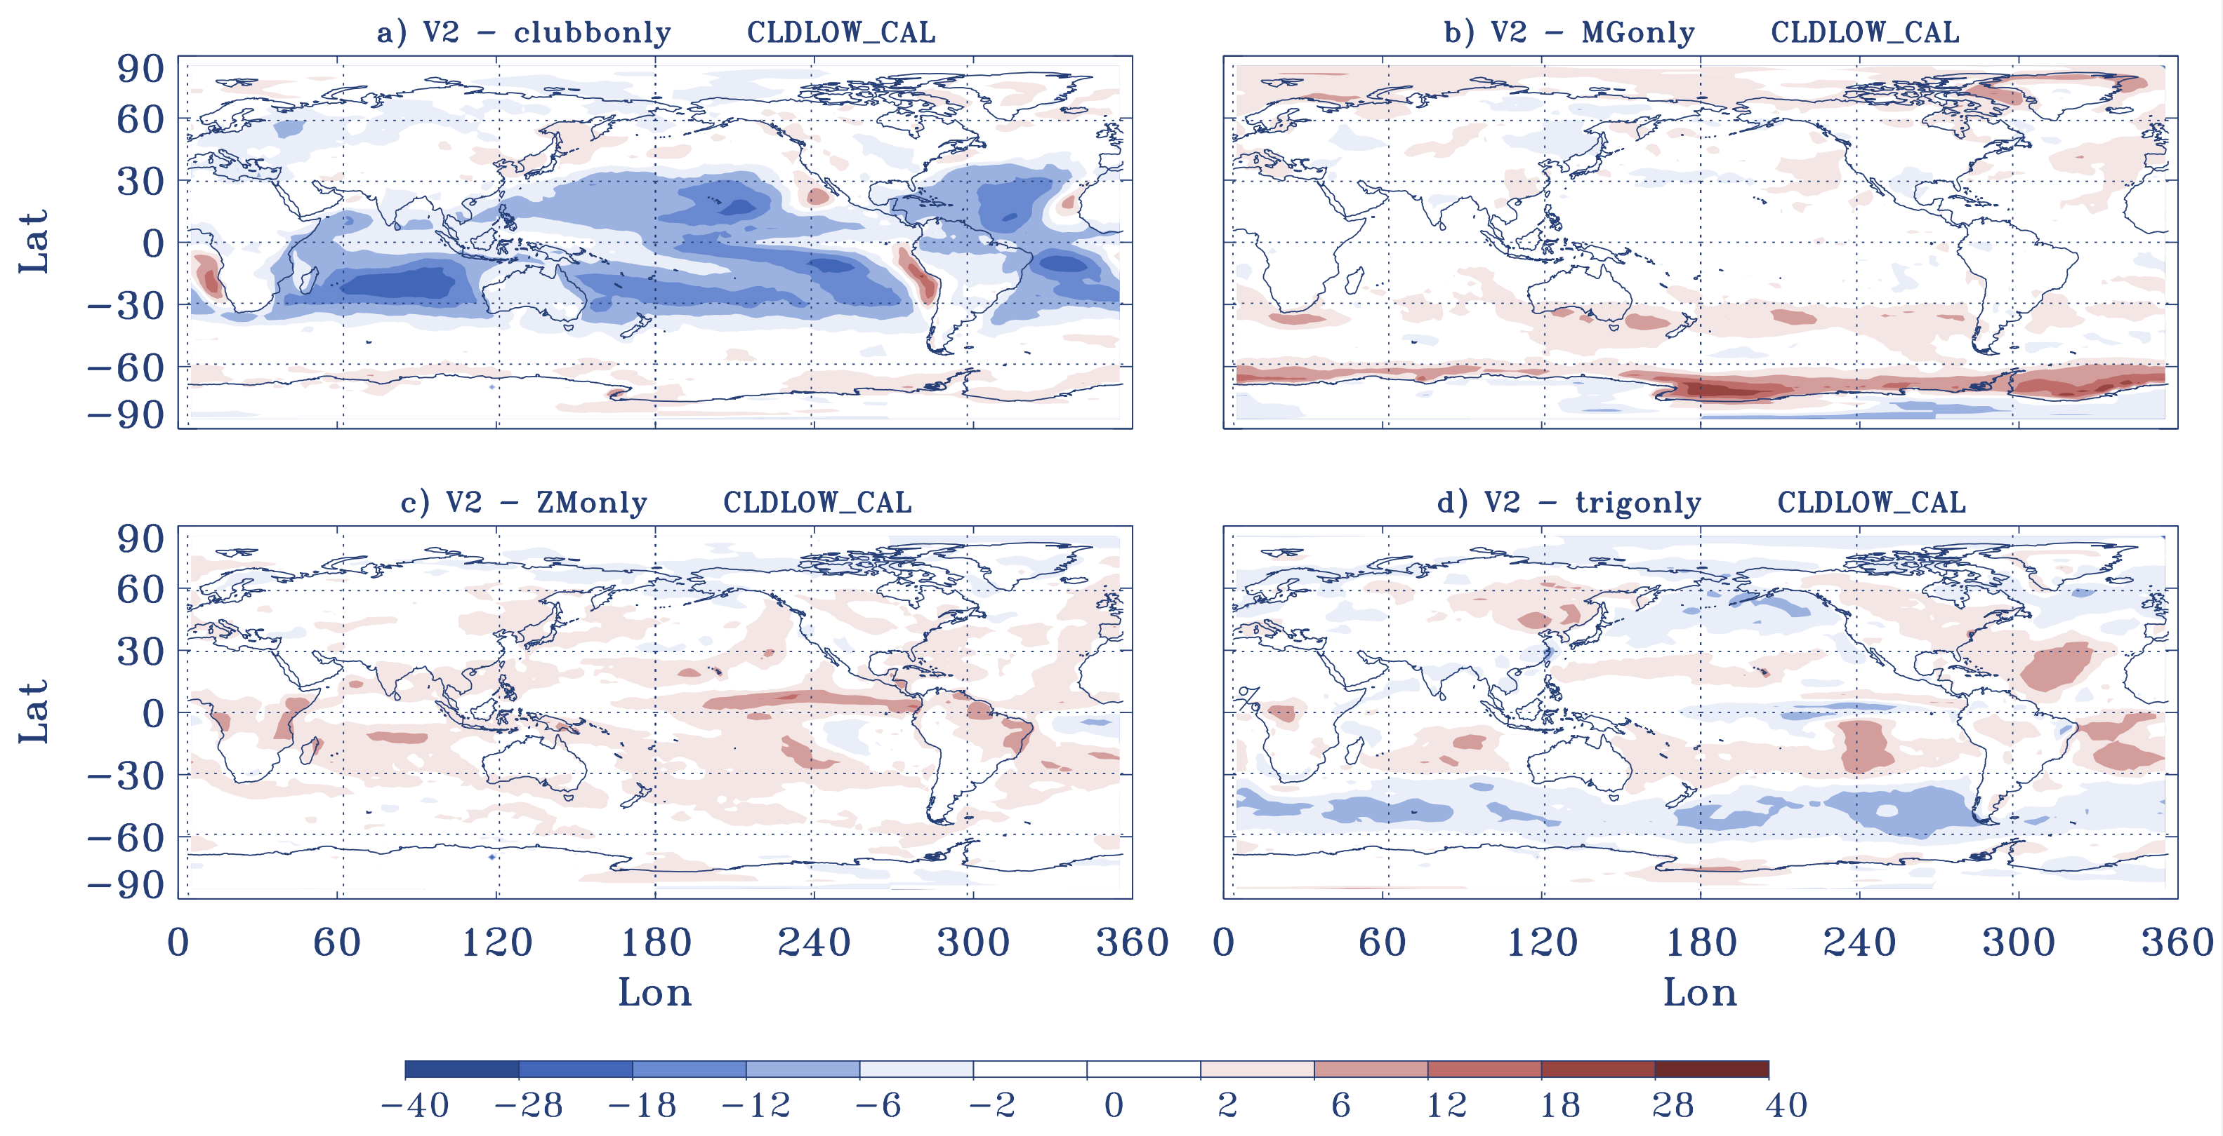
Understanding changes in cloud simulations from E3SM version 1 to version 2
Science Questions
What are the changes in cloud simulation from E3SM v1 to v2 and what causes the model behavior change in clouds relative to E3SMv1?
CALIPSO Low Cloud Fraction
Key Accomplishments
One robust improvement is the increase of stratocumulus clouds along the subtropical west coast of continents in both Hemispheres. Although, E3SMv2 shows a slightly larger negative bias in total low clouds than E3SMv1 in other regions in tropical and subtropical oceans.
The sensitivity tests indicate that the improved stratocumulus along the coast is primarily from the re-tuning of parameters related to CLUBB. However, the CLUBB tuning also underpredicted cloud in other regions in tropical and subtropical oceans
The tuning made in MG2 and ZM as well as the use of the new trigger all help offset the reduction of clouds made by the CLUBB tuning over the tropical and midlatitude regions.
Provide more insights on future model development
Zhang, Y., Xie, S., Qin, Y., Lin, W., Golaz, J.C., Zheng X., Ma, P.L., Qian, Y., Tang, Q., Terai, C.R., and Zhang, M. (2024): Understanding changes in cloud simulations from E3SM version 1 to version 2. Geosci. Model Dev., 17, https://doi.org/10.5194/gmd-17-1-2024.
The CLUBB tuning plays the largest role in the E3SMv2 low cloud changes

