Slide 1
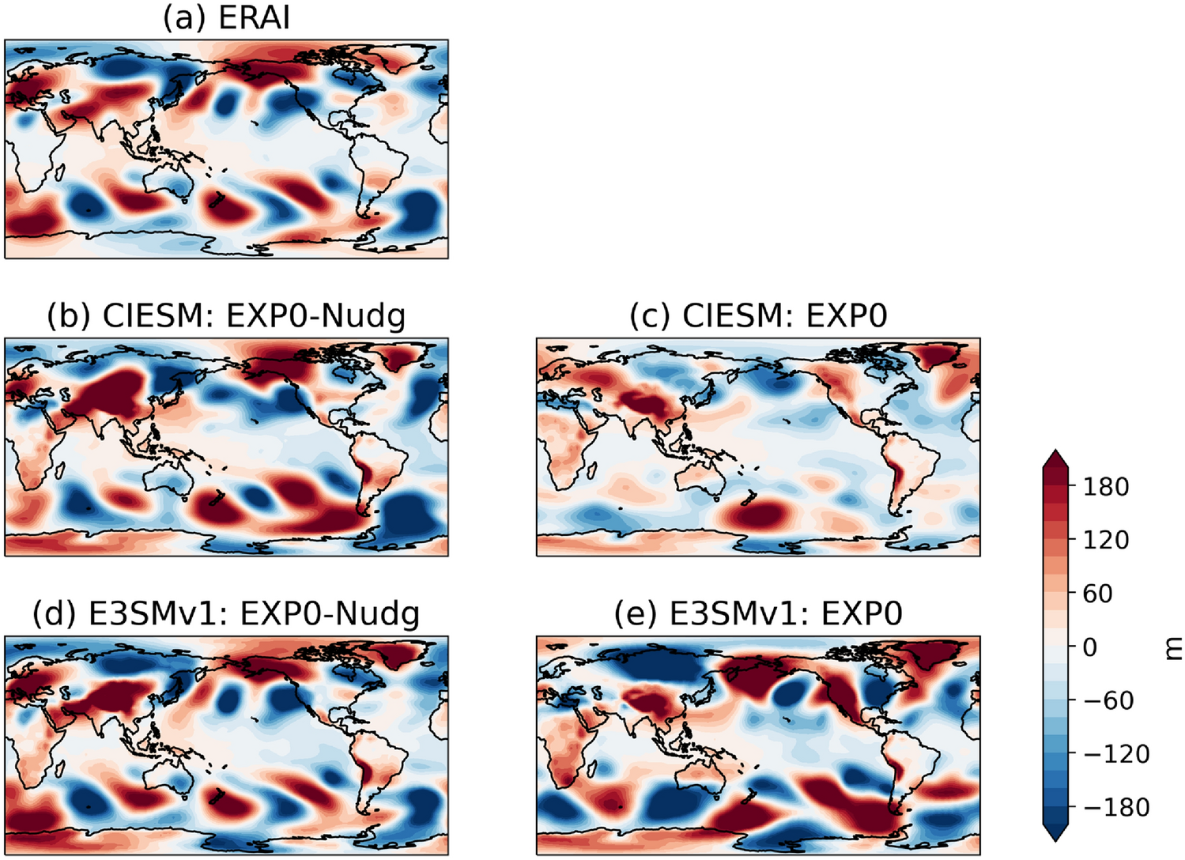
Significance of Improved Initialization in Climate Models for Subseasonal-to-Seasonal Precipitation Prediction
Science Questions
How does nudging contribute to climate models' ability to generate initial conditions closely aligned with observations, and why is this alignment crucial for meaningful subseasonal-to-seasonal (S2S) applications?
More realistic wave patterns after applying nudging approach, critical for S2S prediction
Key Accomplishments
Nudging towards reanalysis winds emerges as a pivotal factor enabling climate models to generate realistic initial conditions.
Simulations with nudged initial conditions significantly improve climate models' capability to capture global summertime precipitation responses to springtime Tibetan Plateau land surface temperature/subsurface temperature anomalies.
The enhanced S2S prediction skill is largely attributable to the substantially improved initialization of the Tibetan Plateau-Rocky Mountain Circumglobal (TRC) wave train pattern in the atmosphere.
Highlight the importance of initial conditions on S2S prediction
Non-zonal geopotential height (m) at 200 hPa from (a) ERAI reanalysis, (b) CIESM with nudging, (c) CIESM without nudging, (d) E3SMv1 with nudging and (e) E3SMv1 without nudging on April 30th, 2003
Qin, Y., Tang, Q., Xue, Y. et al. Improved subseasonal-to-seasonal precipitation prediction of climate models with nudging approach for better initialization of Tibetan Plateau-Rocky Mountain Circumglobal wave train and land surface conditions. Clim Dyn (2024). https://doi.org/10.1007/s00382-023-07082-1

