Slide 1
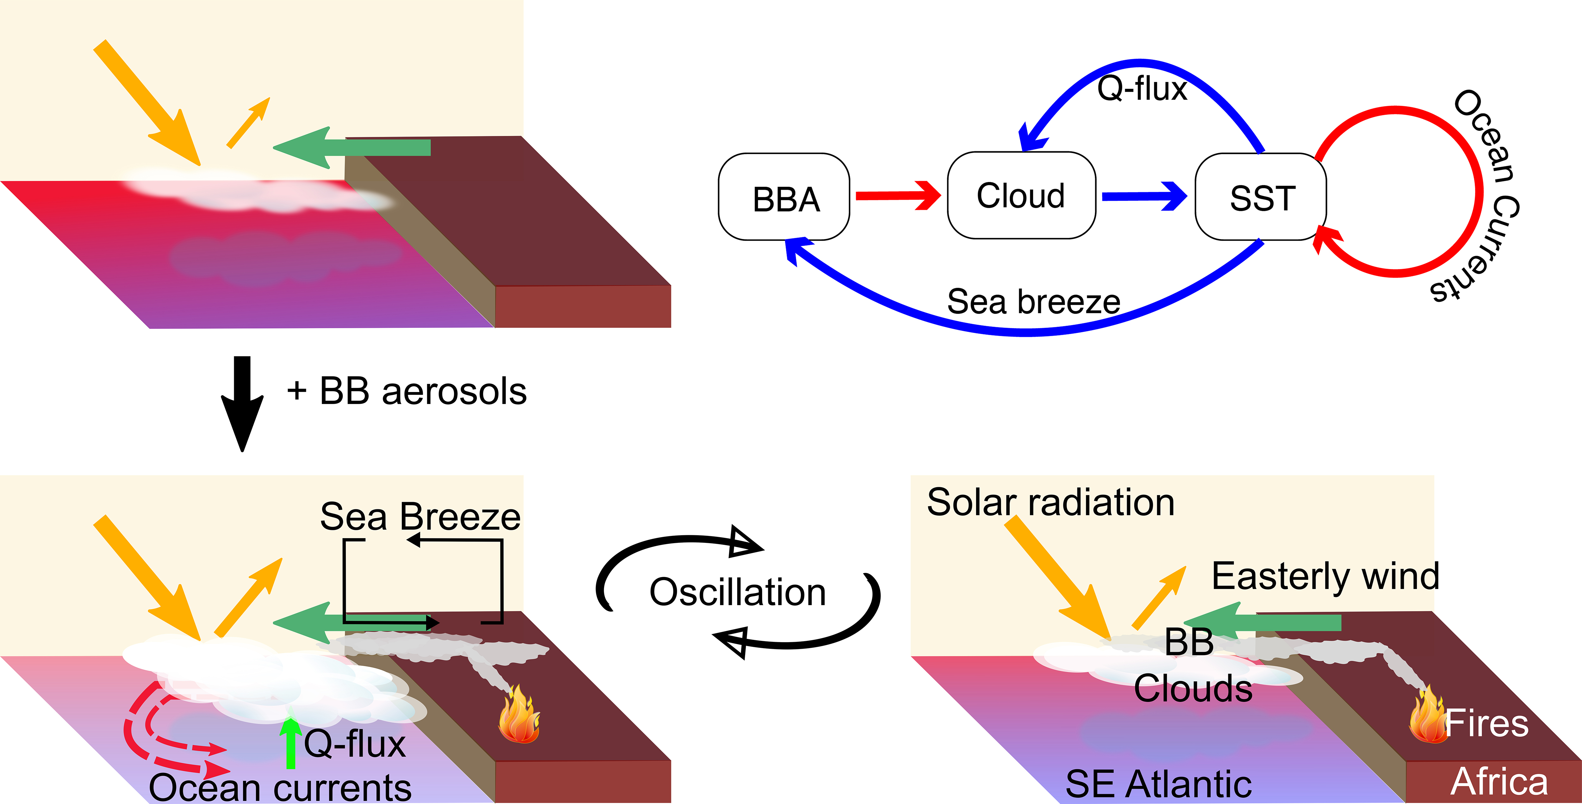
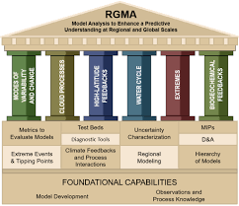
Can biomass burning aerosol induced surface cooling be amplified through sea surface temperature-cloud feedback over the Southeast Atlantic?
Scientific Background and Findings The stratocumulus cloud deck over southeast Atlantic (SEA) is often under the influence of biomass burning (BB) aerosols released from fires over Southern Africa. BB aerosols exert a strong surface cooling effect over the SEA via aerosol-radiation and aerosol-cloud interactions. The scientific question we addressed in this study: can the cooling effect induced by the BB aerosol be amplified through sea surface temperature (SST)-cloud feedback? Counterintuitively our model results show that the cloud radiative effect caused by BB aerosols is weaker if SST-low cloud feedback is considered compared to the fixed-SST simulation. As shown in the Figure, this is caused by 1) stronger sea breeze due to larger sea-land temperature contrast causing less smoke transport over SEA and 2) less moisture supply (Q-flux) from surface due to colder SST. Changes in SST also lead to counterclockwise rotation of ocean circulation anomalies, which reverses the direction of SST-cloud feedback in this region.
Research Details
In this study, we conduct both full-coupled and atmosphere-only simulations with and without BB aerosol emissions over the southern Africa using NCAR Community Earth System Model version 2 (CESM2) model. By contrasting BB aerosol-induced changes in clouds, radiation budgets, and ocean thermodynamic conditions between fully-coupled and atmosphere-only simulations, we elucidated the role of SST-cloud feedback in the BB aerosol induced changes as illustrated in the Figure.
Figure. Schematic plot of our scientific findings. The figure in the upper panel depicts a situation with no BB aerosols, while the two figures in the lower panel represent the oscillation between two atmosphere and ocean states when considering BB aerosols. The diagram summarizes the main findings of this study. The red arrows indicate increases in the fields, while the blue arrows indicate decreases in the fields.
Lu, Z., & Liu, X. (2023). Can biomass burning aerosol induced surface cooling be amplified through sea surface temperature-cloud feedback over the Southeast Atlantic? Geophysical Research Letters, 50, e2022GL101377. https://doi.org/10.1029/2022GL101377.

