Slide 1
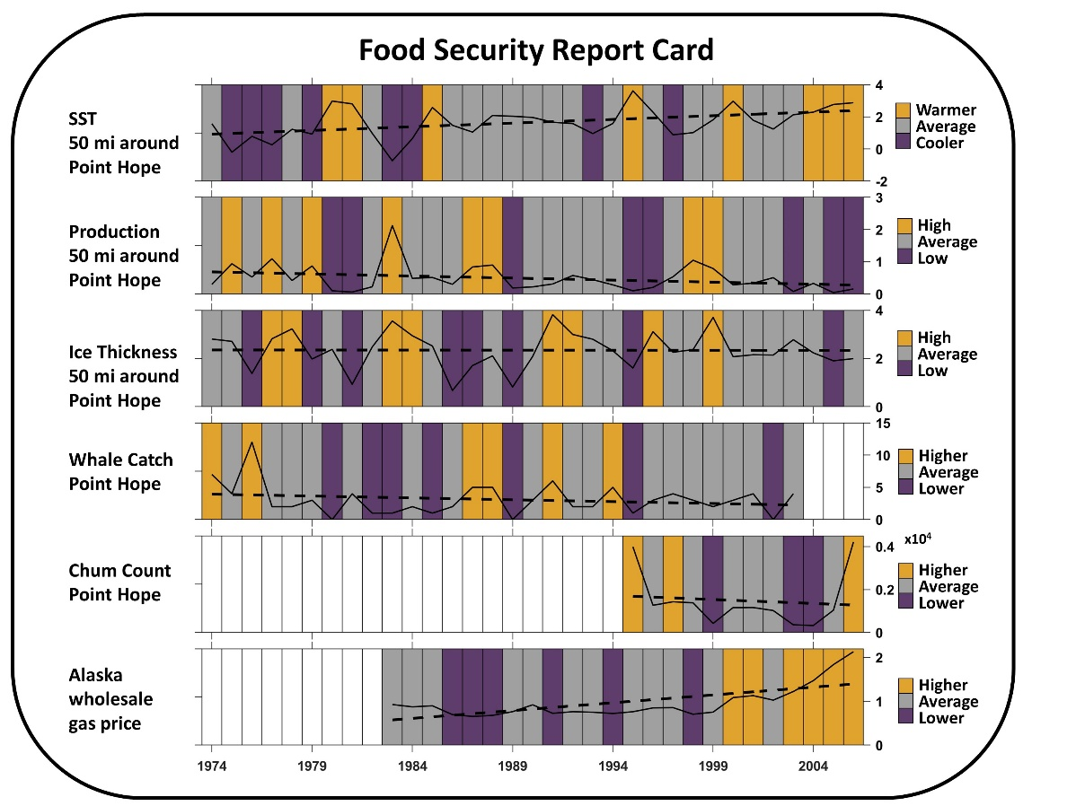
Can Earth System Models inform key dimensions of Arctic marine food security?
Scientific Challenge
Climate change is causing rapid and less predictable environmental shifts that impact three of the key aspects of food security (as defined by Inuit Circumpolar Council-AK): availability, stability, and accessibility.
Approach and Findings
We explored the potential of the Energy Exascale Earth System Model in projecting physical or ecosystem changes relevant to key dimensions of Alaska Indigenous Peoples' food security.
Our model-derived food security indicators illustrate how model output can provide estimates of a broad suite of variables relevant to food security, and how these model indices could be combined with relevant, non-model, information sources.
Significance and Impact
Communities monitor the health of food webs and the environment as part of subsistence harvest practices but anticipating major transformations is challenging and insights from model predictions may prove useful.
Example report card combining simulated ecosystem metrics with other factors of food security for a fuller picture of the food security environment.
Our model products are intended as a starting point for engaging community members in an iterative discussion, and to present, in an accessible way, the model's potential utility to rights holders and stakeholders.
Gibson GA, Eicken H, Huntington HP, Deal CJ, Lee O, Smith KM, Jeffery N and Sam J-M (2024) How Earth System Models Can Inform Key Dimensions of Marine Food Security in the Alaskan Arctic. Earth Sci. Syst. Soc. 3:10082. https://doi.org/10.3389/esss.2023.10082
Department of Energy • Office of Science • Biological and Environmental Research
Notes:
Word highlight text here.

