Slide 1
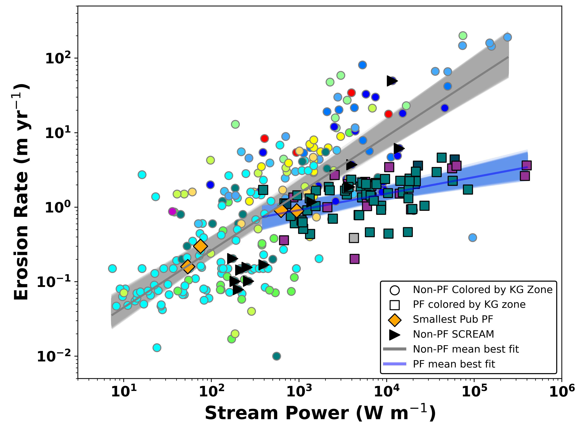
Scale-dependent influence of permafrost on riverbank erosion rates
Scientific Challenge
Whether the presence of permafrost has a strong influence on riverbank erosion rates as been an unsolved question for over 40 years.
Approach and Findings
We analyzed 1,000s of km of riverbank erosion rates across the Arctic and assembled a global database of published erosion rates. A comparison of these datasets show on average permafrost slows bank erosion rates by 9 times, but the difference can be as great as 40 times for very large rivers.
Figure
Significance and Impact
Our study shows the influence of permafrost on riverbank erosion. This erosion controls the timing and magnitude of the input of sediment and carbon to rivers from floodplains. Our work also suggests that erosion rates of large rivers may increase in response to climate change.
Reach-averaged erosion rates plotted by stream power. Circular points are data compiled from published studies and squares are permafrost rivers analyzed in this study. Rivers with permafrost have systematically lower rates.
Rowland, J. C., Schwenk, J. P., Shelef, E., Muss, J., Ahrens, D., Stauffer, S., et al. (2023). Scale-dependent influence of permafrost on riverbank erosion rates. Journal of Geophysical Research: Earth Surface, 128, e2023JF007101. https://doi.org/10.1029/2023JF007101
Department of Energy • Office of Science • Biological and Environmental Research
Notes:
Word highlight text here.

