Slide 1
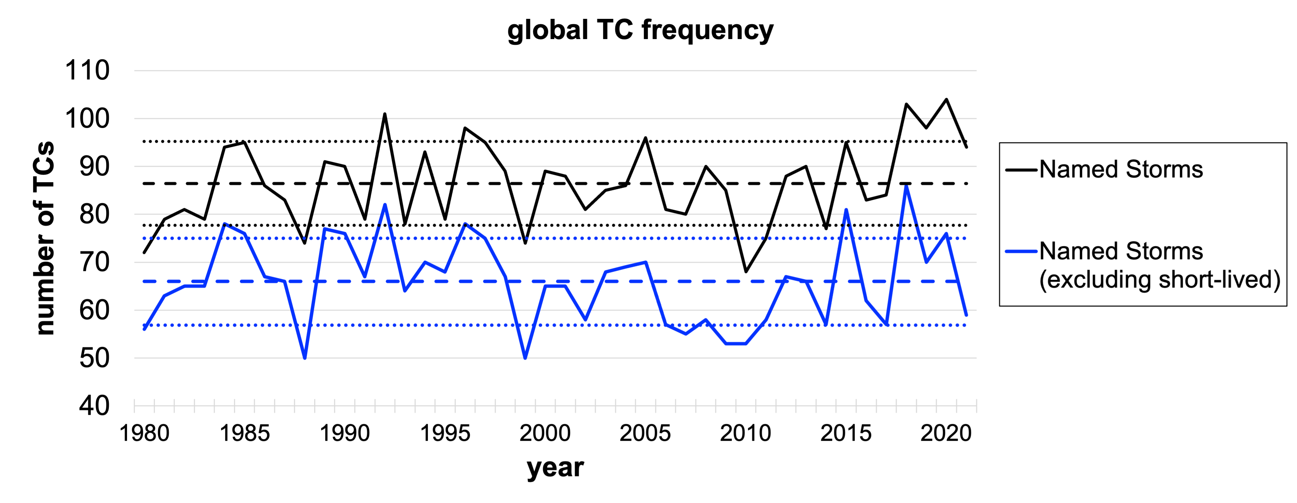
Global Tropical Cyclone Frequency
Objective
The risk of hazards associated with tropical cyclones (TCs) is correlated with TC frequency. However, the controls on global annual TC frequency are poorly understood. Furthermore, future change in TC frequency is highly uncertain. This paper reviews the state of the science regarding what is known about TC frequency.
Impact
This review paper highlights promising tools and research directions to better understand the controls on global tropical cyclone frequency, including high-resolution and idealized numerical models and study of tropical cyclone precursor disturbances or “seeds.”
(top) Observed annual TC genesis density and (bottom) observed global number of named storms.
Sobel, Adam H., Allison A. Wing, Suzana J. Camargo, Christina M. Patricola, Gabriel A. Vecchi, Chia-Ying Lee, and Michael K. Tippett. 2021. “Tropical Cyclone Frequency.” Earth’s Future, 9(12), e2021EF002275. https://doi.org/10.1029/2021EF002275

