Slide 1
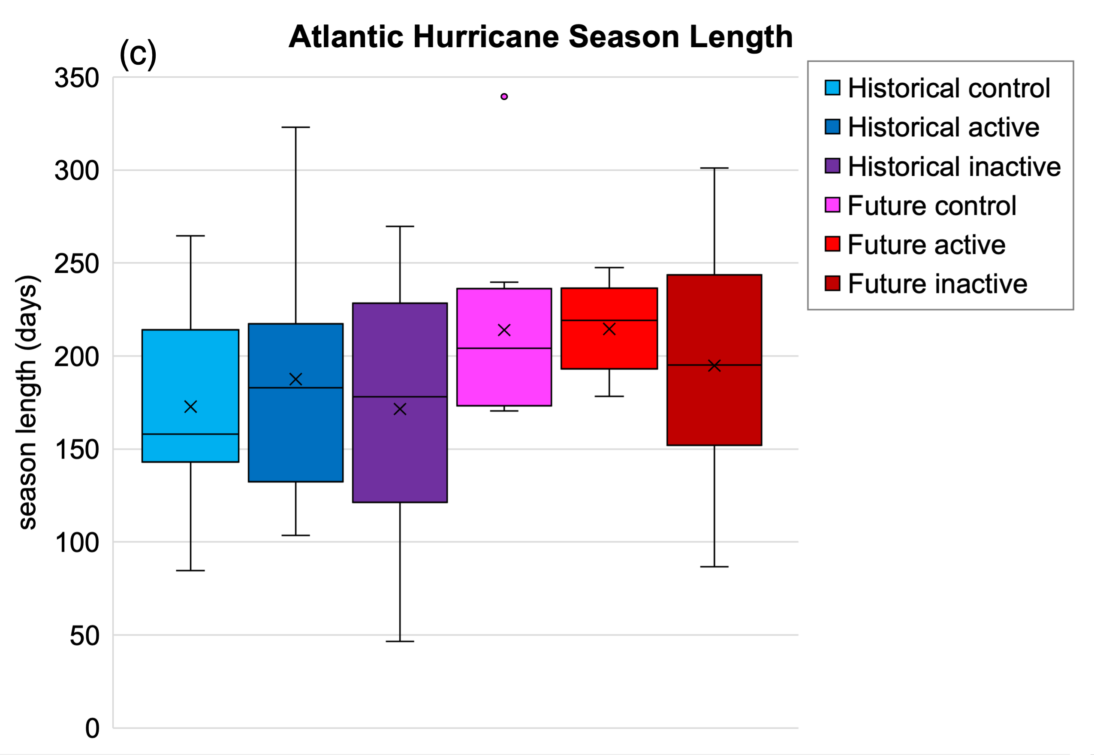

The Influence of Climate Variability and Future Climate Change on
Atlantic Hurricane Season Length
Objective
We investigated oceanic sources of predictability in Atlantic hurricane season length, start, and end using historical observations. In addition, we projected future changes in Atlantic hurricane season length using the Energy Exascale Earth System Model (E3SM).
Results
We found that a warm western subtropical Atlantic ocean in boreal spring drives early Atlantic hurricane season starts and La Niña events in autumn drive late hurricane season ends. In addition, E3SM projected an 27-41 increase in Atlantic hurricane season length in the future.
Impact
This research documents sources of predictability for Atlantic hurricane season length. In addition, E3SM simulations indicate that a future lengthening of the Atlantic hurricane season may exacerbate impacts associated with more intense tropical cyclones.
North Atlantic hurricane season length from the 10-member ensemble of E3SM experiments in historical and future climates representing conditions for active hurricane seasons (La Niña and positive Atlantic Meridional Mode; AMM), inactive seasons (El Niño and negative AMM), and the control (neutral El Niño – Southern Oscillation and AMM).
Patricola, Christina M., Grace E. Hansen, and Ana C. T. Sena 2024. “The Influence of Climate Variability and Future Climate Change on Atlantic Hurricane Season Length.” Geophysical Research Letters, 51(8), e2023GL107881. https://doi.org/10.1029/2023GL107881

