Slide 1
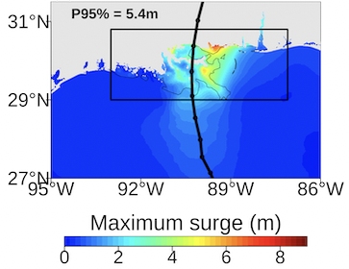
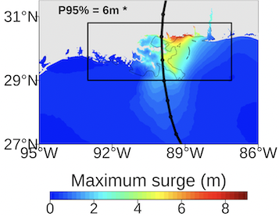
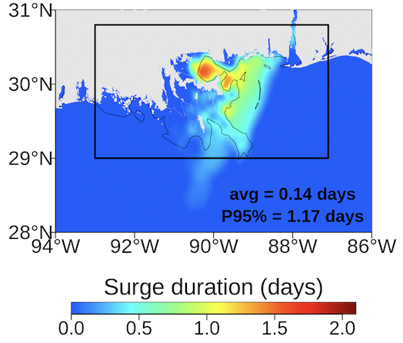
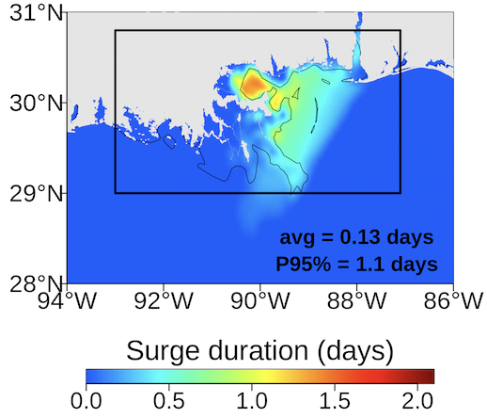
Future Projections of Storm Surge in Hurricane Katrina:
Sensitivity to Meteorological Forcing Resolution
historical
RCP85
Objective
Storm surge is a major hazard from landfalling tropical cyclones. We investigated whether and how the storm surge induced by Hurricane Katrina could change if a similar event occurred in a future warmer climate. In addition, we evaluated the sensitivity of the future storm surge projections to atmospheric forcing resolution.
Approach
Climate model simulations of Hurricane Katrina at 3 km, 4.5 km, and 27 km resolutions were used to drive storm surge simulations in historical and future climates using the ADvanced CIRCulation (ADCIRC) model.
Impact
We found that peak surge height is projected to increase significantly in the future, regardless of atmospheric forcing resolution. However, peak surge height is projected to increase by 22% more under 3 km resolution forcing compared to 27 km forcing. Surge duration is projected to decrease by 6 to 31%, depending on the forcing resolution.
historical
RCP85
Ensemble mean peak surge heights (top) and surge duration (bottom) from the historical (left) and future (right) storm surge simulations for Hurricane Katrina. The black lines represent the simulated TC track. Storm surge statistics are computed for the region denoted by the black box.
Danso, D. K., & Patricola, C. M. (2024). Future projections of storm surge in Hurricane Katrina and sensitivity to meteorological forcing resolution. Environmental Research Communications, https://doi.org/10.1088/2515-7620/ad7351

