Slide 1
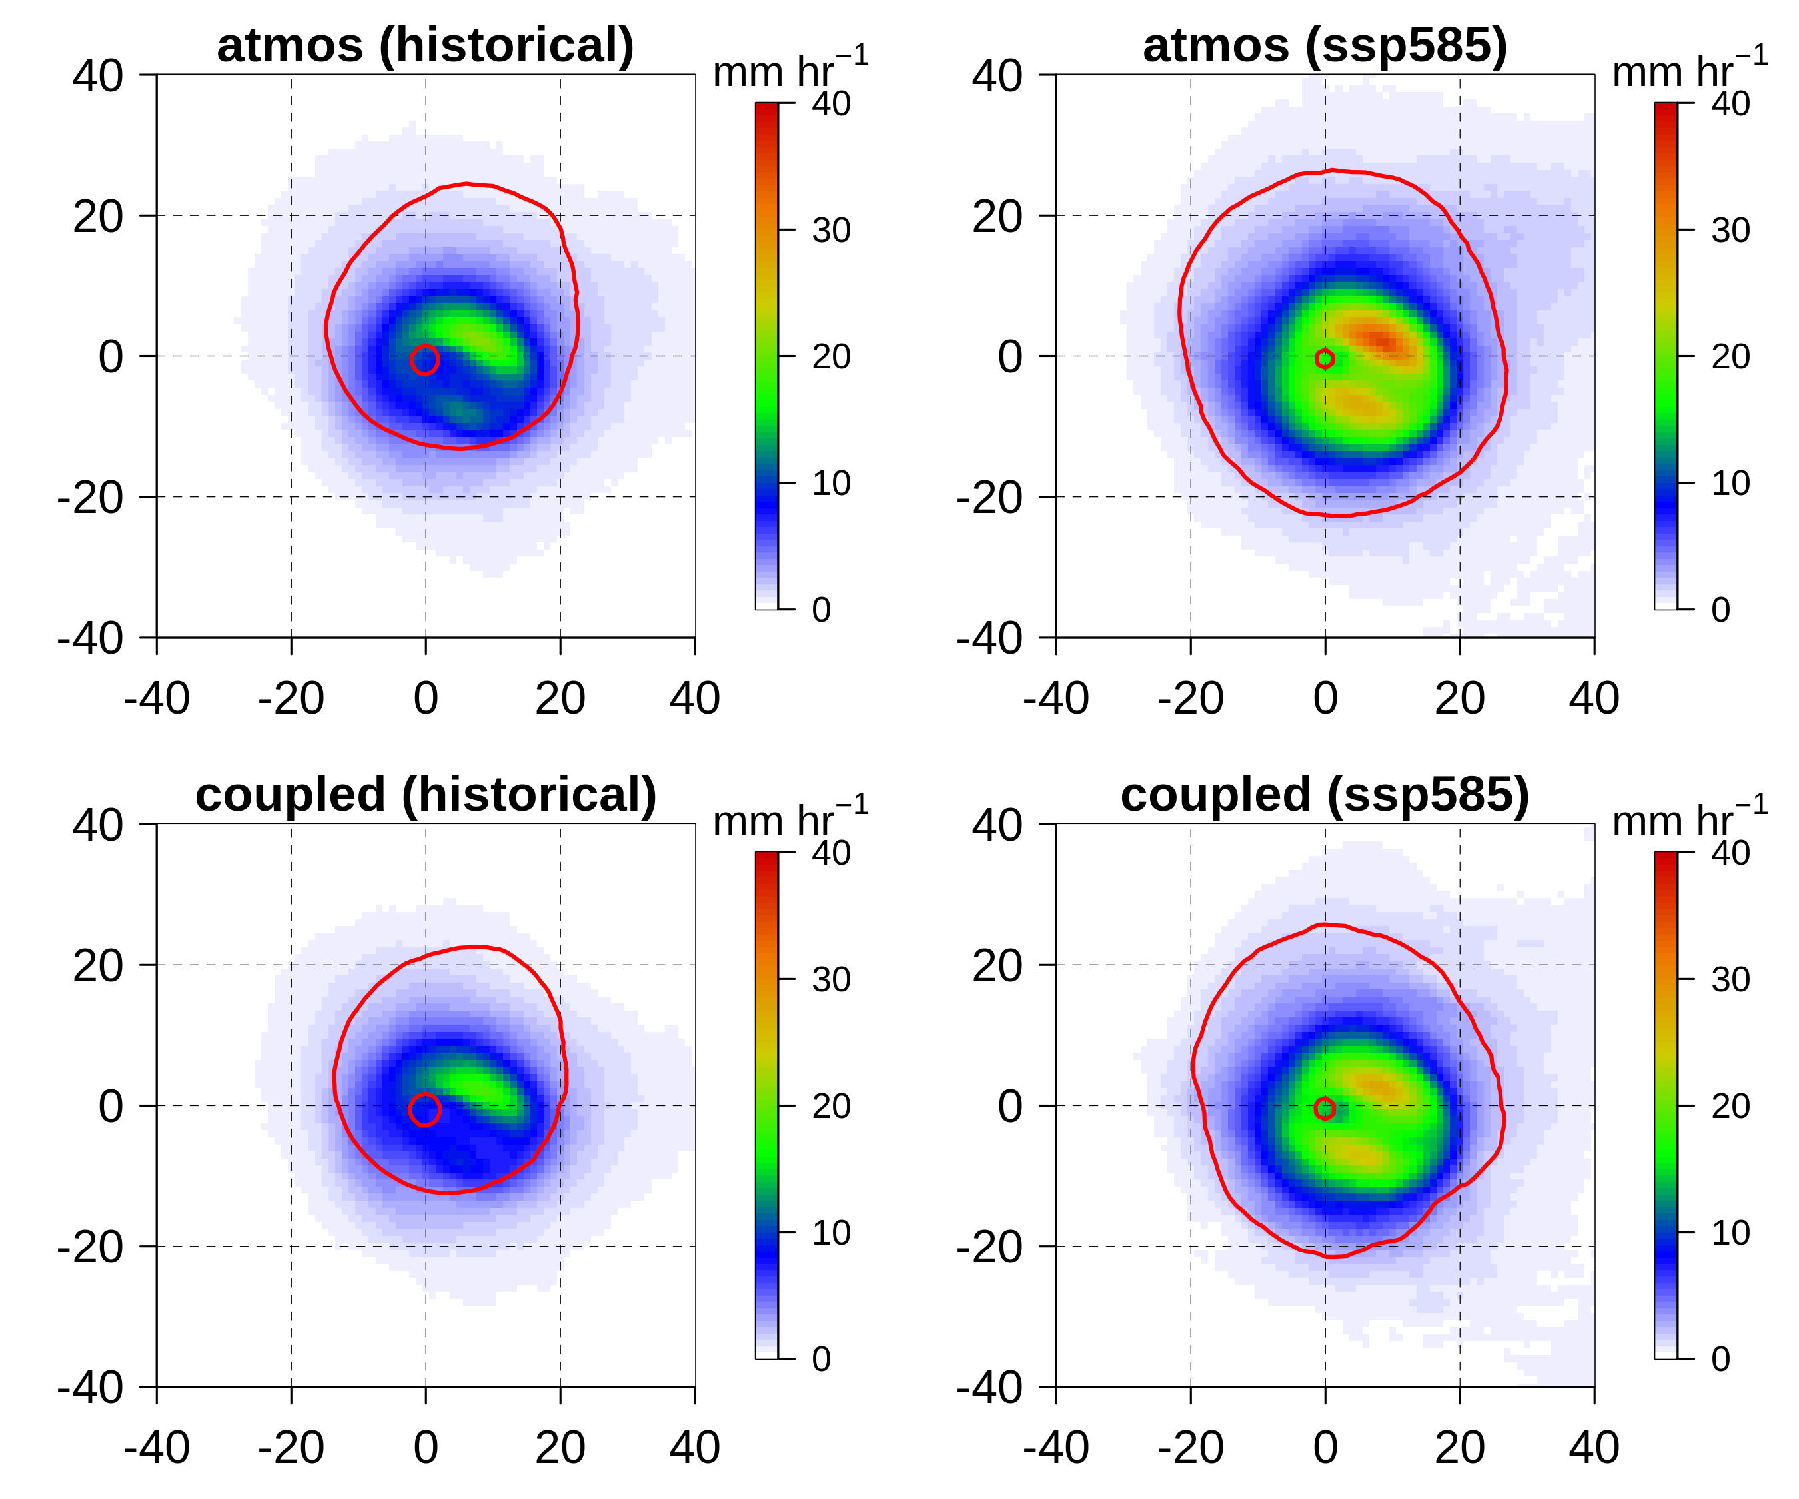

Air-sea coupling influence on projected changes in major Atlantic hurricane events
atmosphere-only
historical
atmosphere-only
future
Objective
Tropical cyclone (TC)-ocean coupling is necessary to represent the processes important for TC intensity. However, typical biases in global coupled models can cause substantial errors in simulated TC activity. We investigated how the treatment of the ocean (coupled or prescribed sea-surface temperatures) influences future projections of Atlantic TCs using regional model simulations.
Approach
We performed ensembles of atmosphere-only and atmosphere-ocean simulations of five historically-impactful Atlantic hurricane events in historical and future climates.
Impact
We found that regardless of the treatment of the ocean, TC intensity, precipitation, and size are projected to increase in the future. Projections of future TC precipitation increases are weaker in the coupled simulations than the atmosphere-only simulations by 3-59%.
atmosphere-ocean
historical
atmosphere-ocean
future
Ensemble mean precipitation (mm/hr) from Hurricane Irma composited within a 500km radius around the TC center over the TC lifetime. (top) atmosphere-only and (bottom) atmosphere-ocean simulations for the (left) historical and (right) future climates. The red contour denotes the 18 m/s 10-m wind speed.
Danso, D. K., Patricola, C. M., Kurian, J., Chang, P., Klotzbach, P., & Lin, I.-I. (2024). Air-sea coupling influence on projected changes in major Atlantic hurricane events. Weather and Climate Extremes, 43, 100649. https://doi.org/10.1016/j.wace.2024.100649

