Slide 1
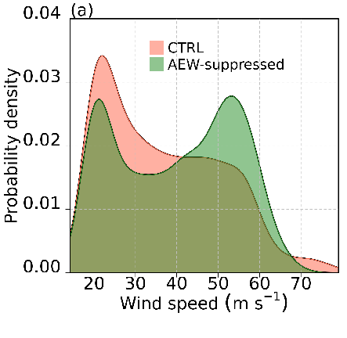
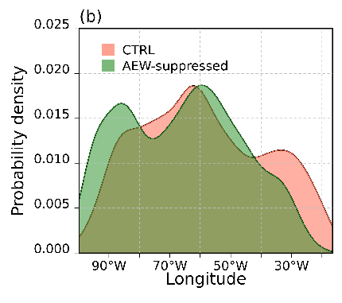

Influence of African Easterly Wave Suppression on Atlantic Tropical Cyclone Activity in a Convection-Permitting Model
Objective
The physical controls on tropical cyclone (TC) frequency remain poorly understood. We investigated the role of the typical Atlantic TC precursor (or “seed”), African easterly waves (AEWs), on seasonal Atlantic TC activity.
Approach
We performed 3-member ensembles of convection-permitting regional climate model simulations in which AEWs were prescribed or removed from the lateral boundary condition.
Impact
Suppressing AEWs produced no change in seasonal Atlantic TC frequency, however, TCs were stronger and generated further west. This research suggests that TC seeds are not a primary control on future TC frequency but can influence TC characteristics.
TC wind speed
TC genesis longitude
Probability density functions of the (a) maximum 6-hourly wind speeds (m/s) during the lifetimes of all TCs and (b) TC genesis longitudes in the ensemble of the control (orange) and AEW-suppressed (green) simulations.
Danso, Derrick K., Christina M. Patricola, and Emily Bercos-Hickey. 2022. “Influence of African Easterly Wave Suppression on Atlantic Tropical Cyclone Activity in a Convection-Permitting Model.” Geophysical Research Letters, e2022GL100590. https://doi.org/10.1029/2022GL100590.

